Slide 1
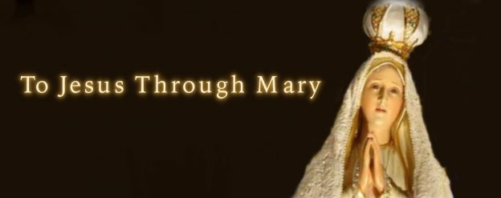
True Devotion to Mary

Slide 2

In Search of Mother Mary
Take a walk around the room and look at the various images of Mother Mary on display.
When one of the image struck you particularly, take a photo shoot of it.
Spent a moment and reflect on what in the image that attracted you. Ask yourself what aspect of the image speaks to you about your spiritual life (relationship with God).

Slide 3
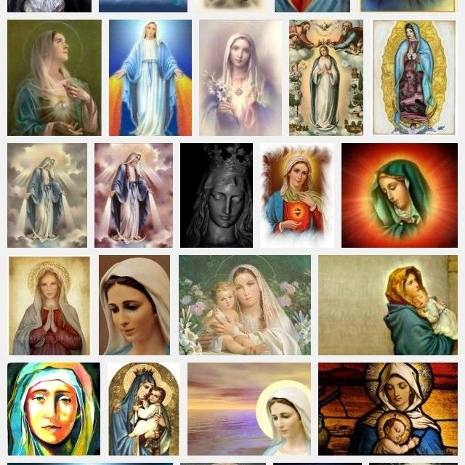
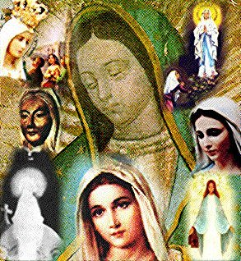
Images of Mary
Which image of Mary struck you particularly?
What in the particular image of Mary attracted you?

Slide 4
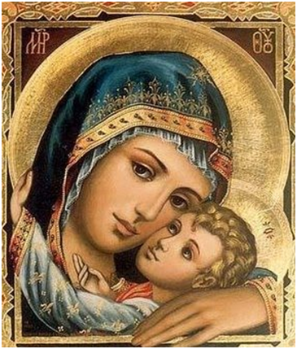

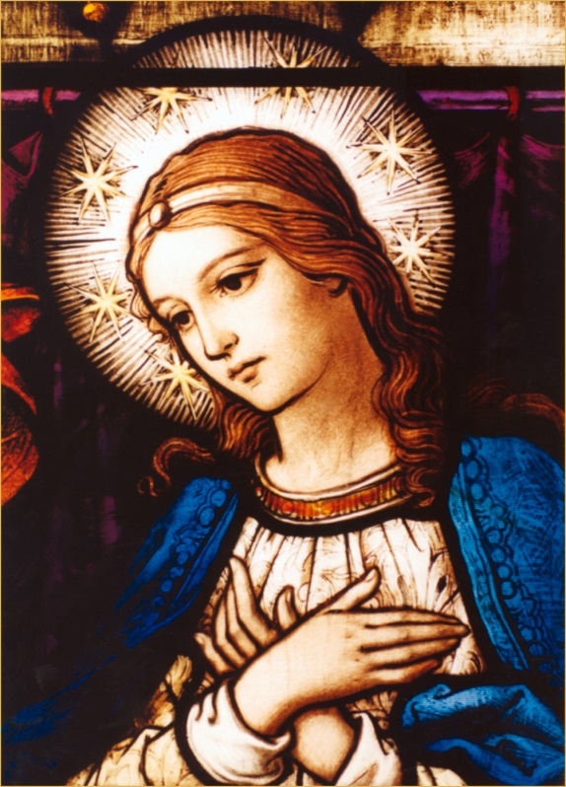
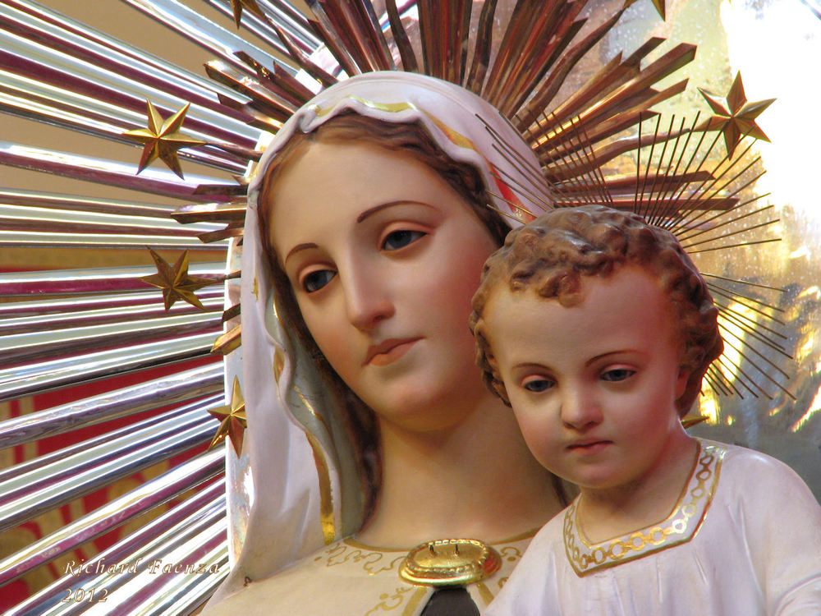
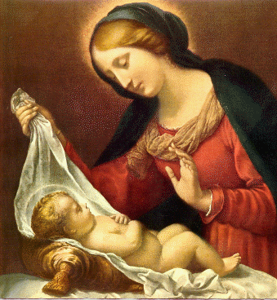
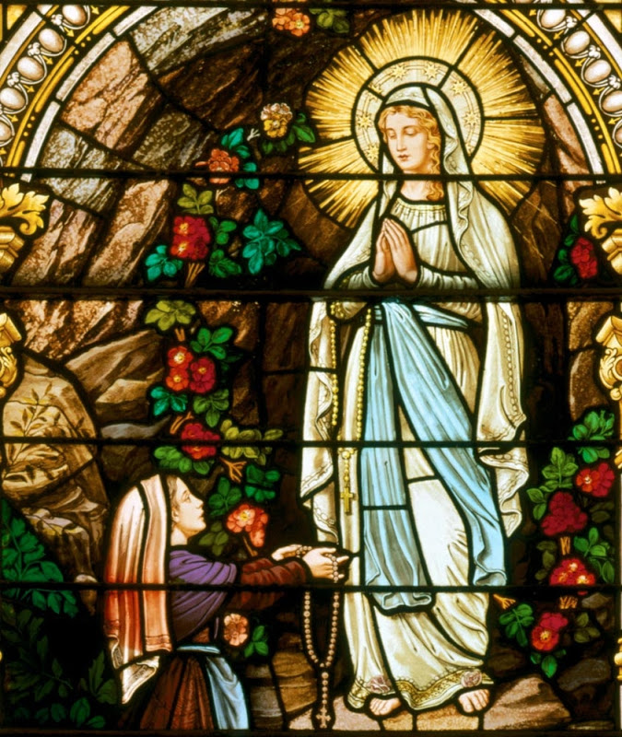
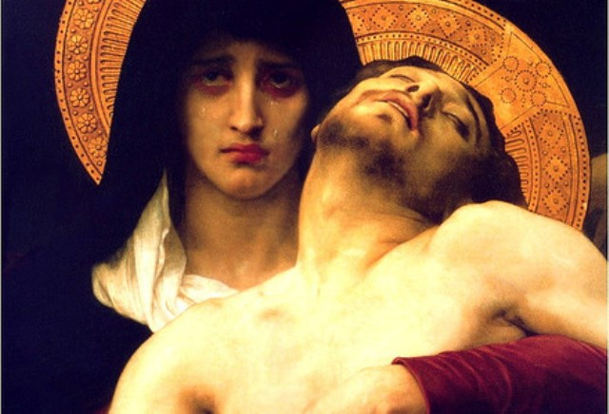

Slide 5
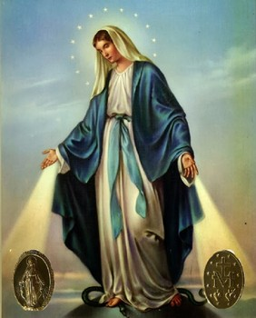
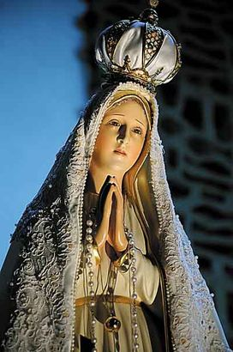

Slide 6
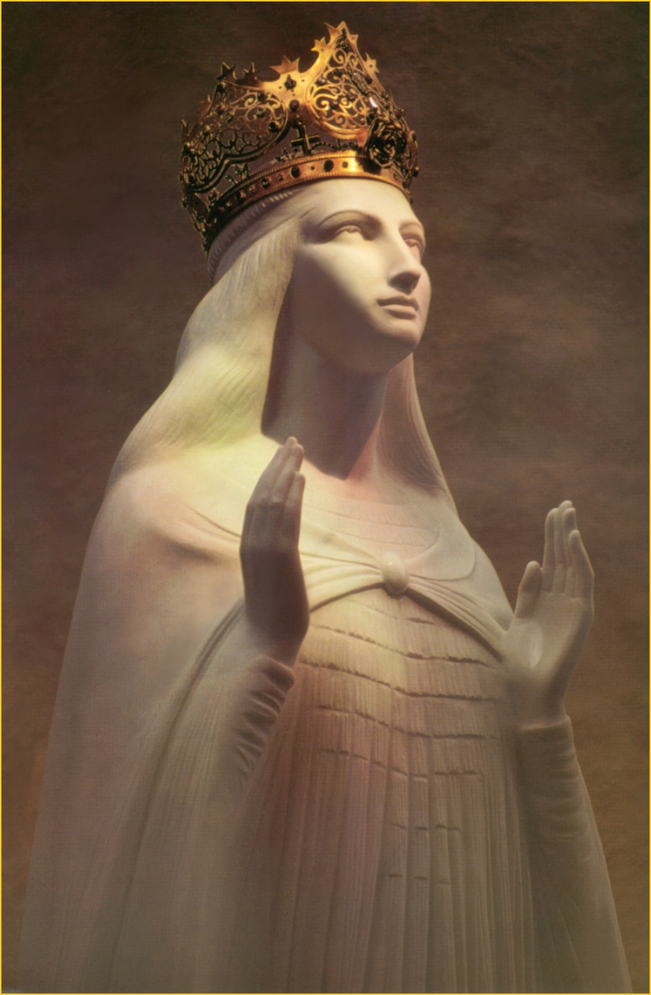
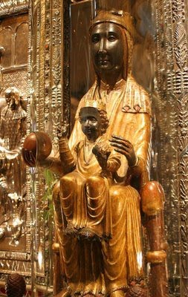

Slide 7
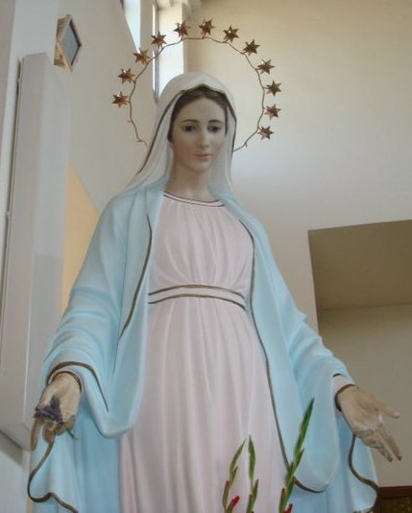
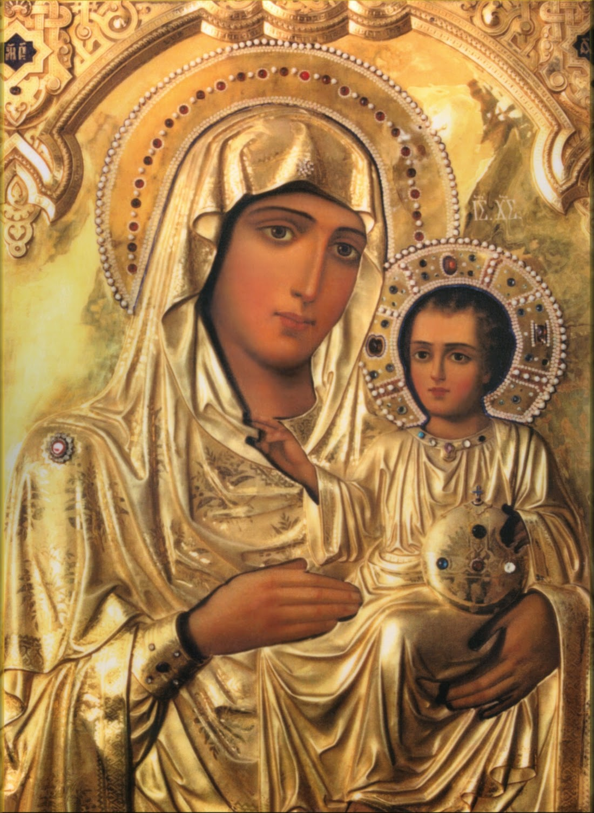

Slide 8
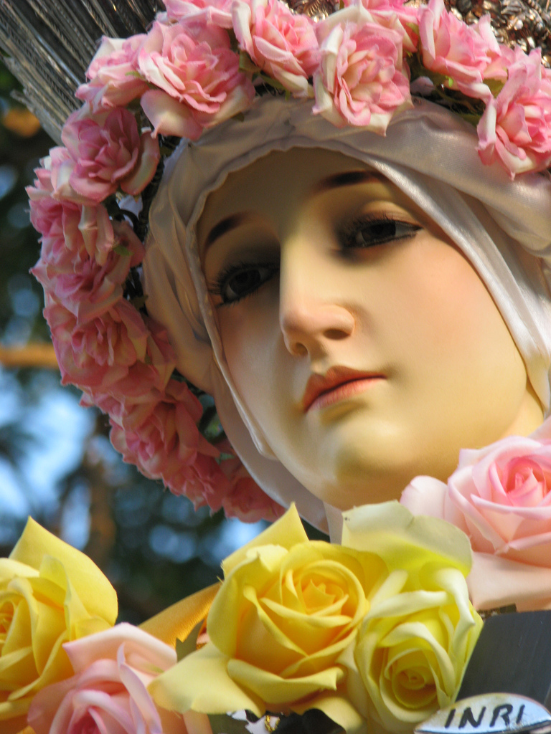
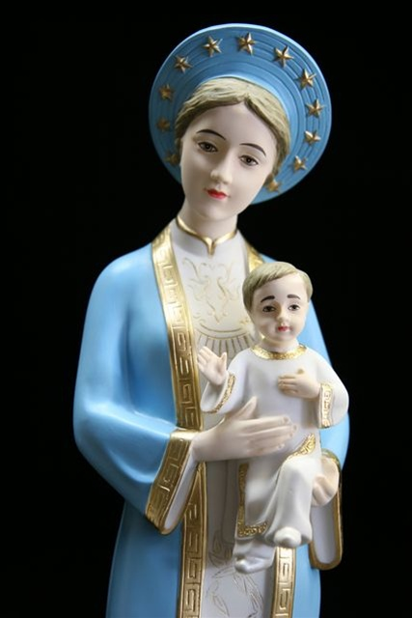

Slide 9



Slide 10
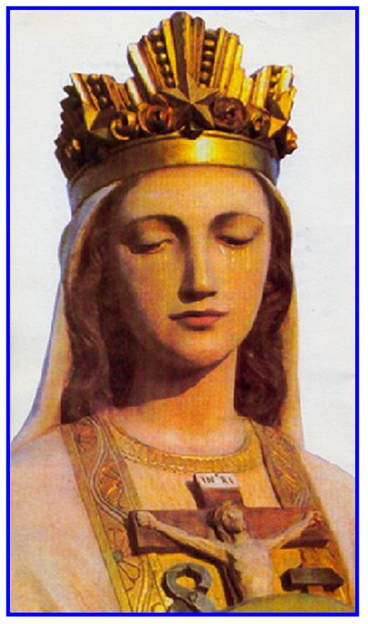
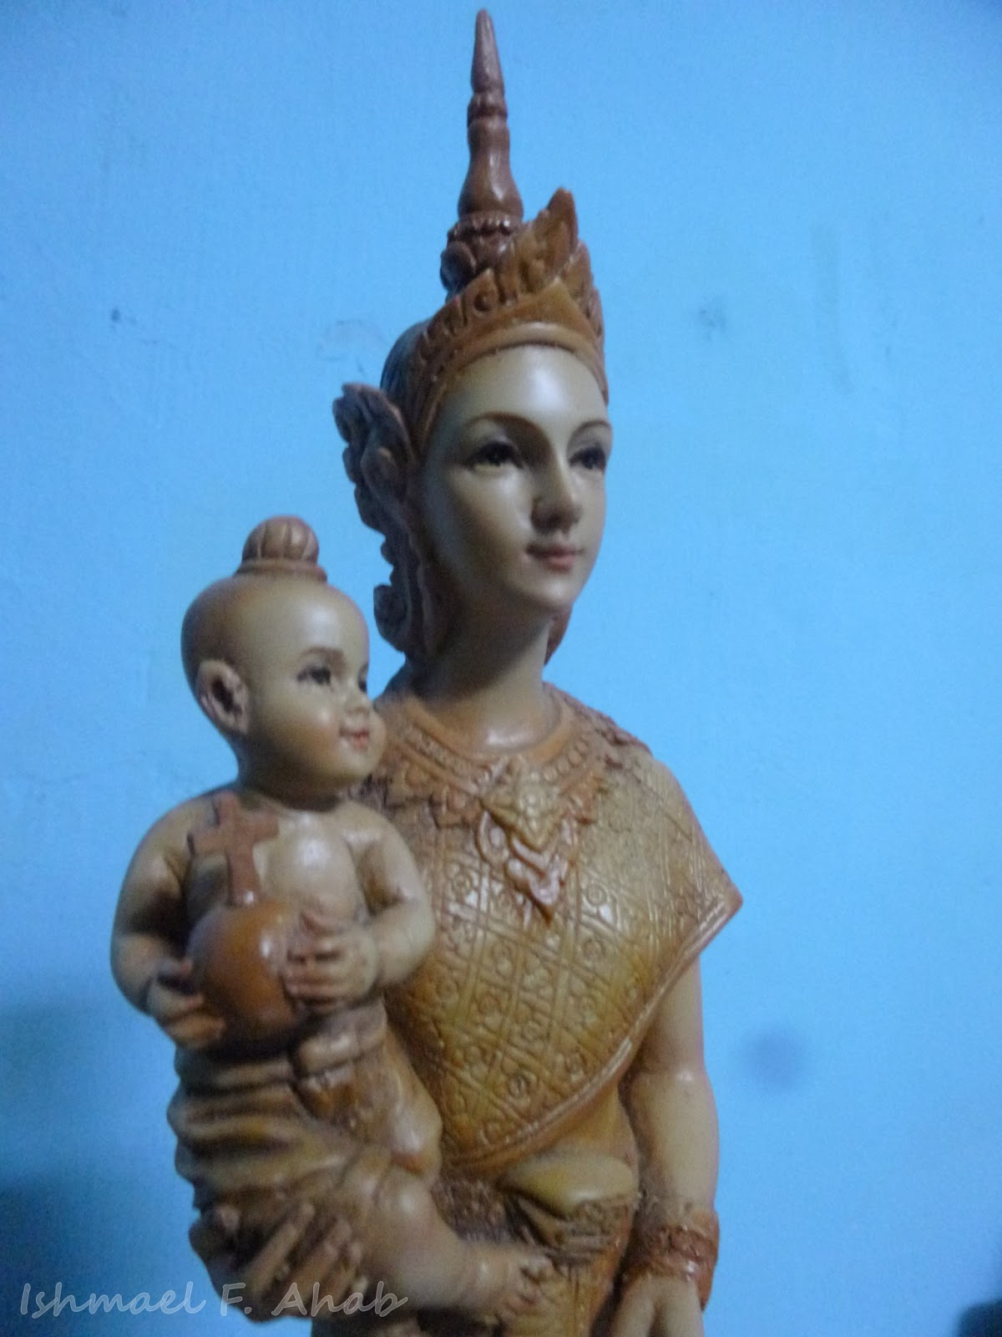

Slide 11
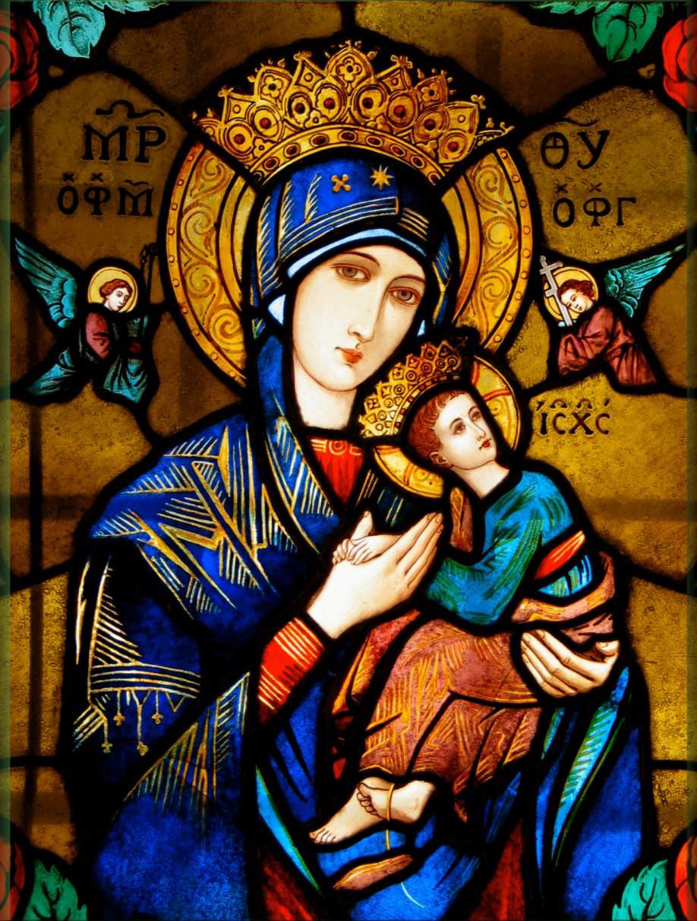
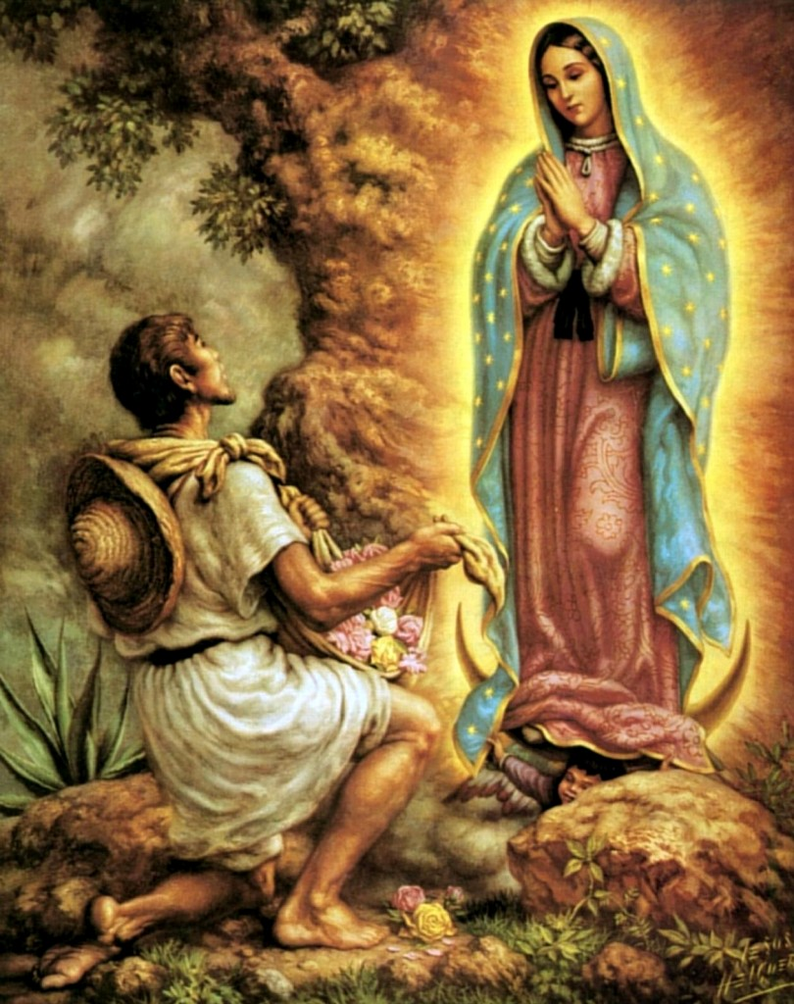

Slide 12
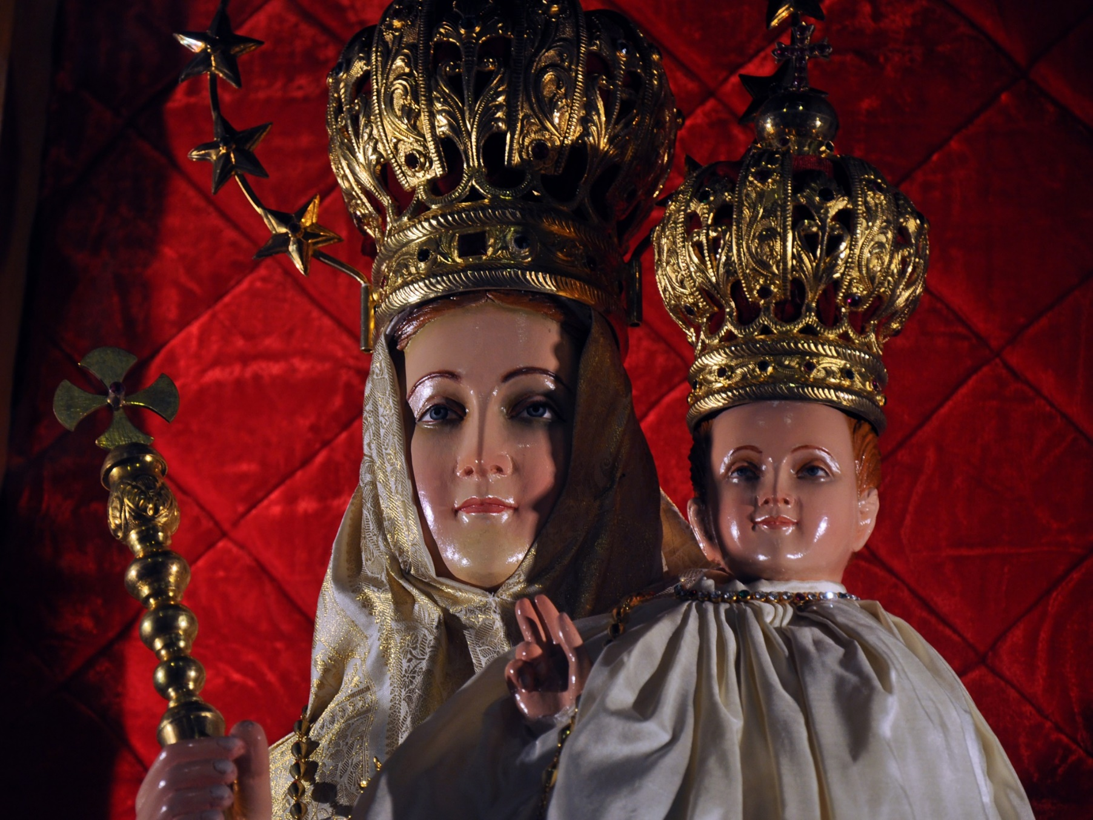

Slide 13
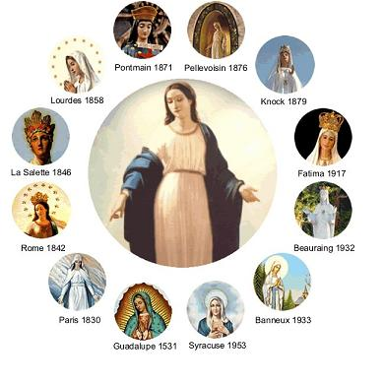
Some of the better-known Apparitions of Our Lady
Lourdes
Guadalupe
Fatima
Medjugore
La Sallete
Knock

Slide 14
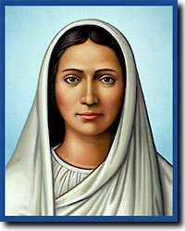
Image of a Woman
Woman of Faith
Woman of Prayer
Woman of the Spirit

Slide 15
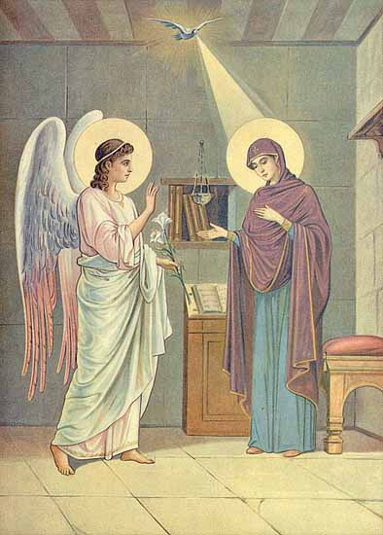
Woman of Faith
“Let is be done to me according to your word.” (Lk 1:38)
“Do as he tells you.” (Jn 2: 1-10)
“a sword will pierce your own soul too.” (Lk 2:35)

Slide 16
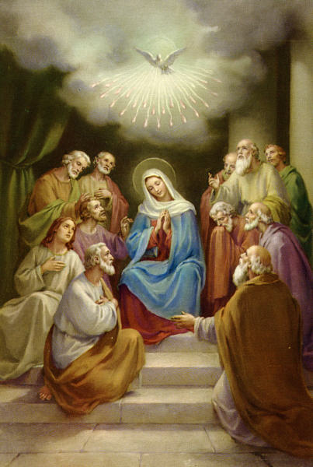
Woman of Prayer
Magnificat (Lk 1:46-55)
“who hears the word of God and put it into practice.” (Lk 8:21)
“His mother stored up all these things in her heart.” (Lk 2:52)
“All these joined in continuous prayer, together with several women, including Mary the mother of Jesus, and with his brothers.” (Acts 1:14)

Slide 17
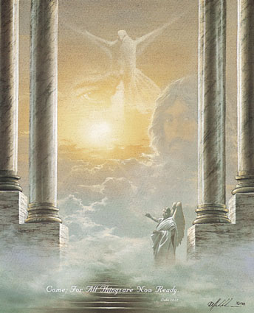
Woman of the Spirit
One who was most responsive to the life of the Spirit within her.
Mary was there at Pentecost (Acts 1:14)
“The Holy Spirit will come upon you.” (Lk 1:35)

Slide 18
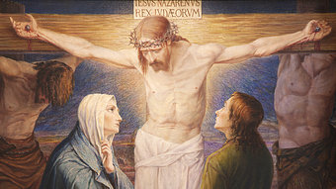
Christian Discipleship and Devotion to Mary
St Louis Marie maintains in LEW 214 that we cannot be truly children of God and disciples of wisdom, if we are not children of Mary
The Beloved disciple takes Mary into his own (Jn 19:27)

Slide 19
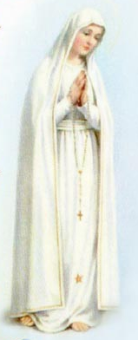
Treatise on the True Devotion to Mary
A Book written by St. Louis Marie de Montfort possibly around 1712.
It remained hidden during the French revolution and was discovered on 29th April 1842.
The best known work of Montfort.
Montfort’s aim was to show the role of Mary in the plan of God, in one’s life as a baptized person and in one’s apostolic life.

Slide 20

LOUIS DE MONTFORT INFLUENCED FOUR POPES
Pope Leo XIII (Promulgated Marian Devotion – In 10 Encyclicals on the Marian Vision and Rosary)
FEB 20, 1878 –
JULY 20. 1903

Slide 21
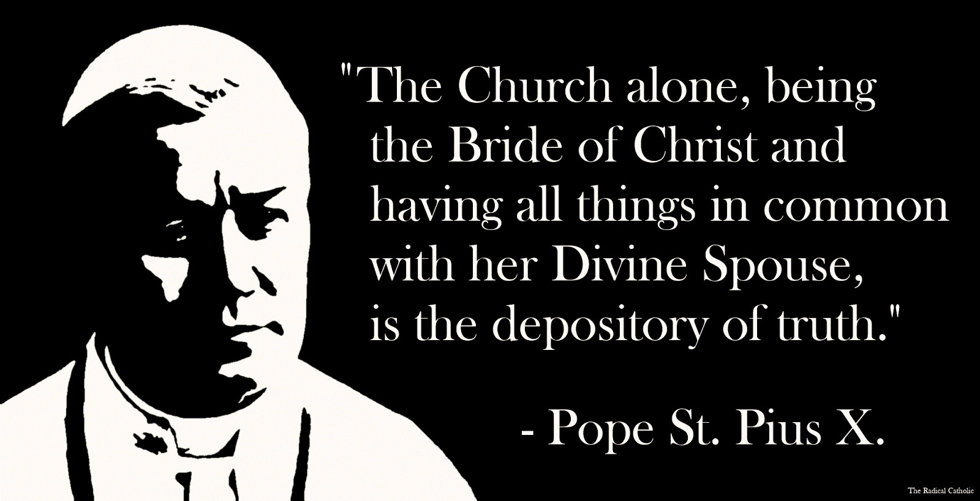
LOUIS DE MONTFORT INFLUENCED FOUR POPES
Pope Pius X ( 2nd Encyclical intensified True Devotion to Mary as view expressed by Montfort)
AUG 4. 1903 – AUG 20, 1914

Slide 22

LOUIS DE MONTFORT INFLUENCED FOUR POPES
Pope Pius XII – Often called as the Marian Pope he was impressed by Montfort’s work on God Alone.
MAR 2, 1939 – OCT 9, 1958

Slide 23
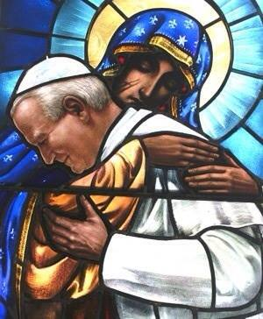

LOUIS DE MONTFORT INFLUENCED FOUR POPES
Pope John Paul II - The Pontiff’s personal motto “Totus Tuus” was inspired by St. Louis Marie doctrine on the excellence of Marian devotion and total consecration. Apostolic Letter Rosarium Virgine Mariae.

Slide 24

LOUIS DE MONTFORT INFLUENCED FOUR POPES
Pope John Paul II – “As a young seminarian read and reread many times and with great spiritual profit” the work of Louis Marie de Montfort.

Slide 25

LOUIS DE MONTFORT INFLUENCED FOUR POPES
The Pontiff also said Montfort’s work of True Devotion to Mary was a “decisive turning point” in his life

Slide 26
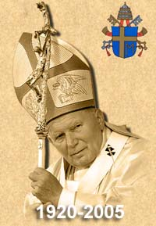
Totus Tuus. This phrase is not only an expression of piety, or simply an expression of devotion. It is more. During the Second World War, while I was employed as a factory worker, I came to be attracted to Marian devotion. At first, it had seemed to me that I should distance myself a bit from the Marian devotion of my childhood, in order to focus more on Christ. Thanks to Saint Louis of Montfort, I came to understand that true devotion to the Mother of God is actually Christocentric, indeed, it is very profoundly rooted in the Mystery of the Blessed Trinity, and the mysteries of the Incarnation and Redemption.
1978 - 2005

Slide 27
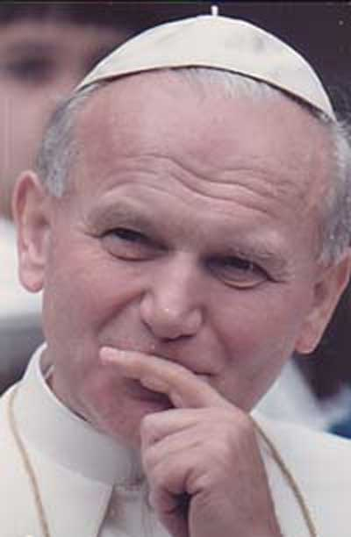
I myself, in the years of my youth, found reading this book a great help. “There I found the answers to my questions”, for at one point I had feared that if my devotion to Mary “became too great, it might end up compromising the supremacy of the worship owed to Christ” (Gift and Mystery). Under the wise guidance of St. Louis Marie, I realized that if one lives the mystery of Mary in Christ, this risk does not exist. In fact, this Saint's Mariological thought “is rooted in the mystery of the Trinity and in the truth of the Incarnation of the Word of God”.

Slide 28

“The reading of this book was a decisive turning-point in my life. I say "turning-point," but in fact it was a long inner journey... - This "perfect devotion" is indispensable to anyone who means to give himself without reserve to Christ and to the work of redemption.”
"It is from Montfort that I have taken my motto: "Totus tuus" ("I am all thine"). Someday I'll have to tell you Montfortians how I discovered De Montfort's Treatise on True Devotion to Mary, and how often I had to reread it to understand it.”

Slide 29
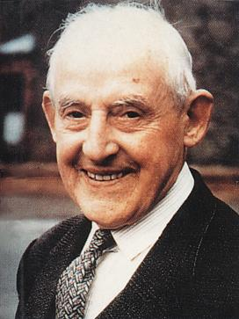
True Devotion and Frank Duff
In 1917, Frank Duff was first introduced to the True Devotion to Mary by a friend, but he was not impressed by it, thinking that it was a bit excessive.
It was only after several readings that Frank Duff came to realize the great value of this Devotion as proposed by St. Louis Marie de Montfort.

Slide 30

Frank Duff and True Devotion to Mary
Referring to his encounter with the book on True Devotion to Mary, Frank Duff said: “I still have recollections of that first reading. The book was laid aside… Then gradually it dawned on me that the book was an inspired production,… Ever since, the book has been a source of light to me so that I add myself to those, who bless the day in which it came to them.”

Slide 31
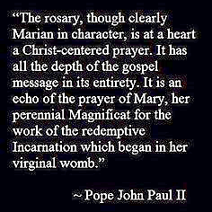


Slide 32
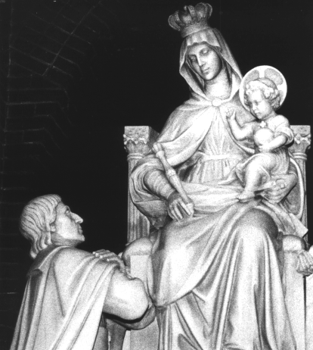
Total Consecration To Jesus through Mary
A renewal of one’s Baptismal Promise
I am all yours and all I have is yours

Slide 33
True Devotion requires interiority
True Devotion consists in that we be interiorly dependent on Mary Most Holy; that we be slaves of Mary, and through Her, of Jesus.
  SM 44
The True Devotion transforms our life of faith – Pure faith, lively faith, firm faith, active faith, courageous faith, blazing faith…
  TD 214
The True Devotion to Mary can have a marvelous effect on one’s life if one takes it seriously.

Slide 34
A Marian synthesis
To understand the True Devotion, we must see it as devotion to the Incarnate God. Our Christian dedication must be lived by “performing all one’s actions through Mary, with Mary, in Mary and for Mary, so as to perform them more perfectly through Jesus Christ, with Jesus Christ, in Jesus Christ, and for Jesus Christ.”
  TD 258
THROUGH
WITH
IN
FOR

Slide 35

Mary is the inseparable associate of Christ
Lord, you are always with Mary, and Mary is always with you. She can never be without you because then she would cease to be what she is… So intimately is she united to you that it will be easier to separate light from the sun, and heat from the fire.”
  TD 63

Slide 36

reflection
How do I see Mary’s role in my life of faith?
What stands out most in my devotion to Mary?

