Slide 1
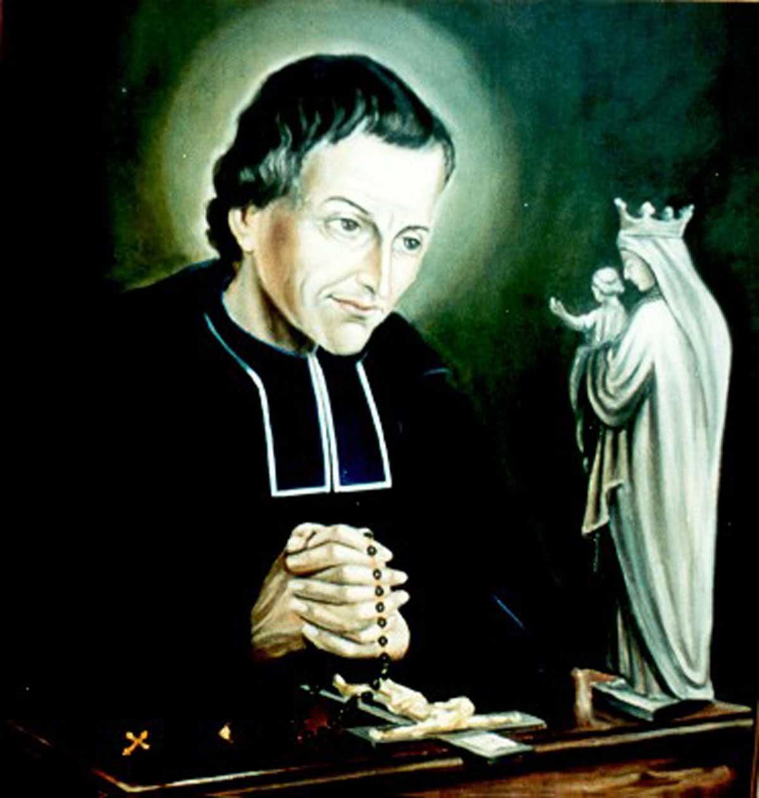
Necessity of True Devotion to Mary

Slide 2
Necessity of Devotion to Mary
Mary is necessary to us because God has freely willed that she should be.
“The salvation of the world began through Mary and through her it must be accomplished.” (TD 49)
The First Coming (Advent of Christ)
The Second Coming (Advent of the Return of Christ)

Slide 3
Necessity of True Devotion to Mary
#4 Mary’s part in the later times
THE URGENCY
OF
THE
NEW EVANGELIZATION

Slide 4
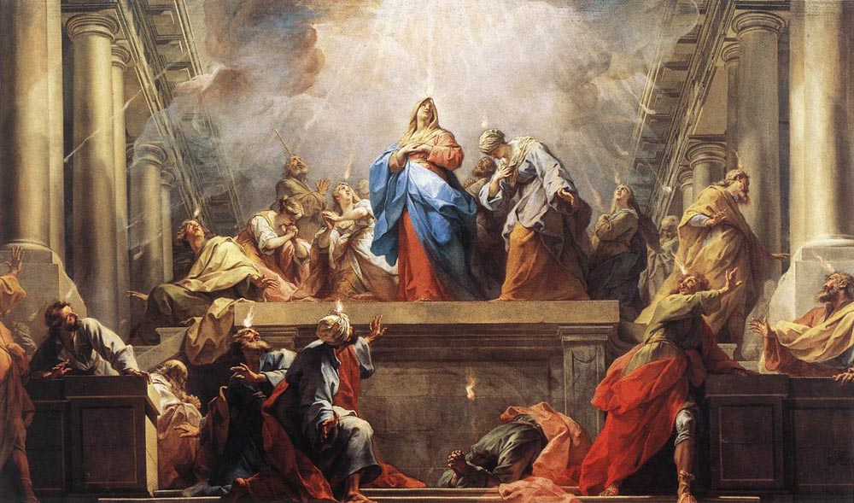
ANSWERING THE CALL
A NEW PENTECOST FOR THE NEW EVANGELIZATION

Slide 5
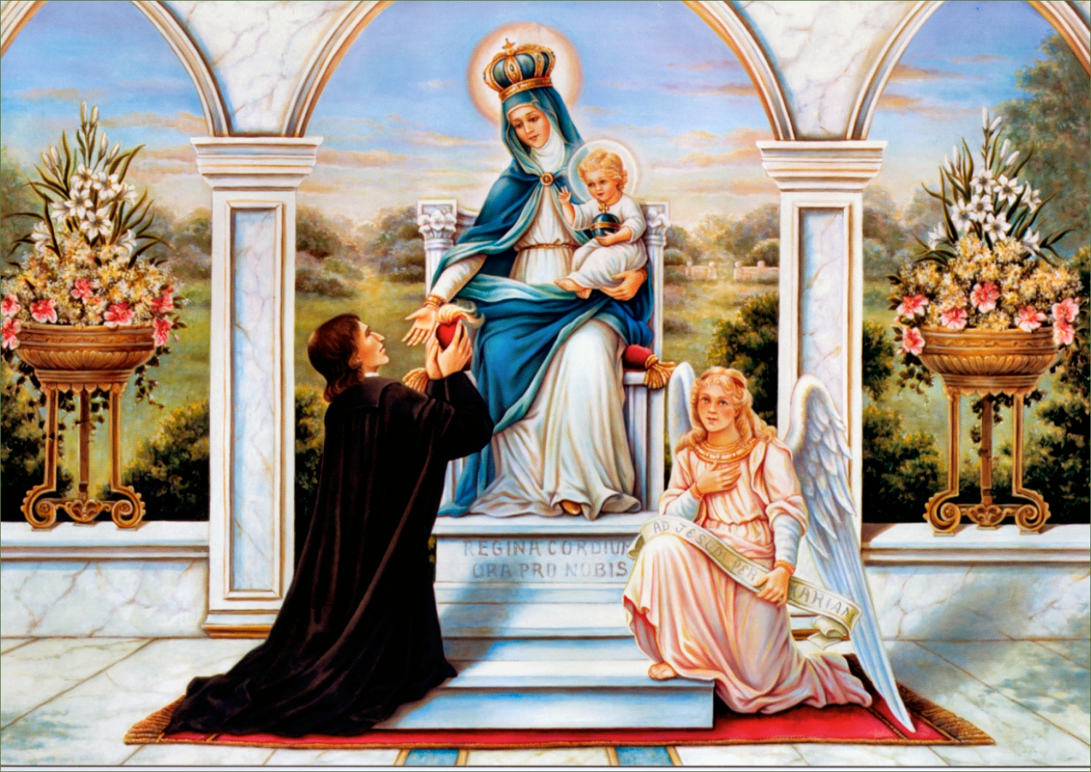
We argue that True Devotion to Mary is a gift to the Church that can restore to the Christian world a true understanding of what consecration, sacraments, vowed celibacy and especially the sacrament of holy matrimony means.

Slide 6

The more one is called to a special perfection the greater is one’s need for Mary (TD 43-45)
As the battle against the forces of evil grows fiercer, Mary’s presence and aid will become even more necessary. (TD 46-59)
Mary must become as terrible as an army in battle array to the devil and his followers. (TD 50)

Slide 7
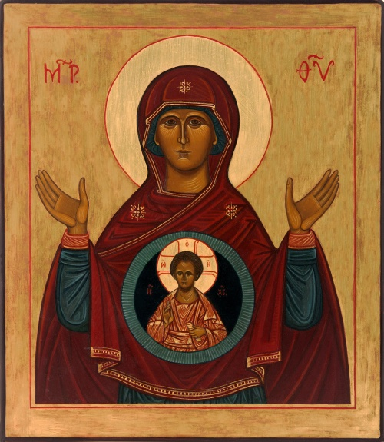
Mary’s part in the incarnation
God gave his only Son to the world only through Mary.
God the Father wishes Mary to be the mother his children until the end of time.
Together with the Holy Spirit Mary produced the greatest thing that ever was or ever will be: A God-Man.

Slide 8
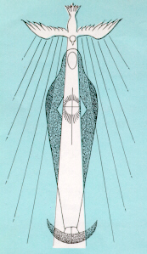
Mary and the holiness of people
When the Holy Spirit finds Mary in a soul he hastens there and enters fully into it.
If then we are establishing sound devotion to our Blessed Lady, it is only in order to establish devotion to our Lord more perfectly, by providing a smooth and certain way of reaching Jesus Christ. (TD 62)

Slide 9
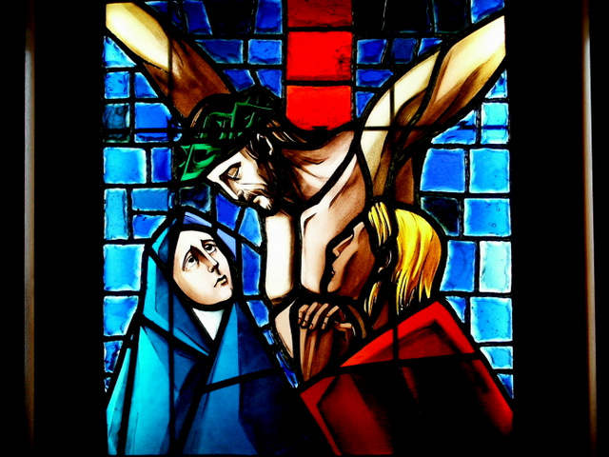
Mary at the foot of the Cross

Slide 10
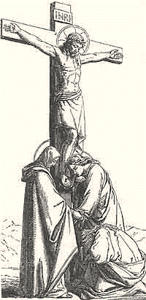
Mother of Disciples
Standing by the cross of Jesus were his mother and his mother’s sister, Mary the wife of Cleopas, and Mary Magdalene. When Jesus saw his mother and the disciple whom he loved standing nearby, he said to his mother, “Woman, behold, your son!” Then he said to the disciple, “Behold, your mother!” And from that hour the disciple took her to his own home. (John 19:25-27)

Slide 11
To take Mary into your own home
Mary received from God a unique dominion over souls enabling her to nourish them and make them more and more godlike. St Augustine went so far as to say that even in this world all the elect are enclosed in the womb of Mary, and that their real birthday is when this good mother brings them forth to eternal life. Consequently, just as an infant draws all its nourishment from its mother, who gives according to its needs, so the elect draw their spiritual nourishment and all their strength from Mary. (SM14)

Slide 12
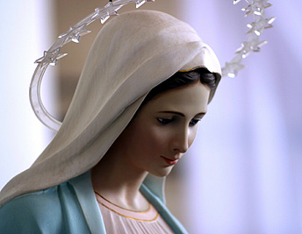

The Way to Jesus
Mary is the Surest, Shortest, Smoothest and most Perfect way of approaching Jesus. (TD55)

Slide 13

Secret of Mary
It is not something that is so obvious. One needs to work at it and discover Mary.
Happy, indeed sublimely happy, is the person to whom the Holy Spirit reveals the secret of Mary, thus imparting to him true knowledge of her. (SM20)

Slide 14

God wants you to be holy like Him
How can you attain holiness?
“What steps will you take to reach the high level to which God is calling you?” (SM4)

Slide 15
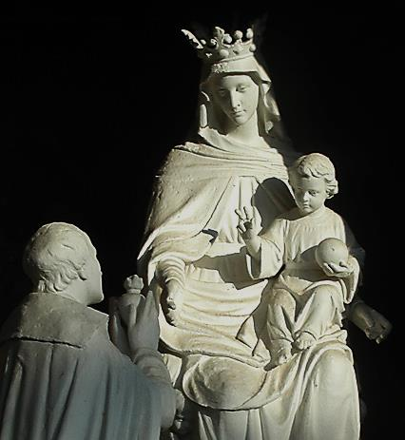
To Be Holy
TO FIND THE GRACE OF GOD, WE MUST DISCOVER MARY
We must discover a simple means to obtain from God the grace needed to become holy. It is precisely this I wish to teach you. My contention is that you must first discover Mary if you would obtain this grace from God. (SM6)

Slide 16
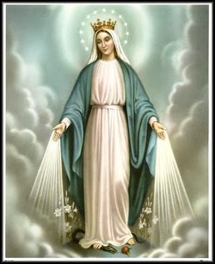
God gathers all the graces and called it Mary
God chose her to be the treasurer, the administrator and the dispenser of all his graces, so that all his graces and gifts pass through her hands. (SM10)

Slide 17
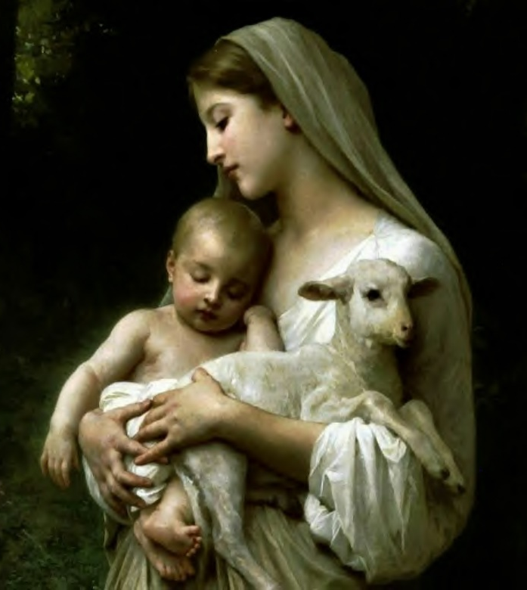
Be formed in Mary
If anyone wishes to become a member of Jesus Christ, and consequently be filled with grace and truth , he must be formed in Mary through the grace of Jesus Christ… (SM12)

Slide 18
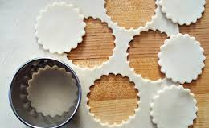
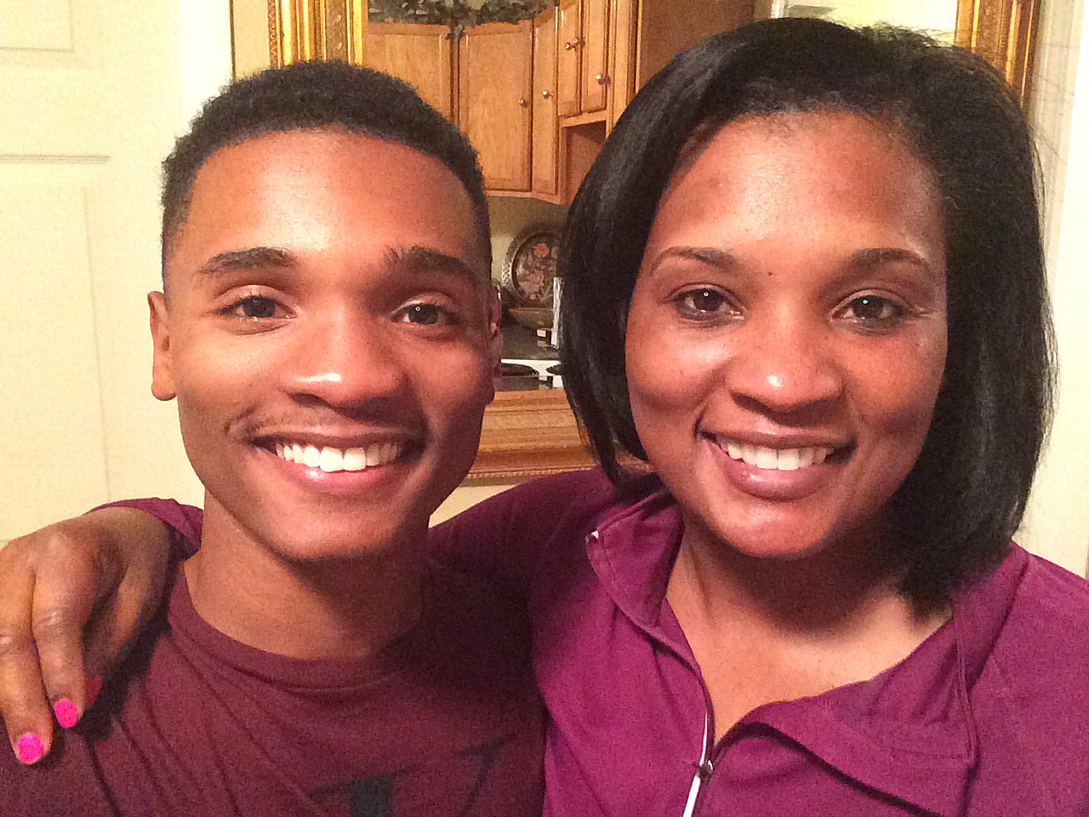
Mary the “Living Mould of God”
No godly feature is missing from this mould. Everyone who casts himself into it and allows himself to be moulded will acquire every feature of Jesus Christ, true God… (SM17)

Slide 19

Mary was created only for God, and it is unthinkable that she should reserve even one soul for herself. On the contrary she leads every soul to God and to union with him. Mary is the wonderful echo of God. The more a person joins himself to her, the more effectively she unites him to God. When we say "Mary", she re-echoes "God". (SM21)

Slide 20
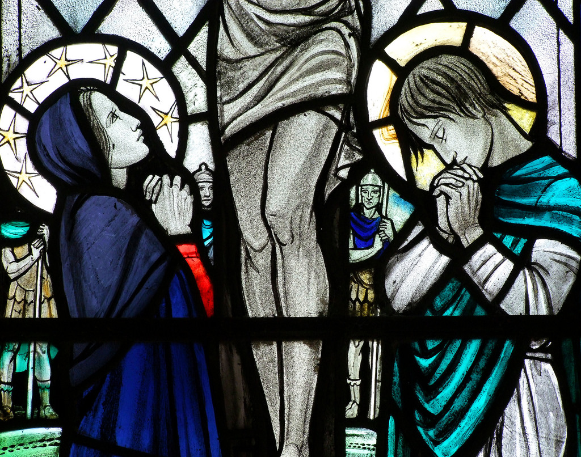
If anyone wants to follow me
One who has discovered Mary through a genuine devotion is not exempt from crosses and sufferings.

Slide 21
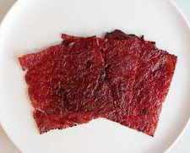
Bearing the Cross with Joy
While meting out crosses to them she gives the grace to bear them with patience, and even with joy. In this way, the crosses she sends to those who trust themselves to her are rather like sweetmeats, i.e. "sweetened" crosses rather than "bitter" ones. (SM22)

Slide 22
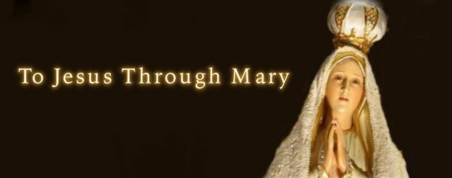
To Jesus Through Mary
God ordinarily imparts his graces to men through Mary. Therefore, if we wish to go to him, seeking union with him, we must use the same means which he used in coming down from heaven to assume our human nature and to impart his graces to us. That means was a complete dependence on Mary his Mother, which is true devotion to her.

Slide 23
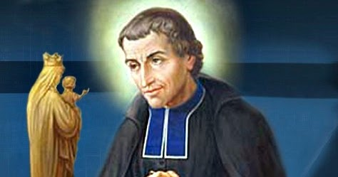
When you follow Mary you will not go astray;
When you pray to her, you will not despair;
When your mind is on her, you will not wander;
When she holds you up, you will not fall;
When she protects you, you will have no fear;
When she guides you, you will feel no fatigue;
When she is on your side,
you will arrive safely home.
(Saint Bernard), (SM40)

Slide 24
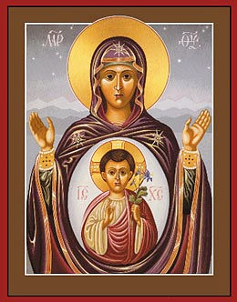
Mary is the fruitful Virgin
If Jesus is equally the fruit of Mary for each individual soul as for all souls in general, he is even more especially her fruit and her masterpiece in the soul where she is present. (SM56)

Slide 25
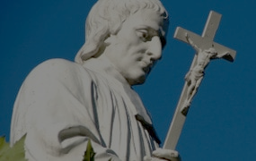
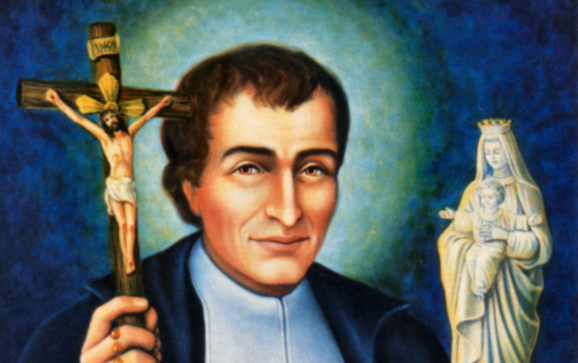
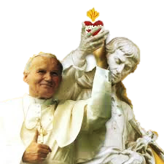
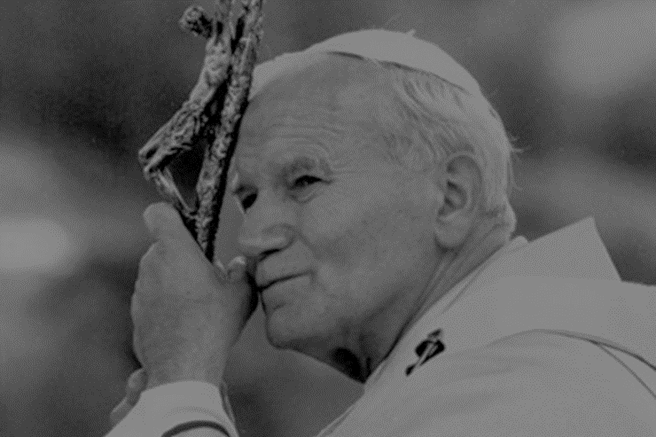
Totus Tuus

Slide 26
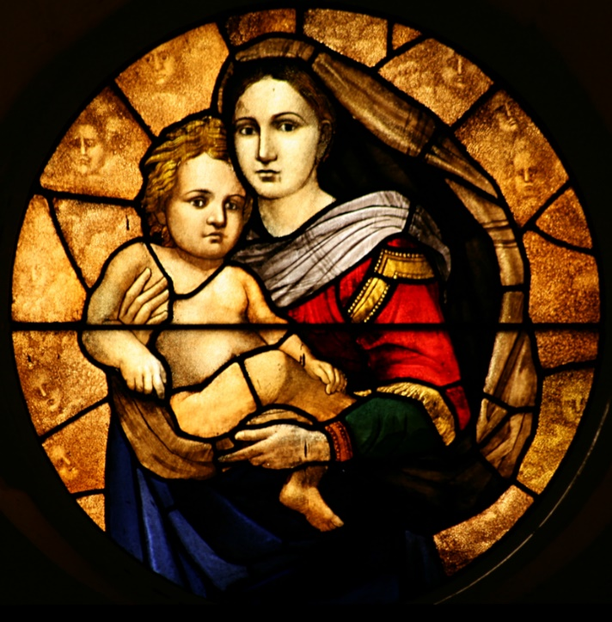
TOTUS TUUS Total Consecration
I am all yours and all that I have
belongs to you, O my sweet Jesus,
Through Mary, your holy Mother.
I am all yours, Mary, holy Virgin,
All that I have is yours, Mary, pure Virgin,
Be my guide in all that I do, Mary, our Mother.

Slide 27

Totus Tuus (Totally Yours) by Rosemary Scallon

Slide 28
Reflection and Sharing
What are some concerns you may have to take Mary into your own home?
How will your life as a disciple be changed when you have Mary into your own home?
True devotion leads into a life that is changed. What do I need to change in my life to be a true disciple of Jesus Christ?
How is my life transformed with Mary as my Mother and Model?

