Slide 1
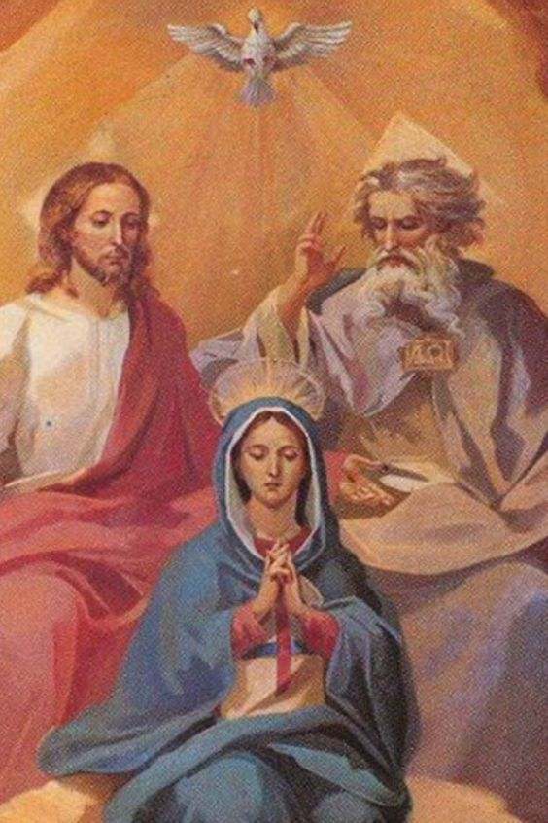
Mary in the Mystery of the Trinitarian Love

Slide 2

O Purest of Creatures

Slide 3
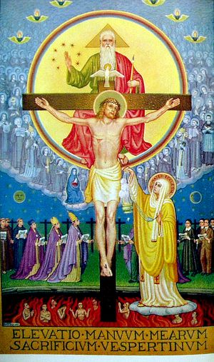
Let us recall here, as proof of the dependence we ought to have on Our Blessed Lady, the example which the Father, the Son, and the Holy Spirit give of this dependence… (TD 140)

Slide 4
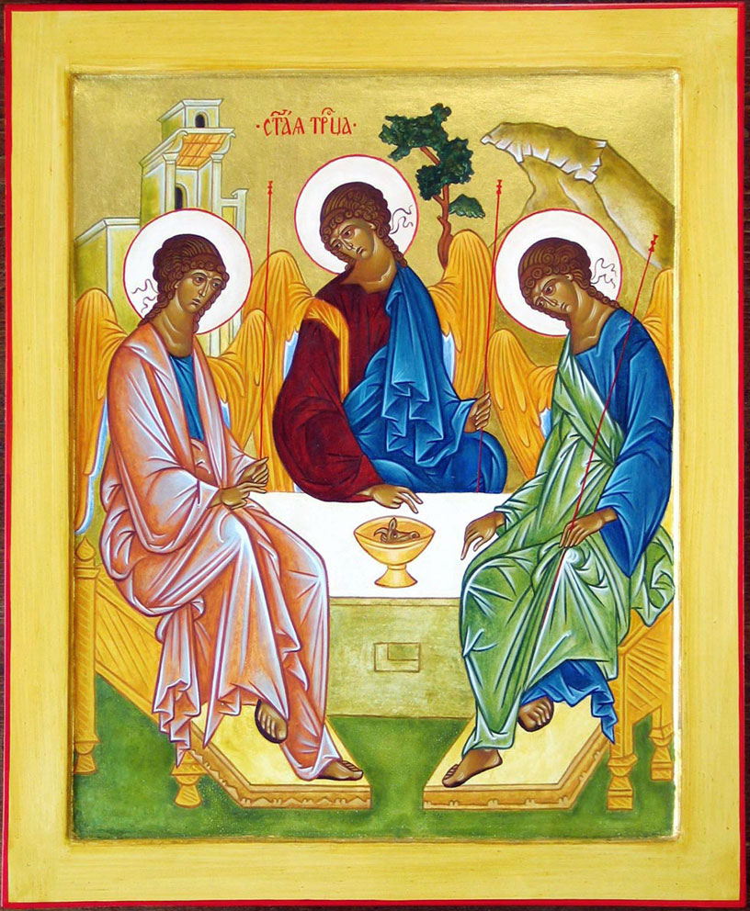
Mary’s Relation to the Holy Trinity
Beloved Daughter of the Father
Faithful Spouse of the Holy Spirit
Admirable Mother of the Son

Slide 5
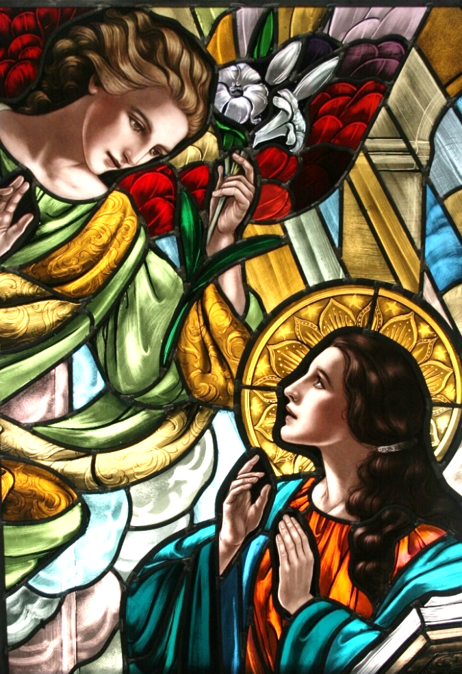
The Holy Trinity thus declared Itself to Mary
“The Holy Spirit will come upon you, and the power of the Most High will overshadow you; therefore the child to be born will be holy; he will be called Son of God.”
  Luke 1:35

Slide 6
Mary as Daughter
Her position as “the first of all creatures, the most acceptable child of God, the nearest and dearest to him.”
The fullness of her union with Jesus Christ which makes her enter into new relations to the Father.
The pre-eminent resemblance which she bears to the Father, which has fitted her to pour out into the world the everlasting light which issues from the loving Father.
  Legion HB p.44

Slide 7
Mary as Spouse
Mary has been so taken up into the Holy Spirit, made one with him, animated by him, that he is as her very soul. She is no mere instrument or channel of his activity; she is an intelligent, conscious co-operator with him to such degree that when she acts, it is also he who acts; and that if her intervention be not accepted, neither is his.
  Legion HB p.44

Slide 8
Mary as Mother
In the case of Jesus and Mary the union of souls was primary, and of flesh secondary; so that even when separation of flesh occurred at birth, their union was not interrupted but went on into further incomprehensible degrees of intensity and association – such that Mary can be declared by the Church to be not only the “helpmate” of that Second Divine Person – co-Redemptress in salvation: Mediatress in grace – but actually “like unto Him.”
  Legion HB p. 43

Slide 9
Love of the Father
Daughter
MARY
Mother
Spouse
Mission of the Son
Gift of the Holy Spirit

Slide 10
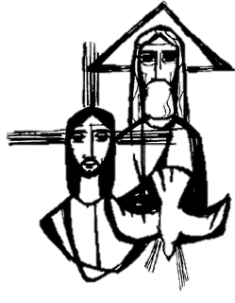
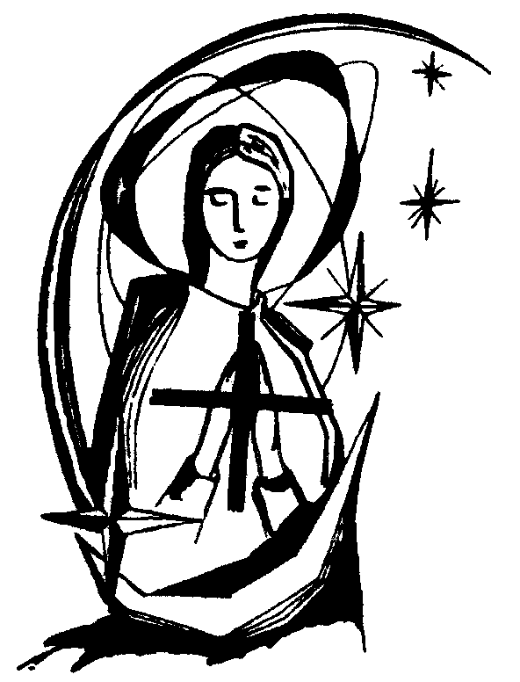
“But when the appointed time came, God sent the Son, born of a woman, born a subject of the Law, to redeem the subjects of the Law, and to enable us to be adopted as sons and daughters. The proof that you are sons and daughters is that God sent the Spirit of the Son into our hearts: the Spirit that cries, ‘Abba, Father’…”
  Gal 4:4-6

Slide 11
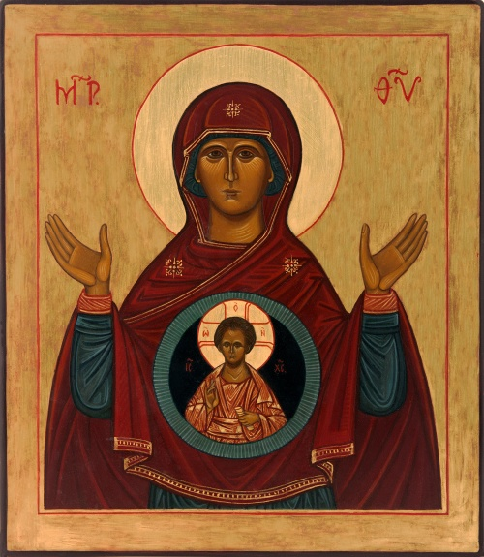
Before the time of Incarnation
“God’s only Son was given to the world through Mary;” (TD 16)
“Became man for our salvation only in Mary and through Mary.” (TD 16)
“Formed Jesus Christ in Mary.” (TD 16)

Slide 12
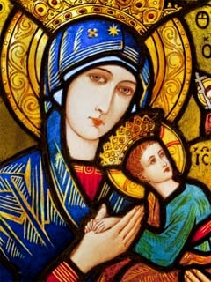
During the time of the Incarnation
“Imparted to Mary God’s fruitfulness.” (TD 17)
“Took his delight in Mary.” (TD 18)
“Became fruitful through Mary.” (TD 20)

Slide 13
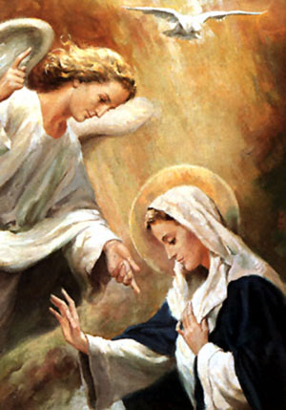
After the time of the incarnation
“Gathered all God’s graces together and called them Mary.” (TD 23)
“Imparted to her all that he has gained.” (TD 24)
“Entrusted the Spirit’s wondrous gifts to Mary.” (TD 25)

Slide 14
reflection
How do I experience the Trinitarian Love in communion with Mary?
How am I aware that, through and in Mary, I am imitating the “compelling example of the three divine Person?” (TD 140)

Slide 15

O Mother Divine

