Slide 1
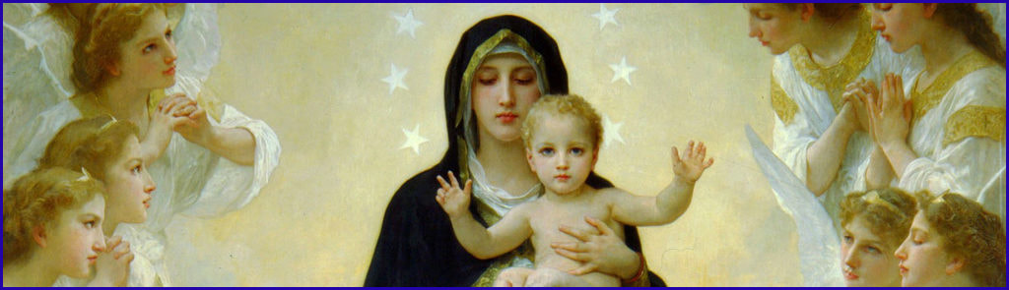
PARTICULAR PRACTICES of the TRUE DEVOTION
Montfort himself does not insist on the distinction between exterior practices (226-56) and interior practices (257-66).

Slide 2
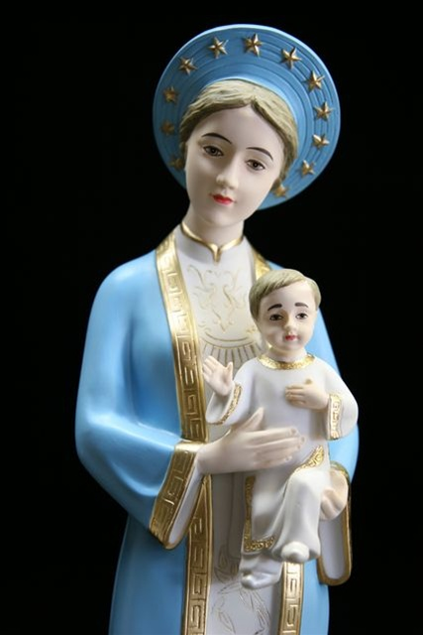
PARTICULAR PRACTICES OF TRUE DEVOTION
I. EXTERIOR PRACTICES

Slide 3

Exterior practices
1. Preparation and Total Consecration 33 Days (TD 227- 233)
The first exterior practice he speaks of is the solemn act of consecration. We must be suitably prepared for this, and the preparation is to be serious and lengthy (33 DAYS).
The consecration requires sufficient time for reflection and prayer; otherwise such an act of devotion might be rendered commonplace; this consecration must be truly personal in character; Montfort speaks of the signature of the act of consecration.

Slide 4
2. The Little Crown of the Blessed Virgin
Once the consecration has been made, Montfort recommends three Marian prayers to the true disciples of Mary.
These are: the Little Crown of the Blessed Virgin Mary (second practice), the Hail Mary, especially as recited in the Rosary (fifth practice), and the Magnificat (sixth practice).
All of these Marian prayers are presented in relationship to the Trinity: their intent is to honour Christ through Mary who is the indissoluble spouse of the Holy Spirit and beloved daughter of the Father. TD 234 - 235
Exterior practices

Slide 5

3. The wearing of little chains – TD 236 - 242
Exterior practices
The wearing of the little chains is also recommended by Montfort as an effect and constant reminder of one’s consecration to Jesus through Mary.

Slide 6
4. Honouring the mystery of the Incarnation – TD 243 - 248
Exterior practices
First of all, since the mystery of Incarnation is the theological foundation for this consecration, Montfort proposes as the foundational external practice a singular devotion to the great mystery of the Incarnation of the Word.
The main theological reason for this devotion is twofold:

Slide 7
4. Honouring the mystery of the Incarnation
That we might honour and imitate the wondrous dependence which God the Son chose to have on Mary, for the glory of his Father and for the redemption of man.
Secondly, that we might thank God for the incomparable graces he has conferred upon Mary and especially that of choosing her to be his most worthy Mother. TD 243 - 248
Exterior practices

Slide 8
5. Saying the Hail Mary and the Rosary TD 249 - 254
Exterior practices
Of all these exterior practices, the one Montfort emphasizes most is the recitation of the rosary. Not only did he create countless different ways for contemplating its mysteries, but also he was very inventive in varying the external trappings with which it was recited.
Always and everywhere Montfort teaches the simple peasants of Brittany to enter deeply into communion with Mary and Jesus by reciting the Rosary.
He also says explicitly that the recitation of the Rosary brings perfect knowledge of Christ, without which we cannot be saved.

Slide 9
5. Saying the Hail Mary and the Rosary
At the same time, Montfort is realistic in saying that the effects of the holy rosary will manifest only gradually.
He understood fully well that it is not we who achieve results by prayer, not even that of the knowledge of God.
On the contrary, it is always God who reveals himself and his loving plan as he wishes, when he wishes, to whom he wishes and as much as he wishes. TD 249 - 254
Exterior practices

Slide 10
6. Praying the Magnificat – TD 255
To thank God for the graces he has given to our Lady.
Her consecrated ones will frequently say the Magnificat.
It is the greatest offering of praise that God ever received under the law of grace.
On one hand, it is the most humble hymn of thanksgiving and on the other, it is the most sublime and exalted, contained in it are mysteries so great and so hidden that even the angels do not understand them.
Exterior practices

Slide 11
7. Contempt of the world – TD 256
Mary’s faithful servants despise this corrupted world. They should hate and shun its allurements, and follow the exercises of the contempt of the world. LEW 194 - 200
Exterior practices

Slide 12
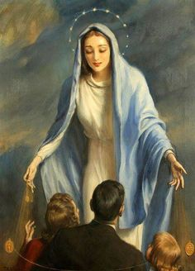
PARTICULAR PRACTICES OF TRUE DEVOTION
II. INTERIOR PRACTICES

Slide 13
Interior Practices Through Mary
We must do everything through Mary, that is, we must obey her always and be led in all things by her spirit, which is the Holy Spirit of God. “Those who are led by the Spirit of God are children of God,” says St. Paul. (Roman 8:14) –TD258
I have said that the spirit of Mary is the spirit of God because she was never led by her own spirit, but always by the spirit of God, who made himself master of her to such an extent that he became her very spirit.
St. Ambrose: May the soul of Mary be in each one of us to glorify the Lord…..

Slide 14
Interior Practices With Mary
We must do everything with Mary, that is to say, in all our actions we must look upon Mary, although a simple human being, as perfect model of every virtue and perfection, fashioned by the Holy Spirit for us to imitate, as far as our limited capacity allows. – TD 260
“Mary shines forth to the whole community of the elect as the model of virtues.” LG 65
“Mary is fashioned by the Holy Spirit and formed as a new creature.” LG 56

Slide 15
Interior Practices In Mary
We must do everything in Mary. To understand this we must realize that the Blessed Virgin Mary is the truly earthly paradise of the New Adam and that the ancient paradise was only a symbol of her. – TD 261
In this earthly paradise grows the real Tree of Life which bore our Lord, the fruit of Life, the tree of knowledge of good and evil, which bore the Light of the world.

Slide 16
Interior Practices In Mary
The Holy Spirit speaking through the Fathers of the Church, also calls our lady the Eastern Gate, through which the High Priest, Jesus Christ, enters and goes out into the world. Ezekiel 44: 1-3, Ps 86:1, Isa 6: 1-4
The Holy Spirit also calls her the Sanctuary of the Divinity, the Resting-Place of the Holy Spirit, the Throne of God, the City of God, the Altar of God, the Temple of God, the World of God.
– TD 262

Slide 17
Interior Practices For Mary
Like every good servant and slave we must not remain idle, but relying on her protection, we should undertake and carry out great things for our noble Queen. (Pius XII – Discourse for the Crowning of Mary)
We must defend her privileges when they are questioned and uphold her good name when it is under attack. TD 93 - 94
We must attract everyone, if possible to her service and to this true and sound devotion. TD 95
We must speak up and denounce those who distort devotion to her by outraging her Son. TD 97 – 99
Glory to Jesus in Mary! Glory to Mary in Jesus!
Glory to God Alone!
– TD 265

Slide 18
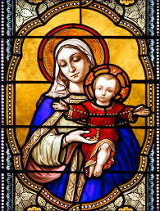
HE WHO FINDS MARY FINDS JESUS
ST. LOUIS MARIE DE MONTFORT

