Slide 1
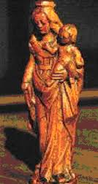
For Fr of MONTFORT,
who was the Virgin Mary?
His experience and what he said about her.

Slide 2
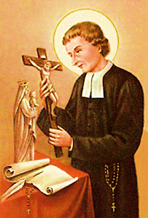
HIS
EXPERIENCE

Slide 3

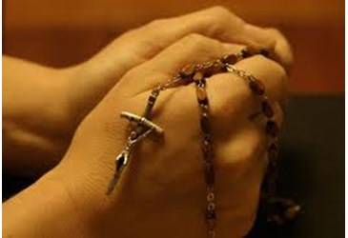
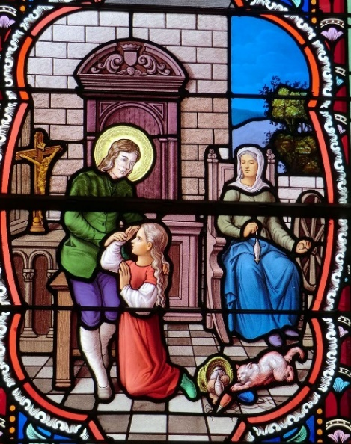
In the family house
Bois-Marquer
Pleasure for prayer
Mary’s images
Rosary
Prayers with
his sister Guyonne-Jeanne

Slide 4
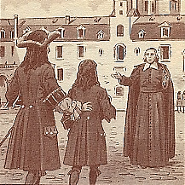
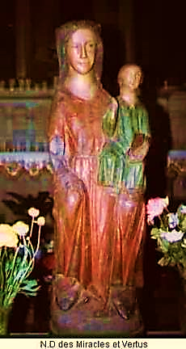
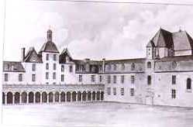
At school in Rennes (1684-1693)
Visits to Saint Saviour’s church.
Association to honour Mary.
He expects everything from Mary.

Slide 5
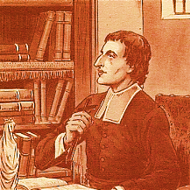
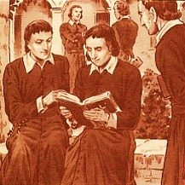
At the seminary in Paris(1693-1700)

Slide 6

At Saint Sulpice seminary
In Paris (1693-1700)
Mary
« Lady of the seminary".
« The little psalter of the Virgin"
(by Saint Bonaventure).

Slide 7
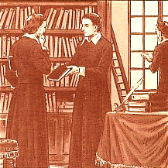
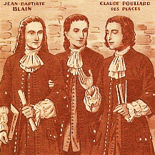
Librarian, he reads a lot about Mary.
He wants to recruit the seminarians
« as slaves of Jesus in Mary »

Slide 8
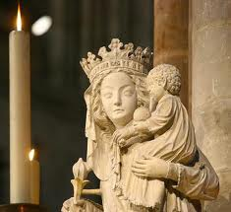
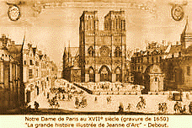
Communion,
every Saturday,
In N.D. In Paris.

Slide 9
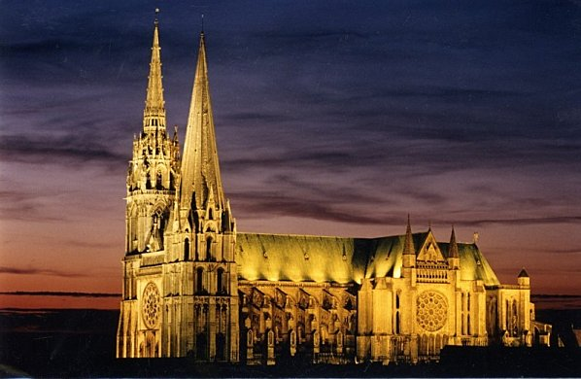
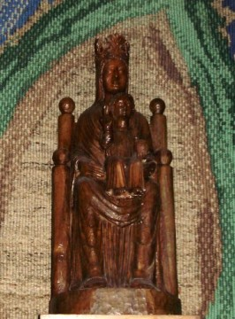
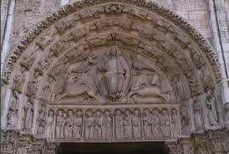
1699, Montfort seminarian
pilgrim to « Our Lady
sous terre »
In Chartres Cathedral

Slide 10
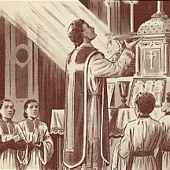
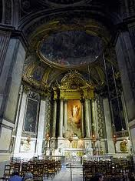
Maintenance of the chapel of the Virgin
In Saint Sulpice Church;
there his first Mass in June1700.

Slide 11
4. Period of his ministry
(1700-1706).
4.1 ‘Outer’ presence
Of Mary

Slide 12
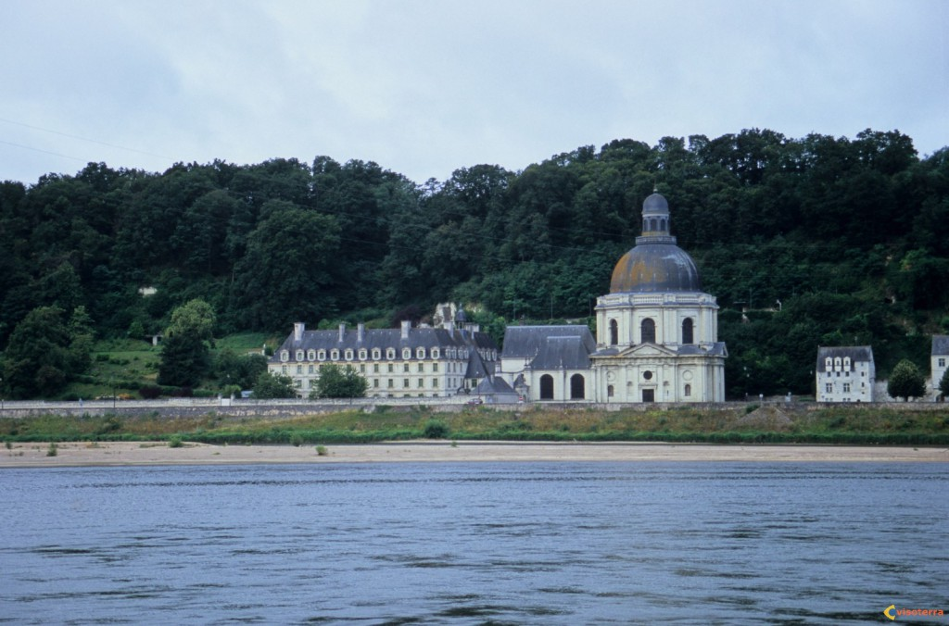
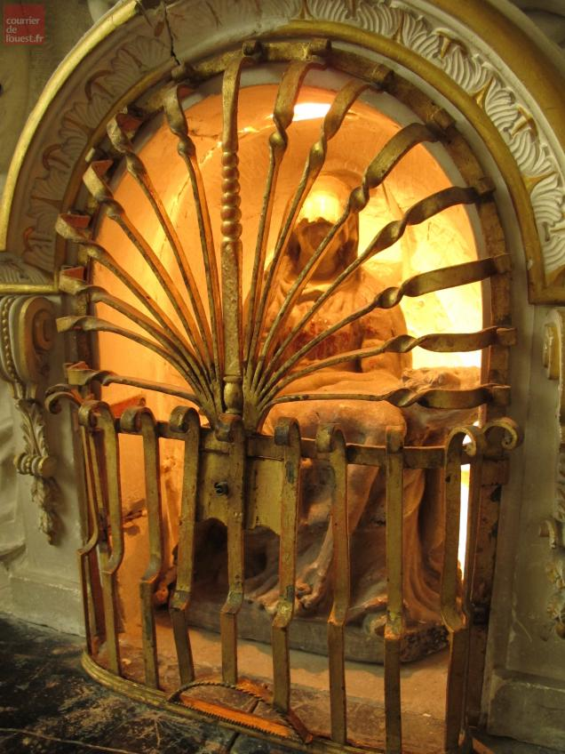
Pilgrimage:
Our Lady of Ardillers, in Saumur:
four times: 1700, 1701, 1706, 1716.

Slide 13
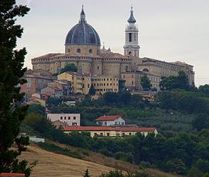
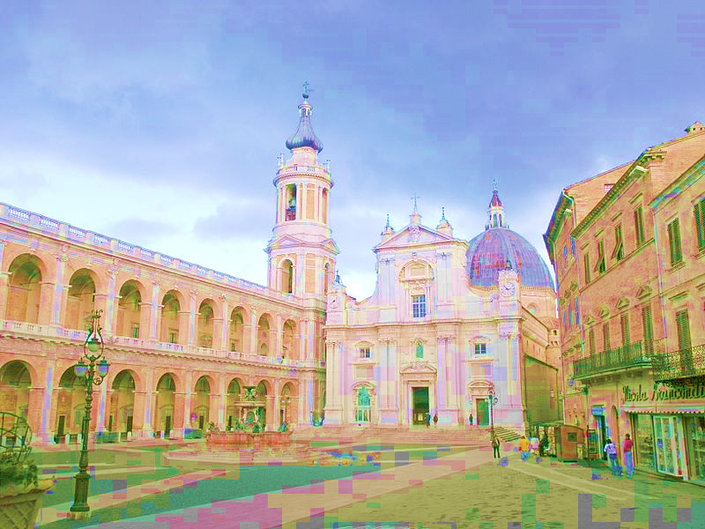
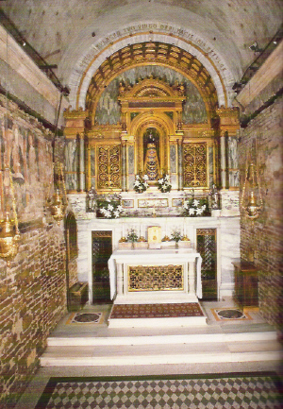

Lorette, 1706, on his way to Rome. He spends there 15 days.

Slide 14
Montfort invites to go
in pilgrimage
to a Mary’s Sanctuary in order to renovate
the Consecration.

Slide 15
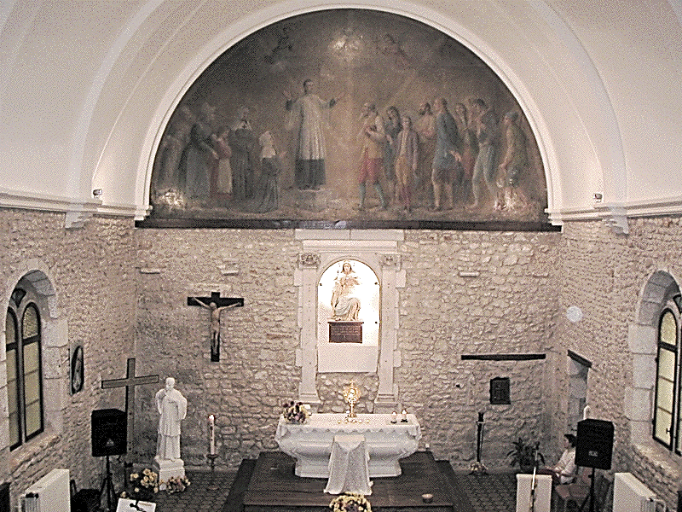
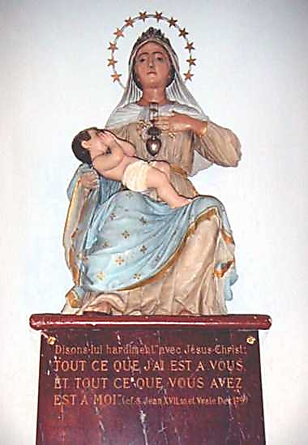
He builds or restores Mary’s sanctuaries:
Poitiers, Montbernage MARY QUEEN OF THE HEARTS

Slide 16
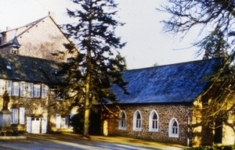
Montfort-sur-Meu,
Chapel of the hermit of St Lazare

Slide 17
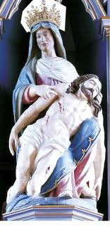
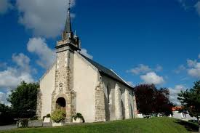
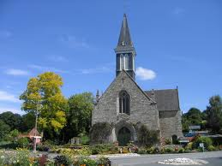
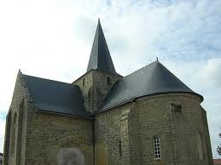
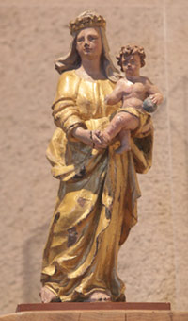
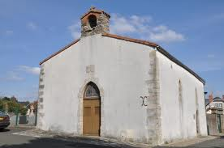
La Chèze
La Garnache
Sallertaine
Nantes
La Séguinière

Slide 18
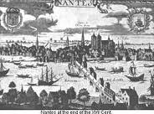
Diocese of Nantes
e.g. In theChevrolière
Mission of 1708
At Notre Dame des Ombres
« Close to her,
We rest in our works,
Tale refuge from all evils,
The faithful
Taste an inmortal joy.
How sweet, how sweet!
Let us hide, then, in her shadow.

Slide 19
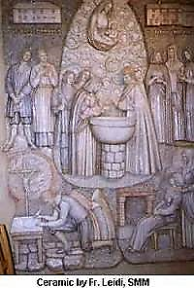
Mary’s Place in the Renewal of Baptismal Promises.
… O Mary…
I renew in your hands
the commitments of my baptism
and I give myself entirely
to Jesus Christ,
Incarnate Wisdom,
to be more faithful to Him,
carrying may cross
in following Him,
All the days of may life….

Slide 20
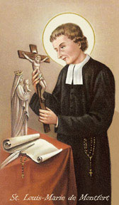

The rosary
(or its prayer)
a prayer,
a popular simple pedagogy,
popular,
to help
to contemplate
the Mysteries
of Jesus’life.

Slide 21
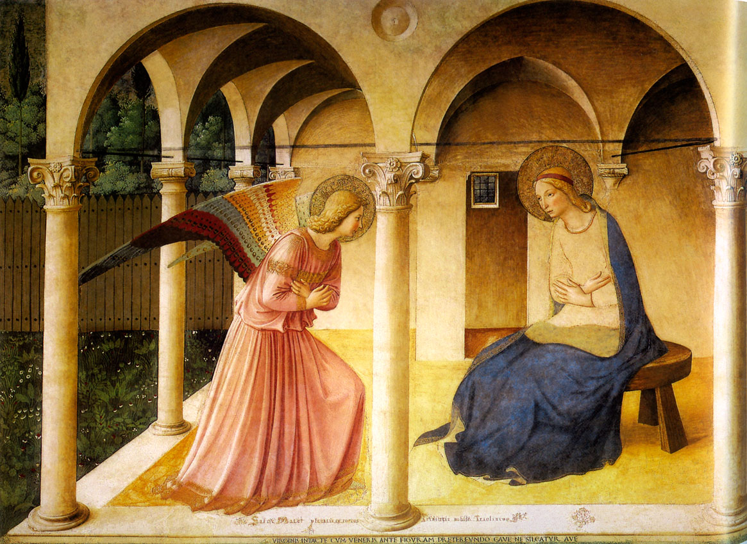
March 25th, feast of the INCARNATION

Slide 22
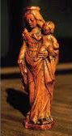
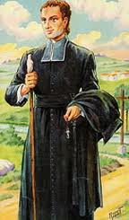
He constantly carried with him a little image of the Virgin.

Slide 23
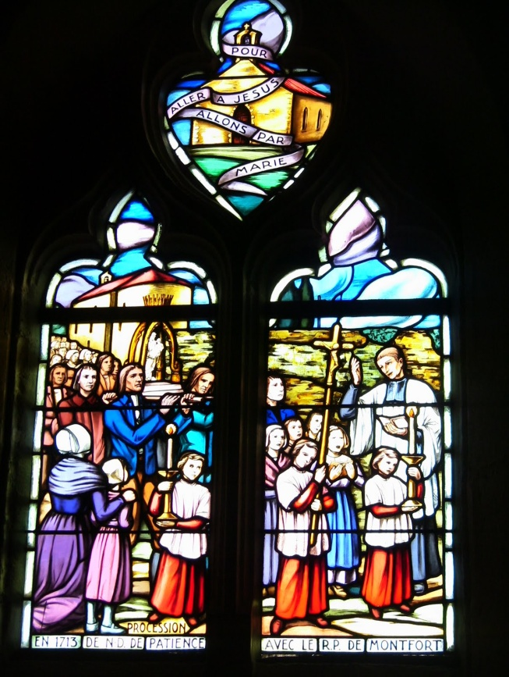

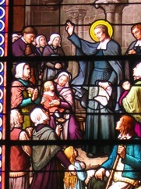
The place of Mary in his preaching,
Letters and writings.

Slide 24
The Company of Mary
« Liberos » : true sons of Mary….
THE WILL OF LOUIS MARIE GRIGNION DE MONTFORT:
I, the undersigned, the greatest of sinners, want my body to be placed in the cemetery and my heart under the altar of the Blessed Virgin.[…]
I give three of my banners to Notre-Dame de Toute Patience in La Séguinière, and four others to Notre-Dame de la Victoire in La Garnache; and to each parish in l'Aunis, where the prayer of the Rosary will persevere, one of the banners of the Holy Rosary.

Slide 25
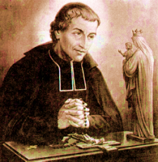
4.2 Mary’s ‘inner’ presence
Mary « his oratory »
A «spiritual image » in the depth of the heart
Continuous presence of Jesus and Mary in the depth of his soul
A continuous presence focused on Christ
Mary is at the same time his Mother and his « Lady »

Slide 26
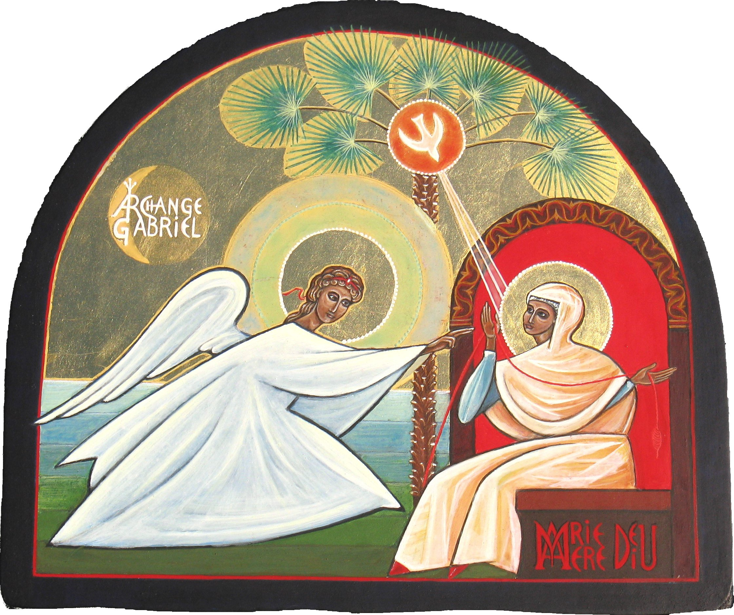
WATH HE SAYS ABOUT MARY: His teaching
All parts of the mystery of the Incarnation
Wisdom, in Mary
The Incarnation itself
Jesus Christ is true God and true man.
To save us and to divinize us.
2. Mary’s role in the Incarnation
2.1 God wanted to have need of Mary
2.2 Trinity communicates with Mary
2.3 Mary’s consent
2.4 Mary’s is the Mother of God

Slide 27
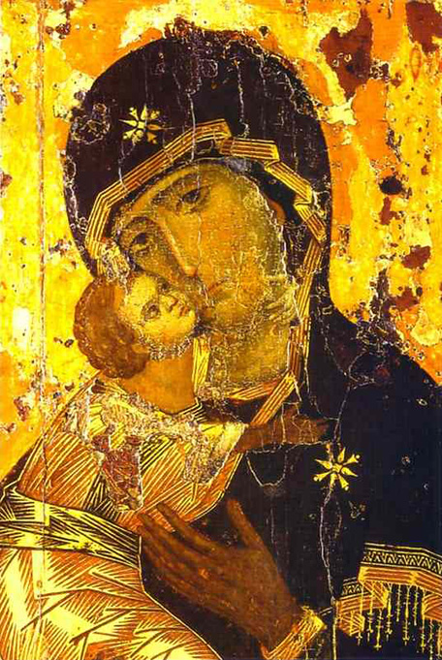
2.4 Mary is the Mother of God
2.5 Note
Second Vatican Council
Lumen Gentium (LG) chapter VIII
« The Bessed Virgin Mary,
Mother of God in the mystery
Of Christ and of the Church » n°52-69.

Slide 28
Mary and Christians (our sanctification)
Mary is the mediator of all grace
2. Mary is the Mother of the redeemed
3. First consequence: Mary queen of the Hearts
4. Second consequence: Marya ‘necessary’ for salvation.

Slide 29
C. Summary : the names of Mary
In relation to God
2. In relation to us
Conclusion
Montfort invites us to live like Mary,
our « yes » to God.

Slide 30
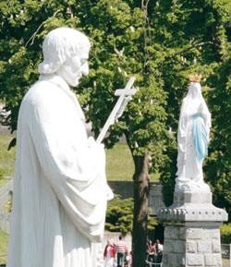
Hail Mary,
Full of grace,
the Lord
Is with you.
Blessed are you among women
and Jesus
« Eternal and incarnate Wisdom »
the fruit, of your womb, is blessed.
Holy Mary,
Mother of God,
Pray for us sinners,
Now and at the hour of our death.
Amén.

