Slide 1
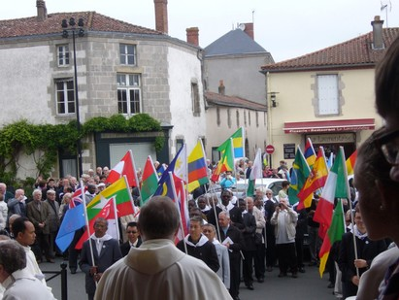

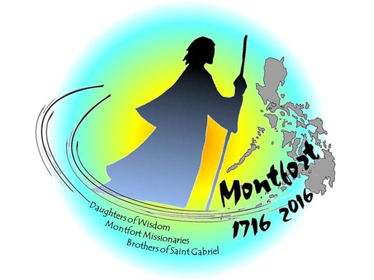
SAINT LOUIS MARIE GRIGNION DE MONTFORT, WHO ARE YOU?

Slide 2
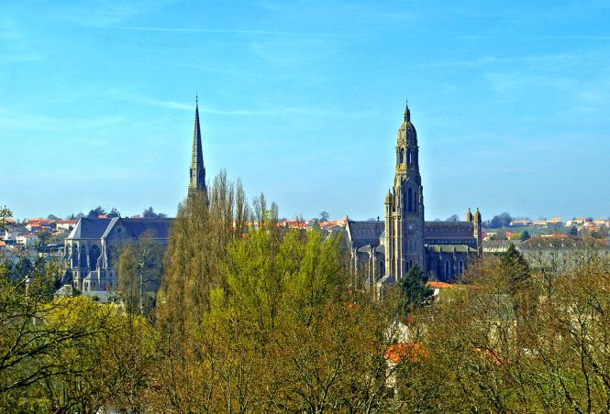
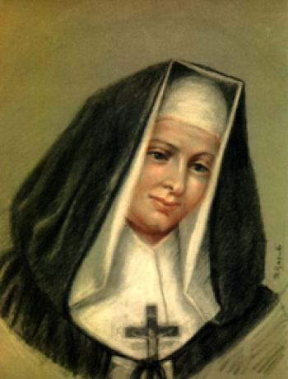
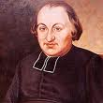
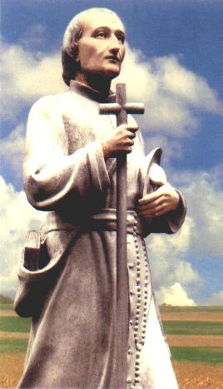
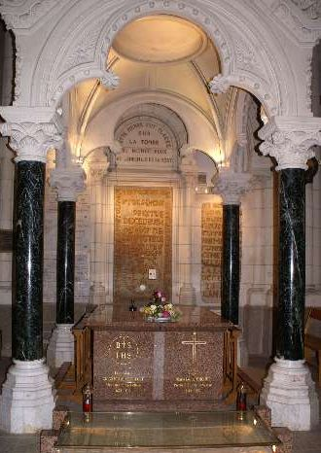


Blessed Mary Louise of Jesus, first daughter of Wisdom 1684-1759
P.
Gabriel Deshayes 1767-1841
Saint L.M. Grignion of Montfort 1673 - 1716

Slide 3
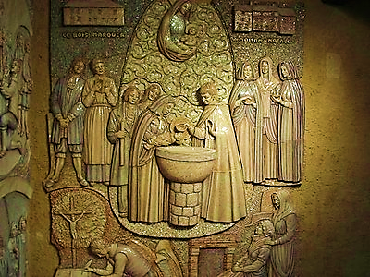
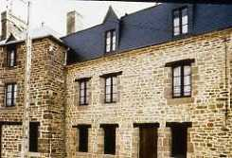
Some biographical details
On January 31st birth in Montfort-la-Cane (near Rennes)
Baptism: February 1st
To his family name, GRIGNION,
he will add DE MONTFORT, in memory of the place of his baptism
Later, he will also add MARIE,
for his love to the Virgin Mary. Hence his name:
Luis-Marie Grignion de Montfort

Slide 4
His life (1673-1716) is contemporaneous with part of the reign of Louis XIV (1643-1715),
absolute Monarch from 1661.
Century of arts, letters, music ... Versailles ...
But also of wars and miseries for the population ...

Slide 5
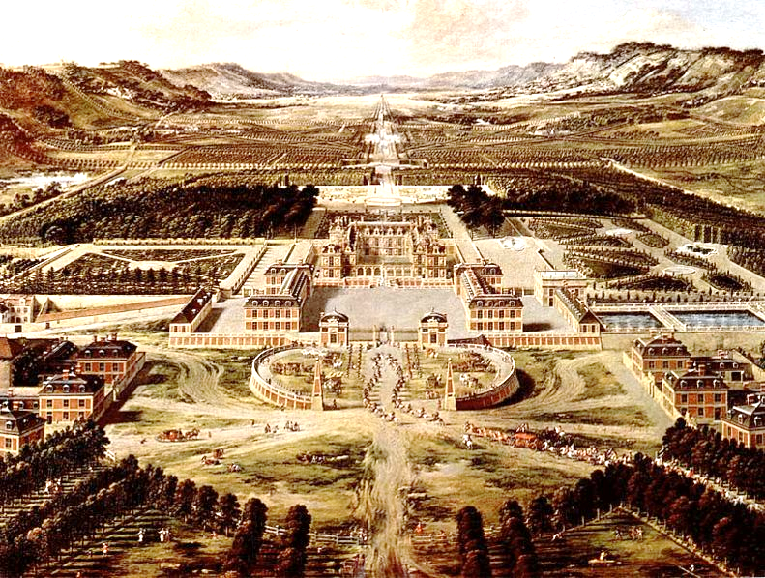
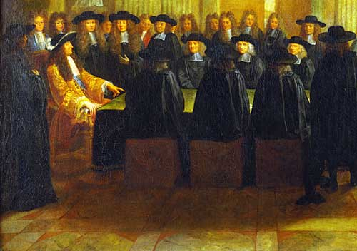
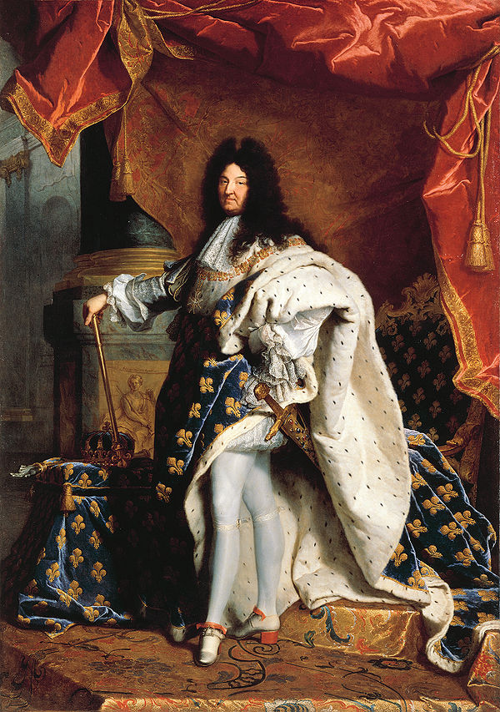
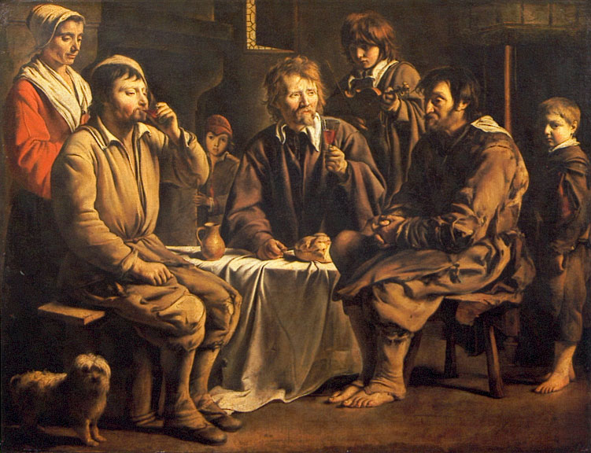
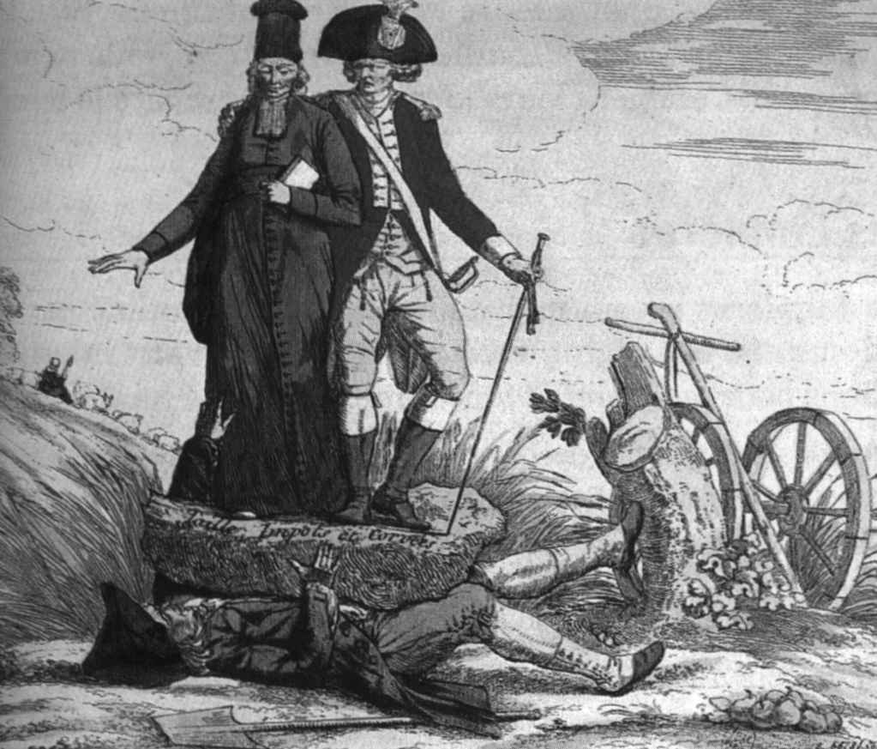
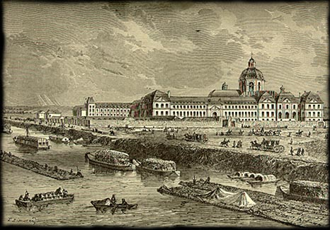

Slide 6
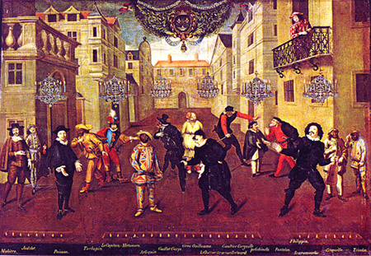
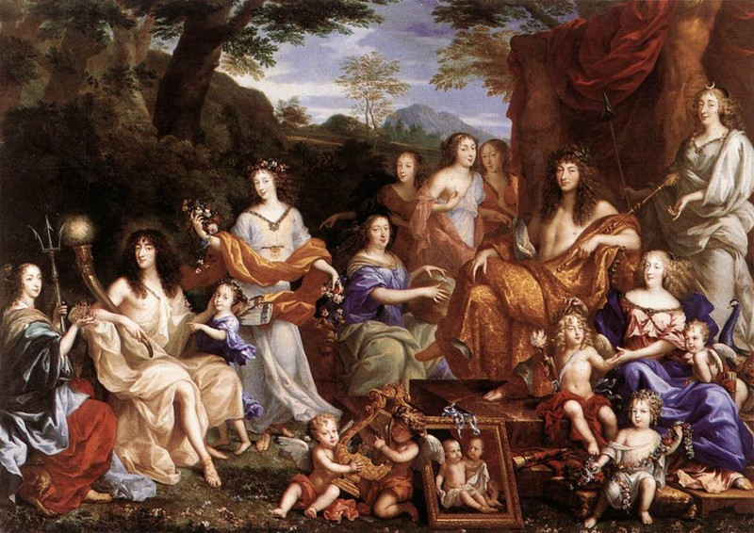
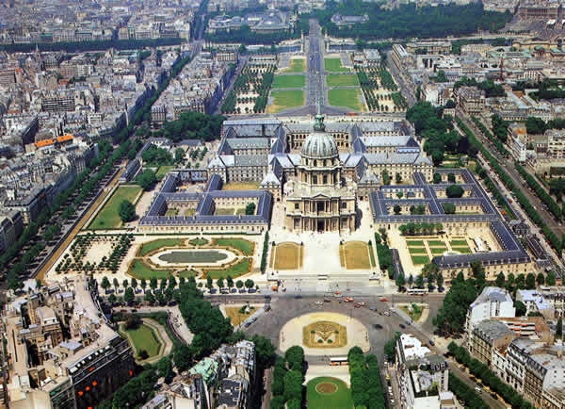
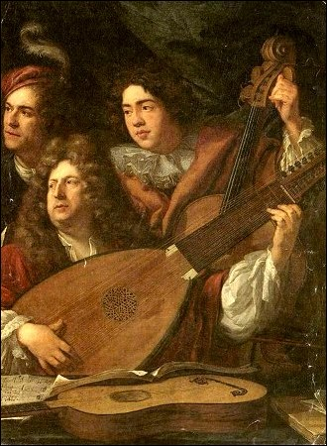
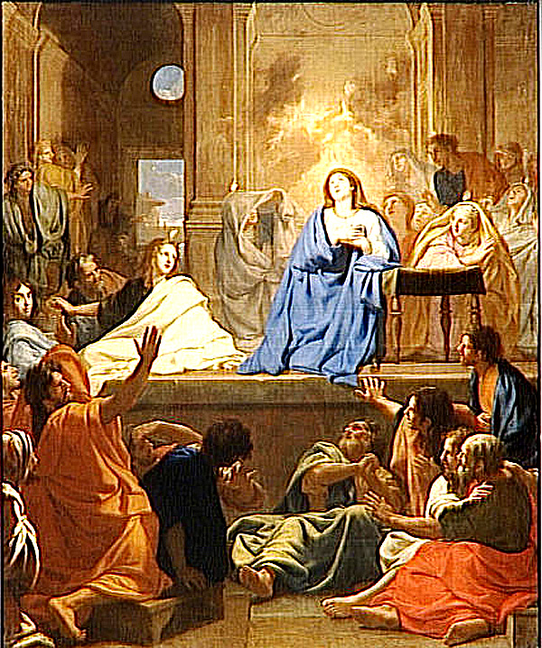

Slide 7
The great century of the souls
Following the steps of the great names of the
«French Spirituality School»

Slide 8
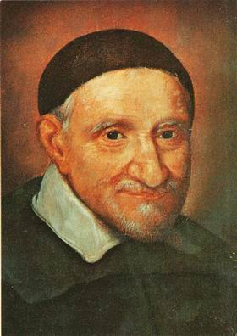
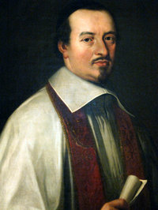
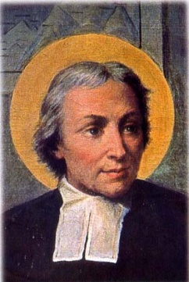
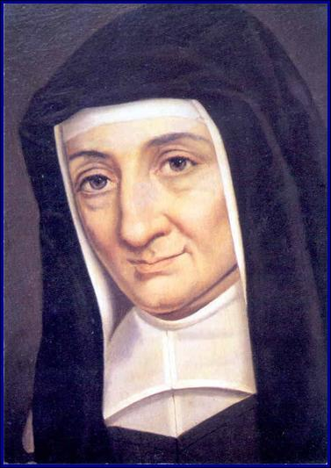
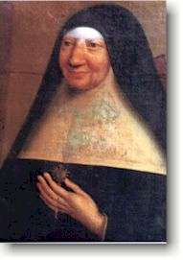
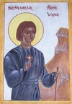
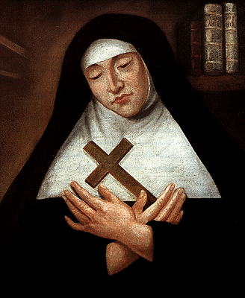
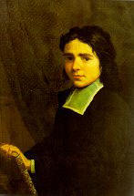
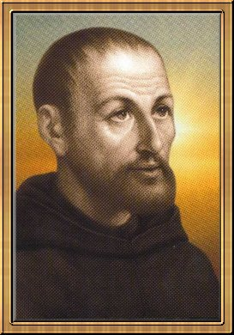
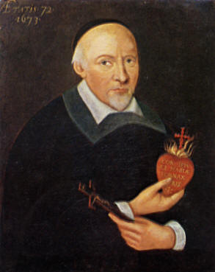
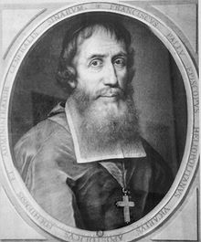
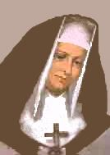
Saint Jean Baptiste
of la Salle
1651-1719
Saint Vincent of Paúl
1581 - 1660
Jean-Jacques
Olier
1608 - 1657
Mother Mechtilde
Of the Holy
Sacrament
1614-1698
Blessed
Pierre Vigne
1670-1740
Louise de Marillac
1591 - 1660
Claude Poullart
des Places
1679-1709
Blessed
Mary of the
Incarnation
1599-1672
Blessed
Nicolas Barré
1621-1686
Saint
Jean Eudes
1601-1680
Francis Pallu
1626 -1684
Blessed
Marie Louise
Trichet
1684-1759

Slide 9
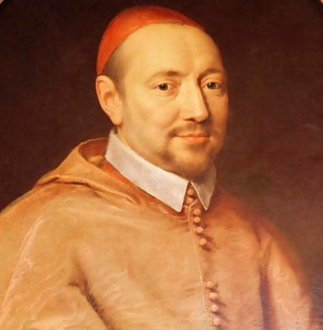
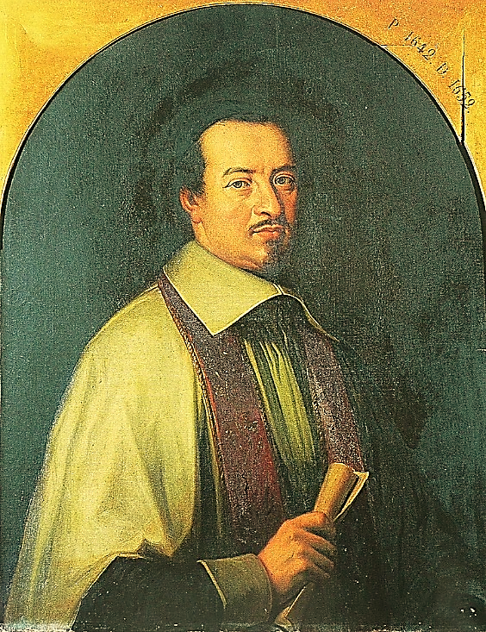
Cardinal Pierre de BÉRULLE
Founder of the Oratory
1575-1629
He ordered to come the first Carmelites
from Spain to France
Jean-Jacques OLIER
(Mr OLIER)
1609-1657
He created the first French seminary, after the celebration of Trent Council.
He founded the Company of the Priests of Saint-Sulpice..

Slide 10
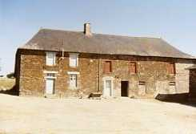
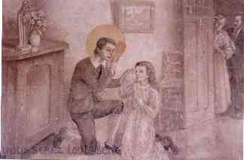
1673-1685
in his family,
in Montfort
and Iffendic
until 12 years
of age

Slide 11
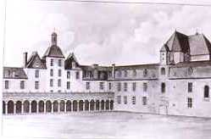
1685 – 1693 ( from 12 to 20 years )
Studies at the Jesuit school
Saint Thomas Becket in Rennes

Slide 12
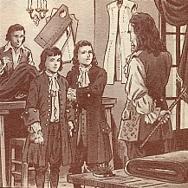
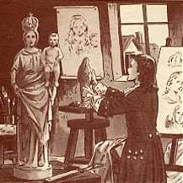
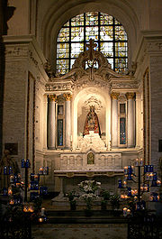
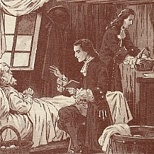
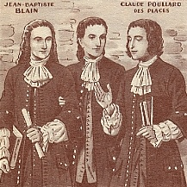
While studying in Rennes, his vocation got strong
Attention to the poor
Studies, arts, friends
Encounter of priests and missionaries
Spiritual accompany
Total trust in Mary

Slide 13
1693 – 1700
(from 20 to 27 years)
Louis Grignion leaves Rennes
to enter
In the seminary of
Saint-Sulpice
in París

Slide 14
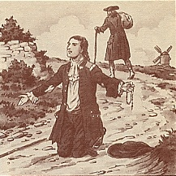
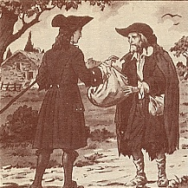
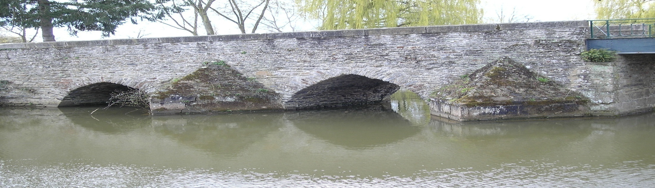
Cesson bridge
He leaves, abandoning his family, to go to Saint Sulpice seminary in Paris. He gives his money and exchanges his suit with that of a poor. At last free!, his total trust placed in God.

Slide 15
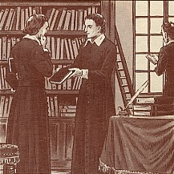
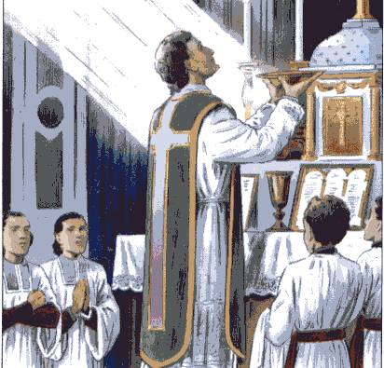
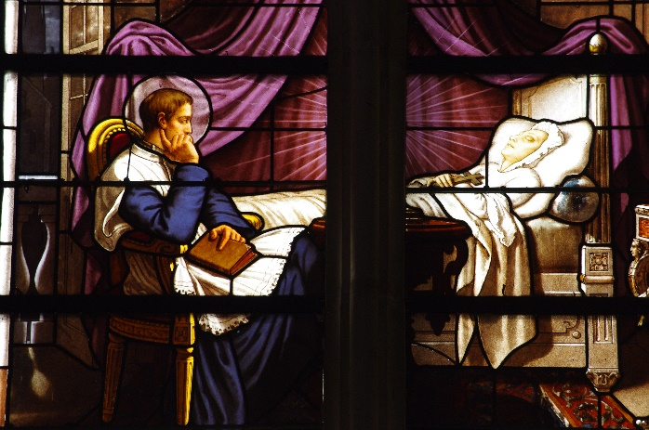
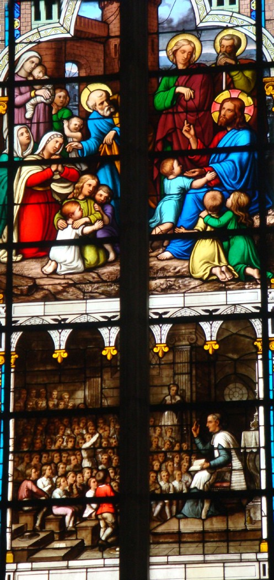
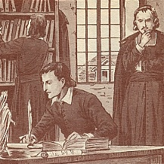

Priestly ordination on June 5th 1700
Studies
Catechism to the children of Saint Sulpice neighborhood

Slide 16

1700 – 1706 (from 27 too 33 years)
First apostolic experiences
Close to the poor (Poitiers…
Parochial missionaries
Misunderstandings, rejections…
1703-1704 street Pot de fer in Paris, moment of spiritual assessment

Slide 17

General Hospital in Poitiers at the service of the poor
The poor: spitting image of Jesus Christ

Slide 18

Summer 1706
Rome,
encounter with
The Pope Clement XI
He confirms his mission in France with the title:
« Apostolic Missionary »
A life at the apostolic way

Slide 19

1706 – 1716
( from 33 to 43 years)
Añpostolic missionary
Missions, retreats…
Various dioceses
in Rennes, Saint Malo, Saint Brieuc, Nantes, Luçon, Saintes
and especially
La Rochelle

Slide 20






Slide 21
On April 28th he dies, at the age of 43 years, during the mission of Saint Laurent-sur-Sèvre
(dioses of La Rochelle)

Slide 22
Some highlights
to get near
Saint L.M. de Montfort

Slide 23





1- A rich and contrasted personality

Slide 24


2- A leader of crowds

Slide 25


3- A man who upsets

Slide 26



4- A man who loves the poor

Slide 27




5- A preacher who touches the hearts

Slide 28


6- A contemplative in action

Slide 29

7- A man at the service of the church, obedient and nonconformist

Slide 30

8- A man of desires

Slide 31

9- A teacher and a spiritual guide

Slide 32



10- A founder
Company of Mary
(Brothers and Priests)
Daughters of Wisdom
Mathurin
Marie Louise Trichet
Fr. Mulot

Slide 33
His powerful Word touches the hearts.
With faith and audacity he launches the call to give life for Christ and humanity.
An ardent missionary, at the apostolic way, passionate in the announcement of Jesus Christ for everybody.
SSS
SAINT LOUIS MARY OF MONFORT

Slide 34

Europa
MONTFORTIAN FAMILY IN THE WORLD
France, Italy, Spain, Portugal, Belgium, Holland, Denmark, England, Ireland, Germany, Poland and Croatia
Asia
North America
Africa
Canadá and
U.S.A.
Senegal,
Guinea C.,
Burkina F.
Cameroon,
Gabon,
R.C.A.,
Congo Brazza,
R.D. of Congo,
Rwanda,
Burundi Tanzania, Malawi, Kenya, Mozambique, Uganda, Zambia, Maurice Island and Madagascar
Burma, India, Malaysia, Singapore, Thailand and Philippines
Antilles Central America and the South
Haiti, Nicaragua, Bolivia, Colombia, Equator, Peru. Argentina and Brazil
Oceania
Indonesia, Papua-N. G., Fidji and Tonga

Slide 35



HEIRS OF A HISTORY, INVENTORS OF A FUTURE
DAUGHTERS OF WISDOM, MONTFORTIAN MISSIONARIES, BROTHERS OF SAINT GABRIEL, NUMEROUS LAY PEOPLE LINKED TO EACH OF THE THREE CONGREGATIONS

