Slide 1
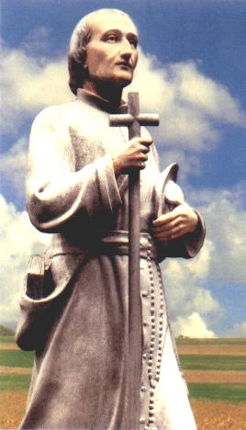
Louis Marie Grignion de Montfort
a man with a passion for
Jesus Christ Incarnate Wisdom

Slide 2
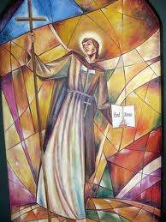
He experienced the encounter with God, in Jesus Christ,
"Eternal Wisdom, Incarnate, Crucified and Glorious"
he consecrated his life as a missionary to make him known.

Slide 3
Personal experience of the Wisdom of God as opposed to
the wisdom of the world
In Nantes (St. Clément),
incomprehension...
opposition...
disappointment...
uncertain future...
(cf. L. 5 of 6 Nov. 1700)

Slide 4
In Poitiers
He locks himself in the hospital with the poor, out of obedience. However, he wrote: "the catechism to the poor of the city and the country is my element" (L. 9, 16 de September 1701).
Opposition …
contempt …
no human support…

Slide 5
In Paris (spring1703),
at the Salpêtrière hospital,
among the poor…
He is soon dismissed by the other chaplains…
Excluded …
Abandoned …
slandered …
expelled from everywhere…
marginalized …

Slide 6
He chooses to take refuge under a staircase,
“in a small hole in a small house”
Street du Pot de Fer (late summer - autumn 1703).
Alone with God.
It is at this painful stage of his life that the writing of ‘The Love of Eternal Wisdom’ (LEW) is situated

Slide 7
1703, Young priest, ordained only three years before, his apostolic dream has been shattered.
He is willing to give up the powerful attraction he feels for the mission. Reduced to nothing. . Ignored by all.
Only God counts for him.
He prays, meditates, contemplates, asks for true Wisdom, who is God himself: Jesus Christ. (cf. L15 ; L 16 of 24 oct.1703).
« Ask and make others ask for divine Wisdom for me, who in Jesus and Mary I am your brother »
(L.17, 1703, to sister religious Guyonne-Jeanne)
He experienced the opposition between the wisdom of the world and the WISDOM OF GOD.

Slide 8
It was not until 1706 that he definitively found his way as an ‘apostolic missionary’,
after meeting Pope Clement XI in Rome.
From then on his life would be completely boosted by
« missionary wisdom…
Always having something new to undertake in the manner of the Apostles »

Slide 9
2. « The Love of Eternal Wisdom » (LEW)
(One of Father de Montfort's early writings).
* The love of Eternal Wisdom for man
* The love of man for Eternal Wisdom

Slide 10
His language expresses a mystical experience;
an experience that confronts the deepest part of our being with ‘Someone’.
It is a moving encounter with the ‘Absolute’.
At the same time
it is a painful experience of a purifying and transforming nature and an experience of deep joy that of knowing Someone who fills us totally.

Slide 11
Knowing and loving Jesus Christ,
the unique and wonderful Wisdom,
leads to wanting to make him known and loved by many.
This is the purpose of the missions that he will give until the end of his life.

Slide 12
Two essential meanings of the word ‘Wisdom’
(among the various meanings Louis Marie gives to this word: cf. LEW 13)
Wisdom as ‘Someone’, i.e. Jesus Christ.
Wisdom as ‘gift’, That is to say, the communication of Christ to men.

Slide 13
3. Jesus Christ, Wisdom, according to Montfort
By attributing to Christ this title of Wisdom,
Louis Marie highlights four aspects of his Mystery,
in harmony with biblical Revelation.
He does so in the perspective of the gift that Wisdom makes of herself to us in a (mystical) experience
of loving and savoury knowledge,
of communion,
of transformation,
of divinization…

Slide 14
3.1. Cristo como ‘plenitud’
‘quien encierra en sí mismo toda la plenitud de la divinidad (Col. 1, 16)
Y la humanidad’… ;
‘resumen de las obras de Dios… preciosa perla
« para cuya adquisición se está dispuesto a sacrificarlo todo » (ASE 9) ;
« una sola cosa, en todas las cosas, que nos debe bastar» (VD 61).
El tema de Cristo
‘tesoro infinito para los hombres’
es subrayado fuertemente
por Luis María (cf. ASE 61, 63).

Slide 15
3.2. Christ as Revealing and Transforming Word.
Louis Marie identifies Wisdom with Christ in his permanent role of revealing the Father.

Slide 16
3.3. . Christ as the 'Love'
of the Father and of the Holy Spirit (LEW 118),
descending to man
in a divine logic of humiliation and poverty,
which contrasts with human perspectives.
In Jesus
the Word and the bread
are transforming foods.
« She - Wisdom –
is therefore all love,
or rather the very love of the Father
and the Holy Spirit » (LEW 118)

Slide 17
3.4. Christ Wisdom
in relation
to the Mystery of the Cross.
Louis Marie sees such a close link between Wisdom and the Cross
that he comes to identify them with each other :
‘True Wisdom …
He has been so incorporated into and united to the Cross ,
that it can be said with certainty that Wisdom is the Cross
and the Cross es la Sabiduría’ (LEW180).

Slide 18
4. The Christian Life as Wisdom
4.1 Fundamental Choice.
The movement of Wisdom (Jesus Christ) towards man requires the free but necessary movement of man towards Wisdom..
A continuous search (LEW 30, 63, 72-73)
to desire Wisdom in response to one's own desire ;
a growing intimacy.
‘Wisdom is for man and man is for Wisdom (LEW 64).

Slide 19
4.2 Breaking with the vain and false wisdom of the world.
An indispensable prerequisite for Christ, true Wisdom, to come and dwell in us with his gifts.

Slide 20
4.3. Transformation of man by
la Sabiduría que comunica sus dones…
‘When the divine Wisdom , she brings with her all kinds
of goods and communicates to it countless riches' (LEW 90) :

Slide 21
Knowledge : a vital and active knowledge (LEW 93),
the sense of discernment (LEW 92),
The experience of a joyful communion : the friendship of Christ, peace (LEW 9)
a purification : the cross is inseparable from Wisdom, it is a rough and smooth road (LEW 100, 103)
the transformation of internal dynamism :
one acts in a new way (LEW 99)
apostolic activity (LEW 100),
the capacity to transmit : the gift of the word (LEW 96),
the action of the Spirit (LEW 97)

Slide 22
5. The paths to w
(LEW cap. XV – XVII n° 181-227)
Louis Marie proposes and presents four means
(fruit of his experience)
to realise the encounter with Wisdom.
These four means are logically articulated :
Desire
Prayer
Renouncement

Slide 23
4. A tender and true devotion to the Blessed Virgin Mary
‘It is the greatest of all means
and the most wonderful of all secrets
to acquire and preserve divine Wisdom…’ (LEW 203)

Slide 24
These four means
are first and foremost gifts from God,
even if they require
the decisive cooperation of man.
‘I give myself entirely to Jesus Christ, through the hands of Mary, to carry my Cross in his footsteps all the days of my life.
This is the basis of the ‘Baptismal Covenant Contract’
that Louis Marie had Christians renew at the end of their parish missions.

Slide 25
6. Becoming Wisdom to others: the mission
The welcome of Wisdom that is given to man out of love and,
in return, the total gift of man to Wisdom, out of love, necessarily leads to a missionary openness.

Slide 26
Wisdom
not only gives man
his light to know the truth,
but also ...
a wonderful capacity
to make her known to others (LEW 95 and 97).
... She makes them completely inflamed;
she inspires them to great undertakings
for the glory of God and the salvation of souls ...' (LEW 100).

Slide 27
7. By way of conclusion

Slide 28
‘God has His Wisdom,
and it is the only true Wisdom worthy
of being loved and sought after as
a great treasure’ (LEW 74).
This wisdom has been manifested to us in Jesus Christ, Incarnate Wisdom.
She is goodness, mercy, beauty, sweetness, fullness, the Word, Love…
The way of the Cross, the way of happiness.

Slide 29
She wants to give herself,
she surrenders,
communicates,
seeks the friendship of the man
she wants
to reach to make him happy
and live in friendship with him.
She seeks,
runs,
shouts :
Listen! Come to me!

Slide 30
It is up to man to desire her,
to ask for her, to seek her
and to seek her again,
to find her, to obtain her,
to acquire her, to possess her,
and above all to know her, to listen to her,
to love her, to preserve her...
and to make her known and loved
by many others...

Slide 31
That is why it is necessary :
to prefer no one but Her,
to leave everything, to be determined,
full of ardour and constancy,
to be ready to suffer everything
and to do everything for Her.

Slide 32
« To know Jesus Christ, Incarnate Wisdom, is to know enough.
To know everything and not to know Him ,
is to know nothing » (LEW 11).

Slide 33
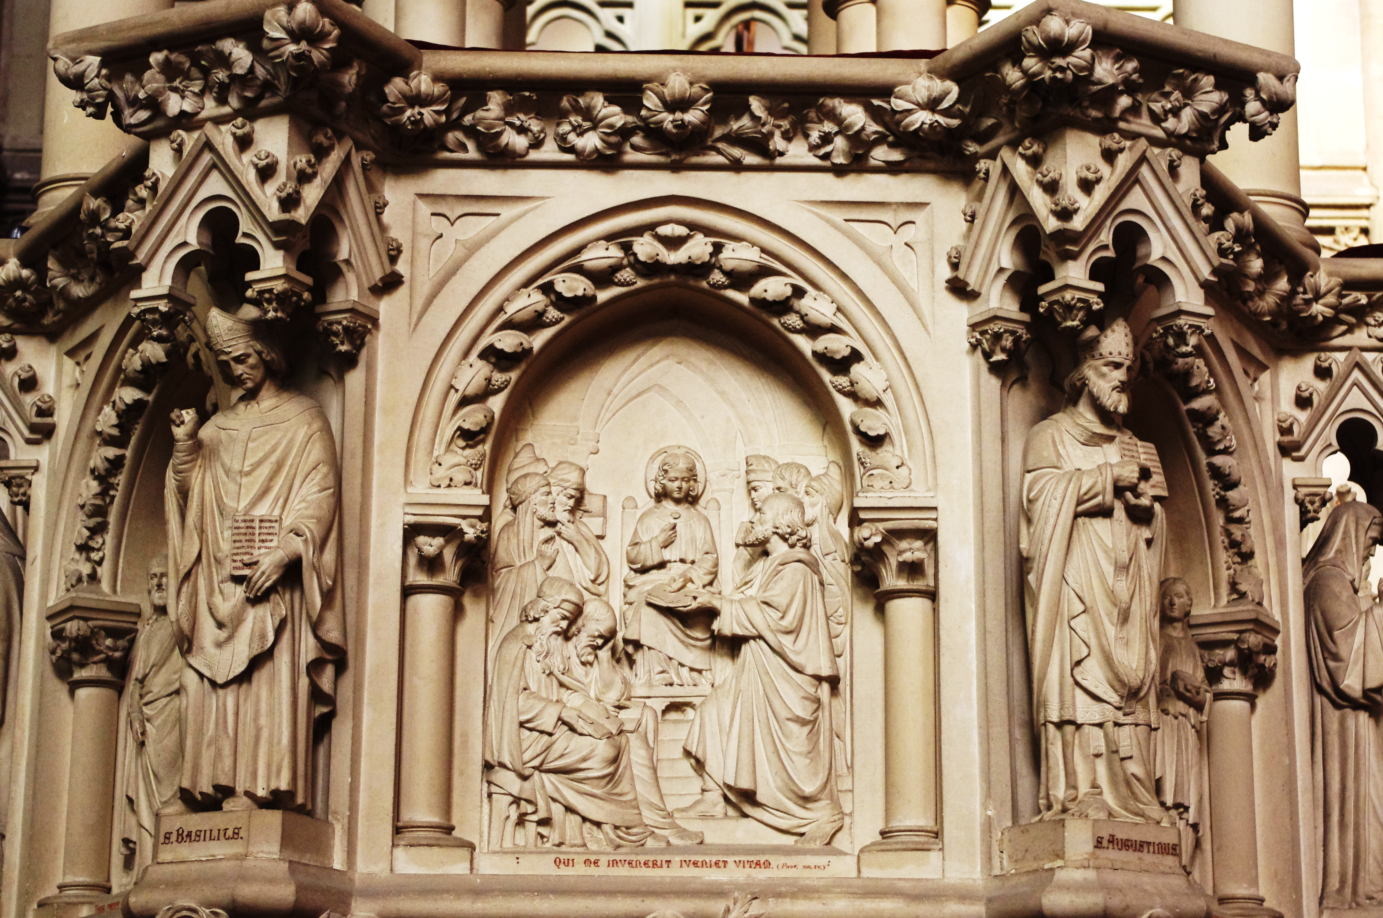
The Child Jesus among the Doctors of the Law in the Temple of Jerusalem
(Lk 2: 41-50)
Pulpit of the great chapel of the Daughters of Wisdom
Saint Laurent-sur-Sèvre

Slide 34
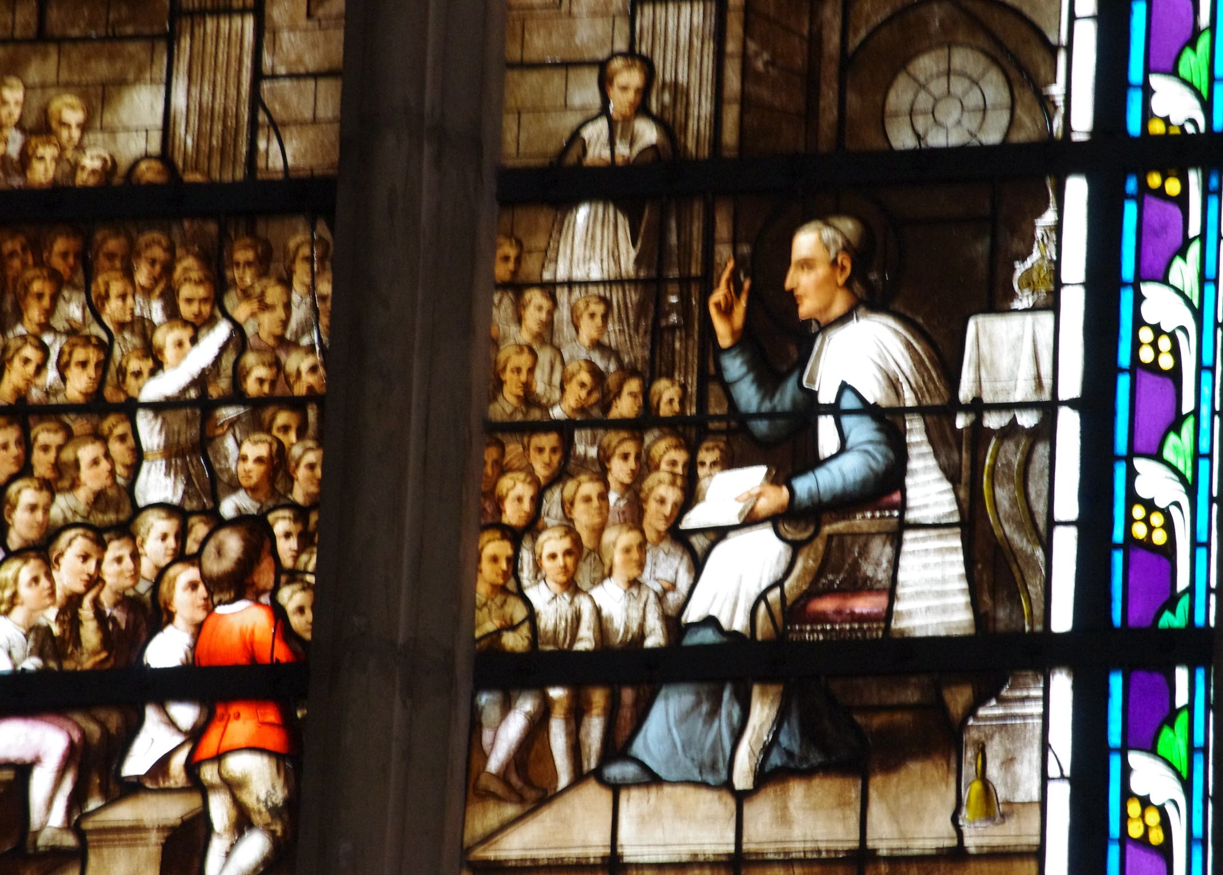
The gift of Wisdom,
the gift of touching hearts …
Stained glass windows, large chapel of the Daughters of Wisdom. Mr. Grignion, seminarian, teaching catechism in the crypt of the church of Saint Sulpice in Paris.

Slide 35
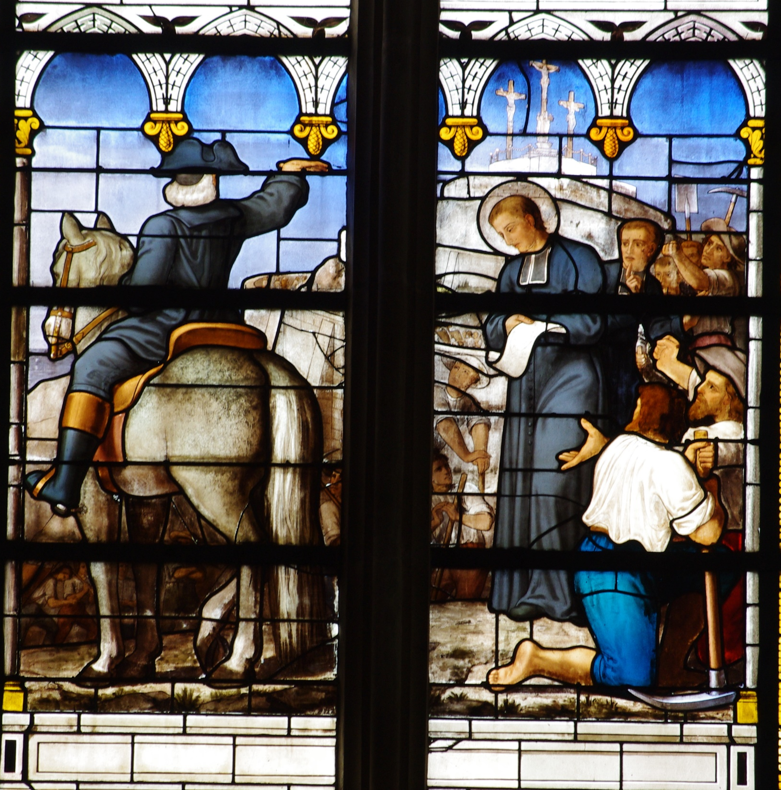
Wisdom is the Cross,
the Cross is Wisdom
Episode of Pontchâteau
Stained glass window of the great chapel of the Daughters of Wisdom Saint Laurent - south - Sèvre

