Slide 1
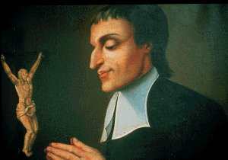
The Mystery of the Cross in the Spiritual Experience of St. Louis Marie Grignion de Montfort

Slide 2
Saint L.M. de Montfort and the Cross in the Context of the 17th Century

Slide 3
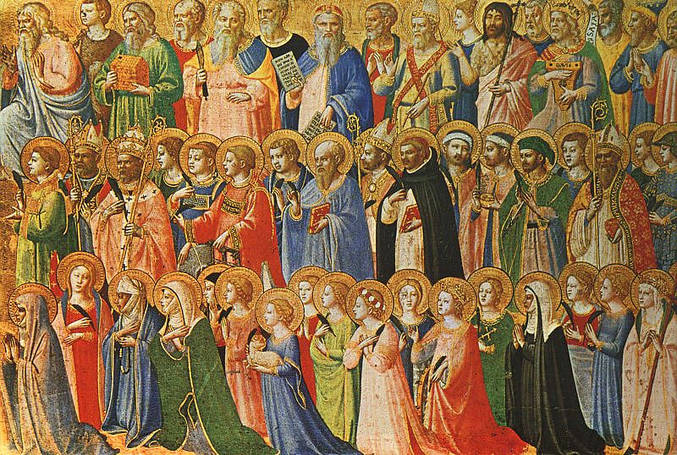
The spiritual physiognomy of a saint is shaped first and foremost by his/her fidelity to the Gospel and to the initiatives of the Holy Spirit...
But it is also marked by the tradition of the Church...
and by the currents of time and the environment in which he/she moves.

Slide 4
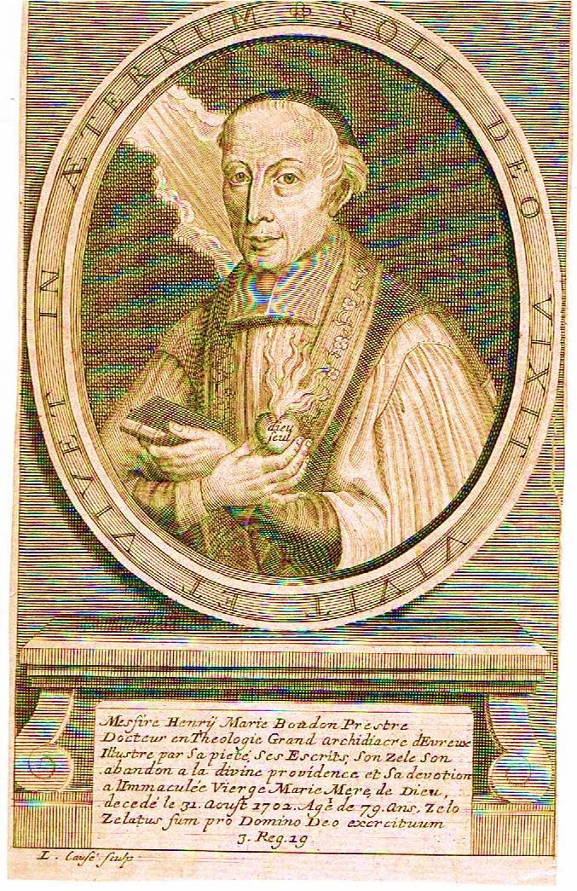
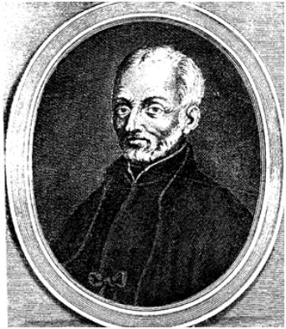
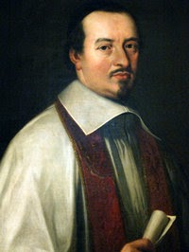
His References regarding the Mystery of the Cross
Henri Boudon: The Holy Ways of the Cross
Joseph Surin: Spiritual Letters
M. Olier (Founder of the Seminary of Saint Sulpice in Paris)
and the Sulpician contexto where it was formed for eight years.
Henri Boudon
Joseph Surin s.j.
Jean-Jacques Olier

Slide 5
THE CROSS IN MONTFORT'S LIFE

Slide 6
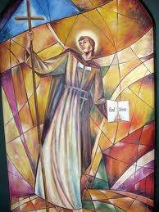
1. His tests
1700 : during his six-month stay in Saint Clément de Nantes after leaving the seminary, he suffered from inaction.
1703 : experience in the Rue du Pot-de-Fer in Paris
1706 : Rejection in Poitiers, trip to Rome, meeting with Pope Clement XI.
On his return from Rome as an apostolic missionary, he will have the cross as his companion in life until deat.

Slide 7
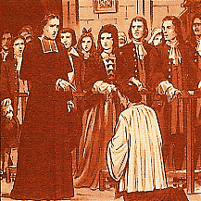
His preaching bothers and makes him enemies. The detractors call him "adventurer“, ... while the humble see in him the "good Father of Montfort".
They will try to take his life (La Rochelle...). Several times he was forbidden or rejected in seven dioceses because of unjust reports or his untimely zeal, although he always wanted to be faithful to the directives of the Bishops.

Slide 8
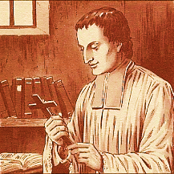
Testimony in the letter to his sister Guyonne Jeanne dated in 1713:
« If you knew my crosses and humiliations in detail, I doubt that you would wish so much to see me»
This letter, like the ones that will follow, has as epigraph:"Long live Jesus, long live his Cross".

Slide 9
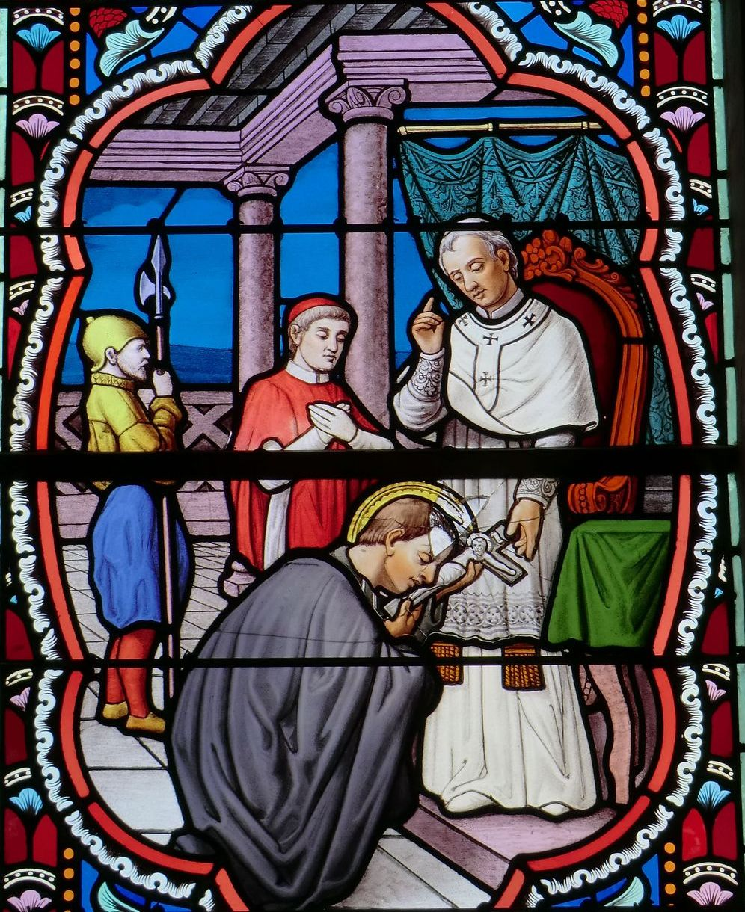
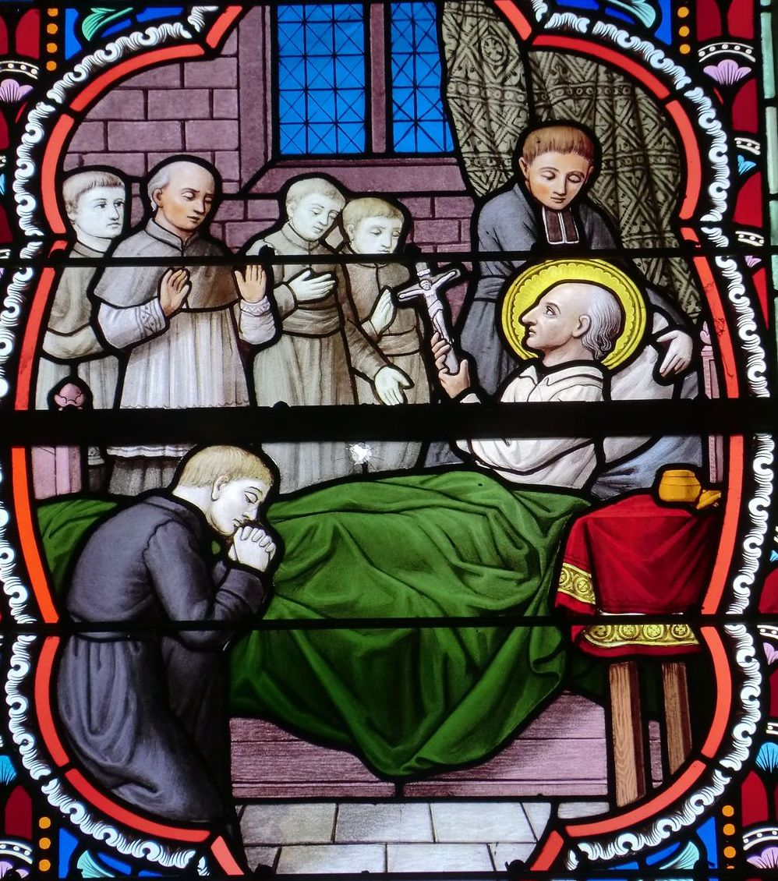
2. The Crucifix, the Calvaries
Montfort as a student "always carried a crucifix and a picture of the Blessed Virgin in relief
Montfort as a student "always carried a crucifix and a picture of the Blessed Virgin in relief
to his ivory crucifix
a plenary indulgence...
He held it in his right hand during his last hours and thus blessed his last visitors.

Slide 10
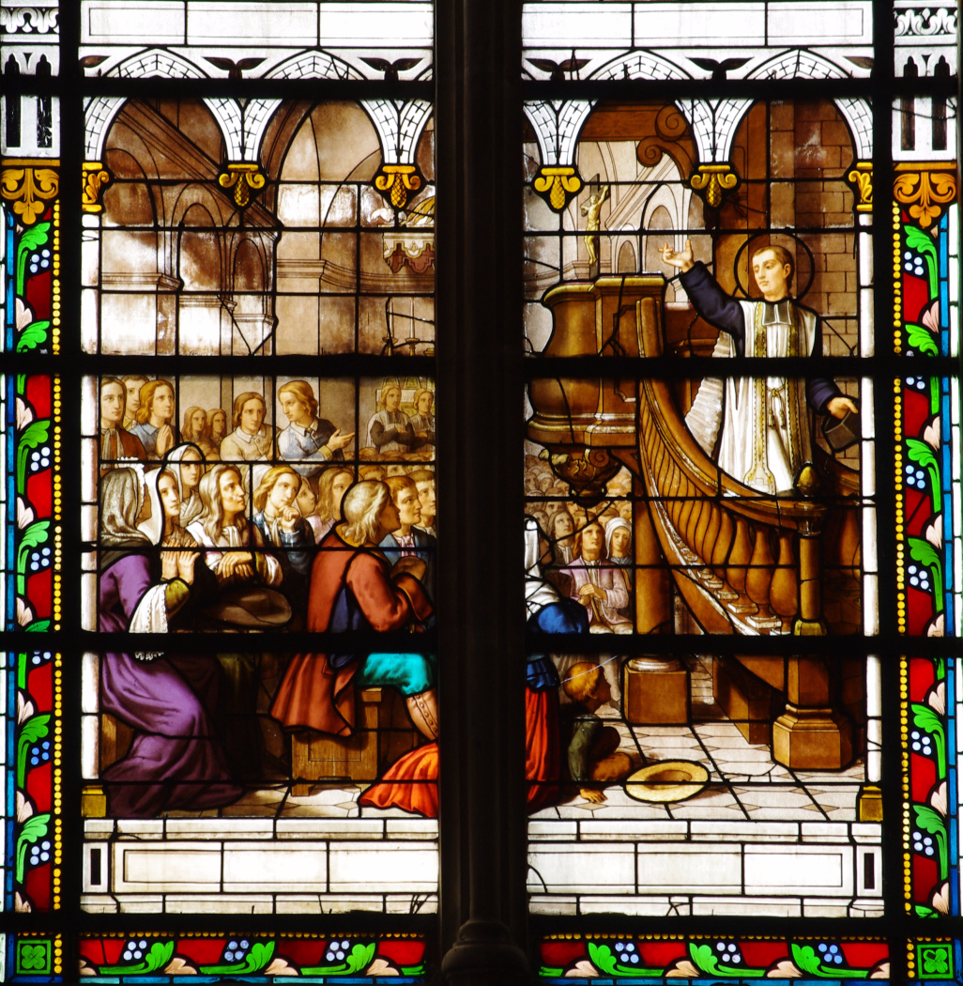

Slide 11
In Montfort-la-Cane, in 1707, instead of preaching, he takes out his crucifix from Rome, looks at it carefully and bursts into tears; he comes down from the pulpit without saying a word, and invites everyone to kiss it one by one. Everyone is moved and regrets it. The goal has been achieved.

Slide 12
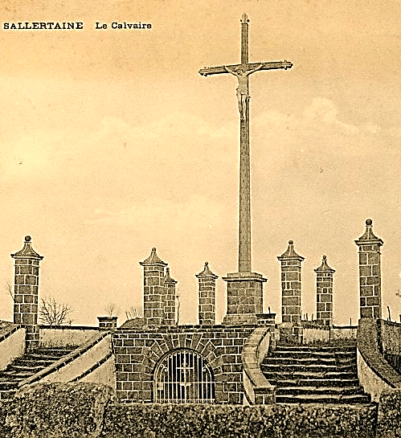
During his missions, he distributed small cloth crosses to participants.
But, one of the highlights of the mission was the blessing of a Calvary.

Slide 13
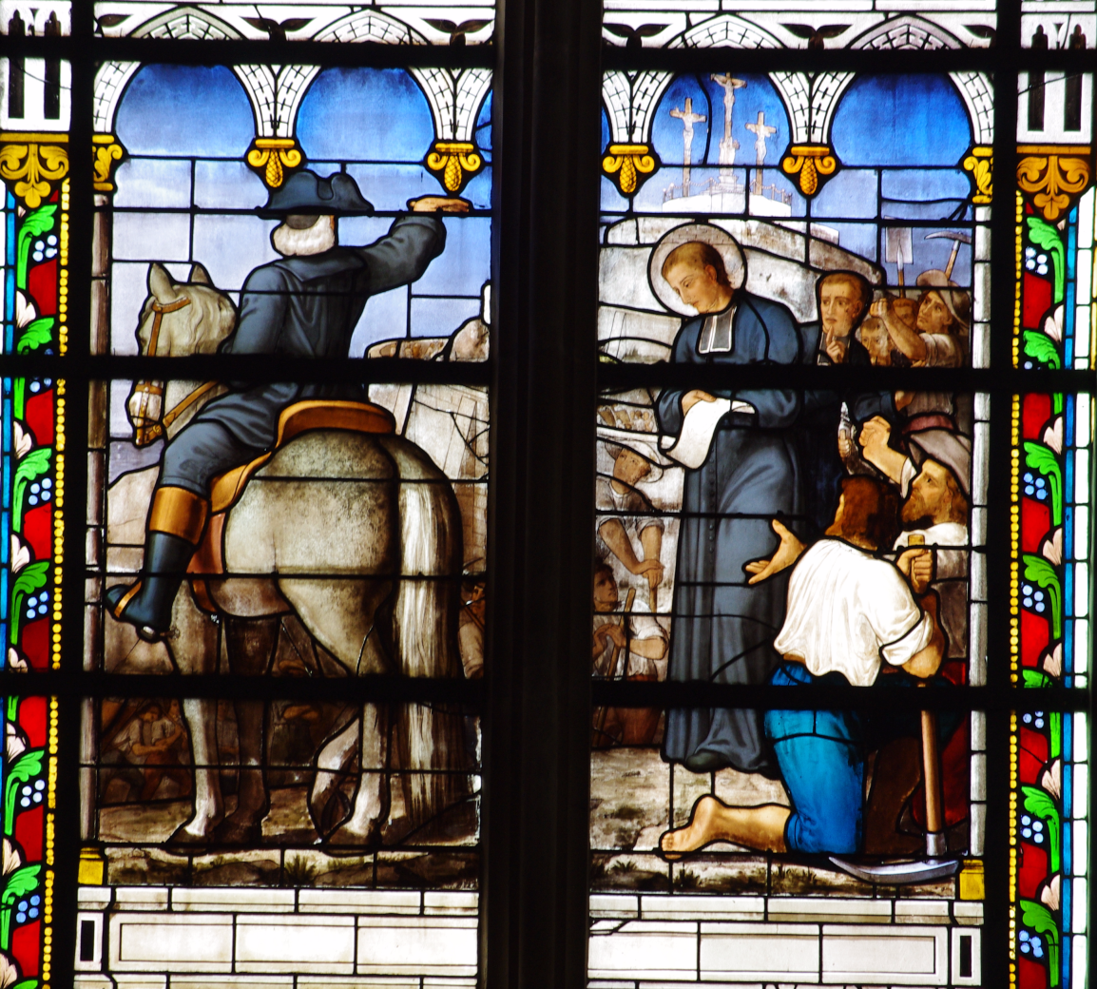
Calvary
of
Pontchâteau
(1708-1710)

Slide 14
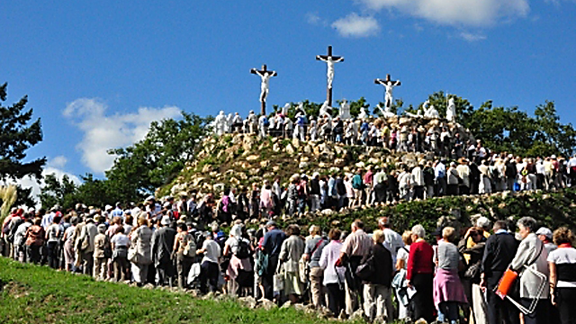

Slide 15
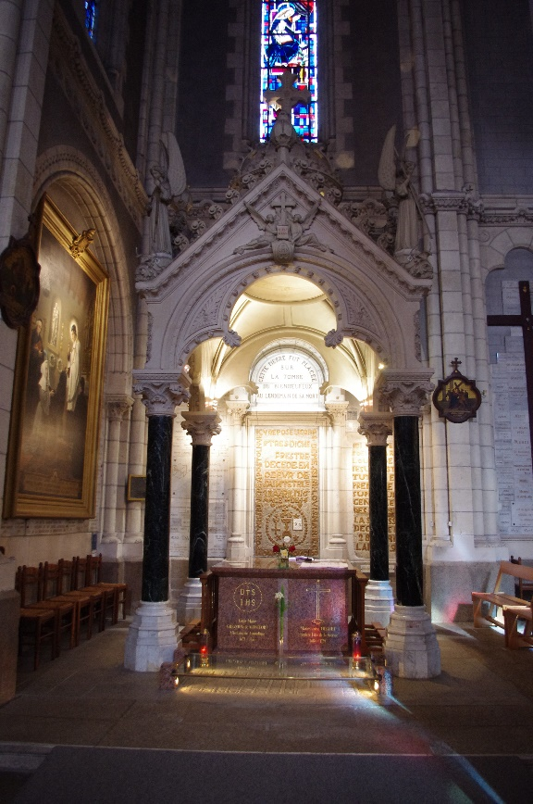
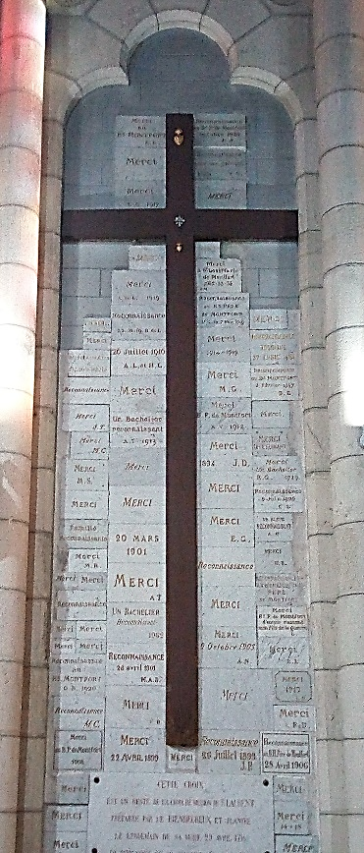
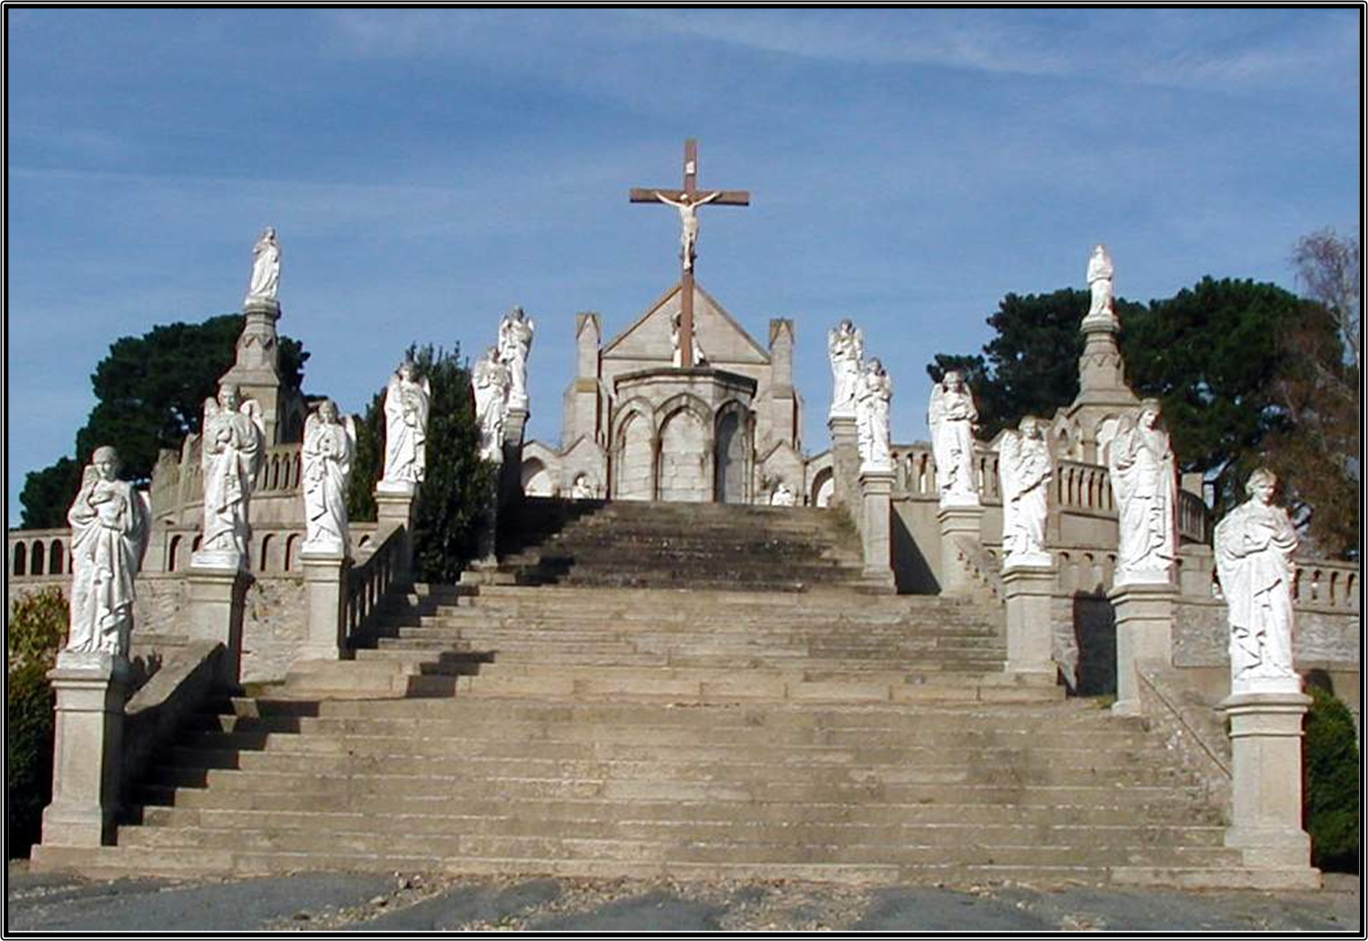
April 1716
in Saint Laurent-sur-Sèvre,
The Calvary of his last mission will be erected the day after his death, a few hours before he is buried.

Slide 16
3. How Montfort carries his cross

Slide 17
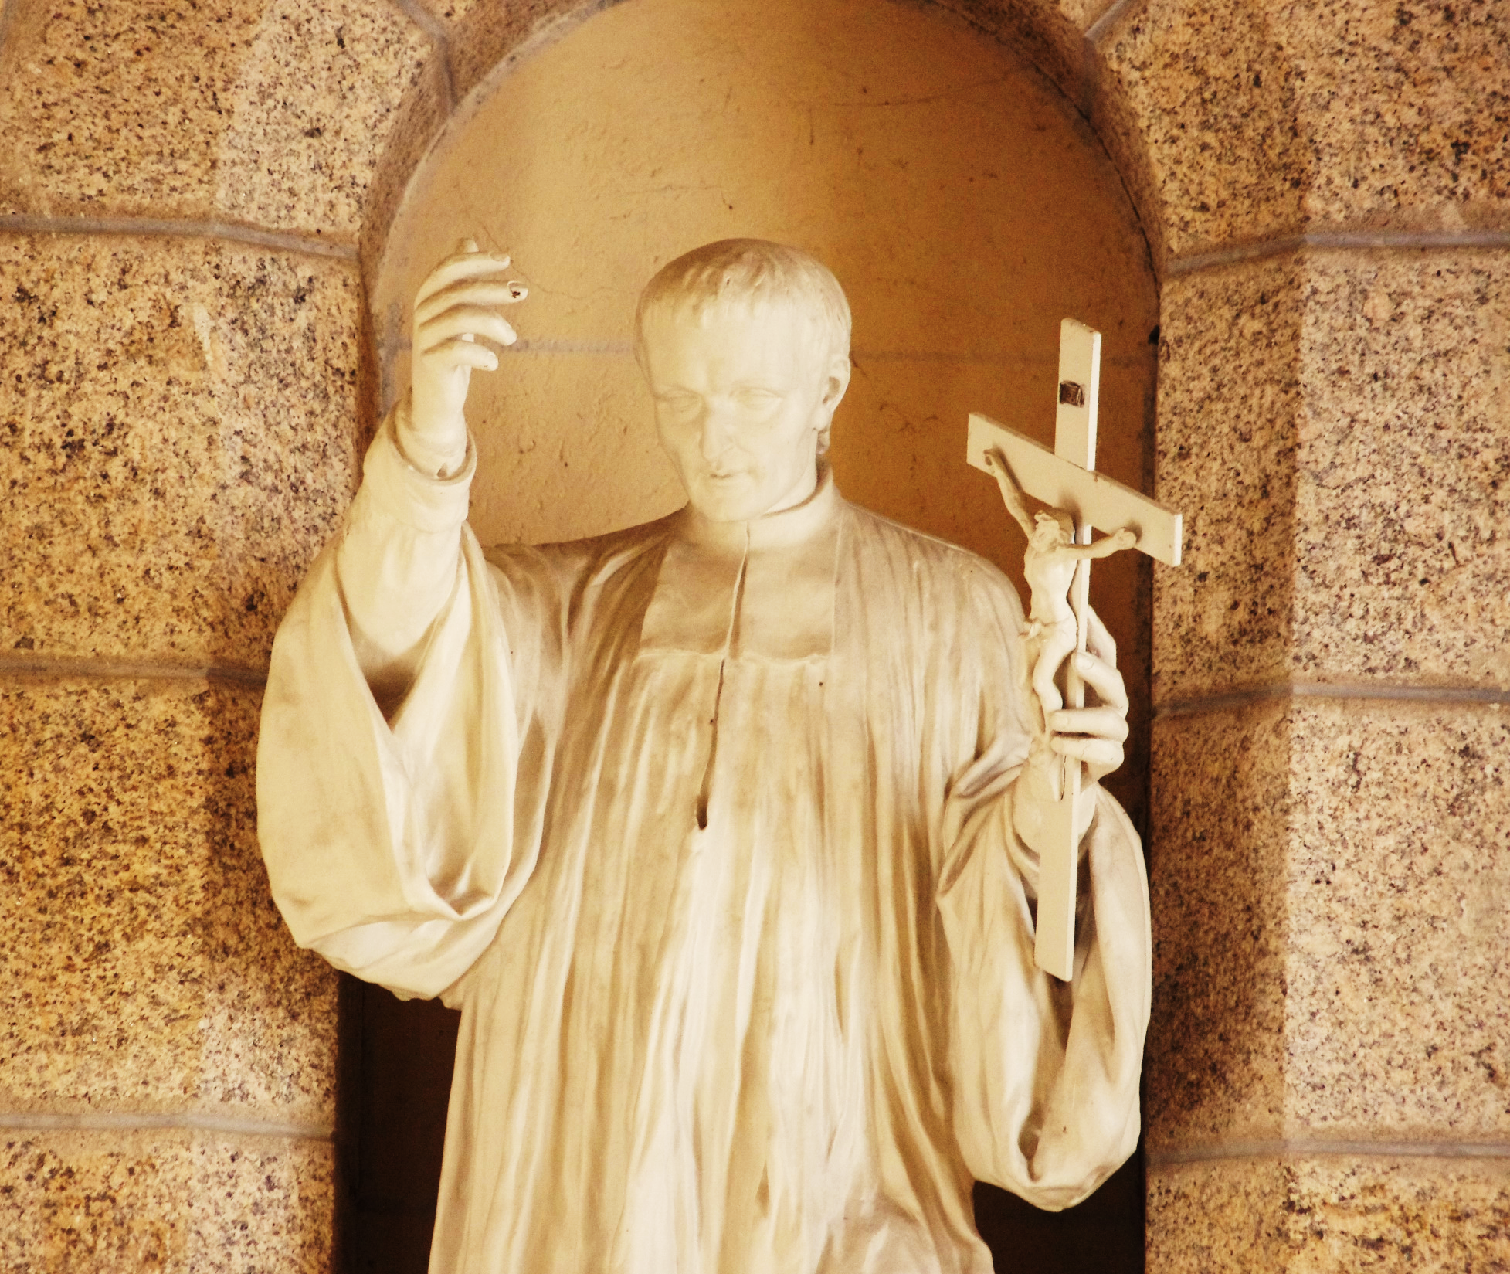
The event at the Calvary of Pontchâteau and the following weeks give us a first-hand understanding of how Montfort is facing the test.

Slide 18
III. FATHER OF MONTFORT'S
DOCTRINE ABOUT THE CROSS

Slide 19
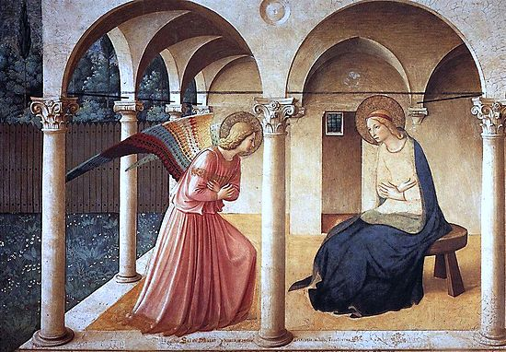
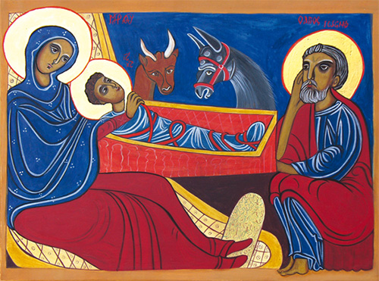
The Cross in the Life of Christ.
The Redeeming Incartantion:
“The first mystery of Jesus Christ, [...] un a compendium of all the mysteries, containing the will and grace of all of them" (TD 248),
makes all the others possible.
In choosing the incarnation, to share our human condition, Christ chose a state of suffering, he voluntarily established himself in a state of cross.

Slide 20
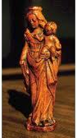
b) Christ lying on the cross
In LEW Montfort thus shows us that Jesus, the Incarnate Wisdom, chose the cross from his incarnation to his real death on the cross (cf. LEW 169, 170).

Slide 21
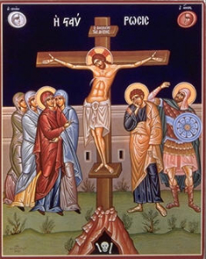
c) Mystery of love and wisdom
Phil 2, 6-8 «Jesus, though he was of the divine nature, did not jealously retain the rank that made him equal with God. But he renounced his own, and took upon himself the form of a servant, being made like unto men. When he appeared as a man, he humbled himself and became obedient until his death, and a death on a cross… ».

Slide 22
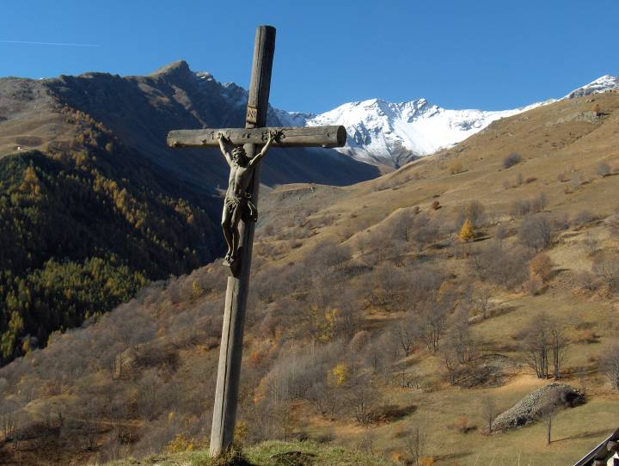
If God chose the cross, then it is no longer foolishness, ignominy or scandal, it becomes supreme wisdom, condemning the narrow-minded human wisdom, the earthly wisdom of which James speaks, that of the goods of the earth (LEW 80), the carnal wisdom (Cf. LEW 80, 81, 82). This is the abridged version of Montfort's reasoning.

Slide 23
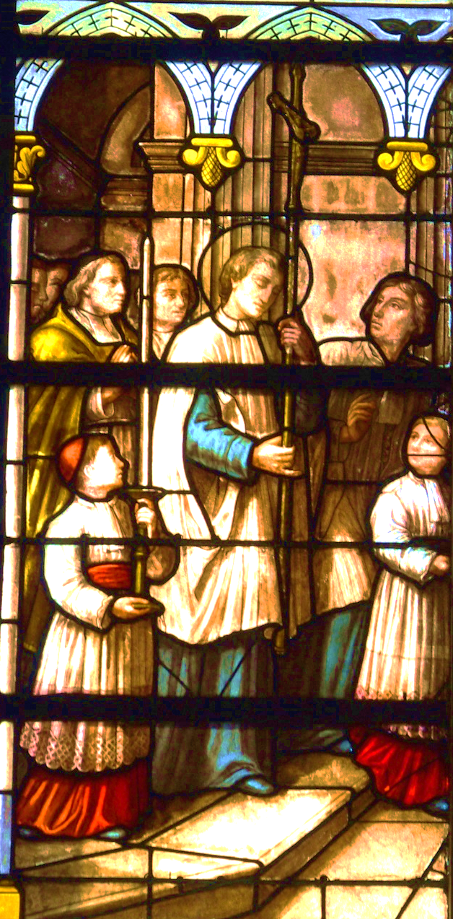
d) Mystery of suffering and glory
Like the authors of his time, Montfort celebrates "the triumph of Eternal Wisdom on and through the Cross" (LEW chap. XV).
The canticle 19 summarizes the triumph of the Cross. Montfort considers the Cross of Christ as a trophy of victory, worthy of adoration (LEW 172).

Slide 24
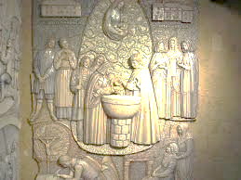
2. The cross in the life of the Christian
Baptism and its requirements
Don't you know? All of us who have been united to Jesus Christ through baptism have been united to his death through baptism. If, then, by the baptism which binds us to his death, we have been buried with him, it is so that we too may lead a new life, like Christ who, by the almighty power of the Father, rose from the dead. (Rom 6:3-4)

Slide 25
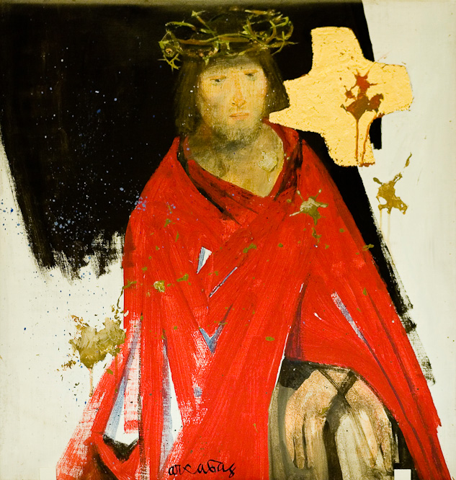
"Wherever we go, we carry in our body the death of Christ so that his life may also be shown in us" (2 Cor 4:10).

Slide 26
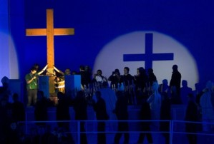
Montfort does not ignore this Pauline doctrine of baptism, but he will shift the focus to the mystery of the incarnation.
"God the Son wants to be formed and, so to speak, incarnated every day, in his members" (TD 31).
We are not our own, but Christ's (1 Cor 6:19), "we are wholly his, like his members" (TD 68) and as such, associated in a special way with his cross.

Slide 27
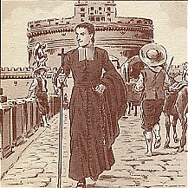
At the end, the baptized is crucified with Christ. The promises of baptism are a decision to follow Christ even in his suffering:
"Me entrego completamente
a Jesús, para llevar mi cruz
en su seguimiento".

Slide 28
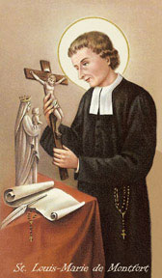
b) Perfect Consecration to Mary and the Cross
The perfect consecration to Jesus Christ through the hands of Mary is "a perfect renewal of the vows and promises of the holy baptism" (TD 120), the one who agrees to carry his cross, following Christ "all the days of his life".

Slide 29
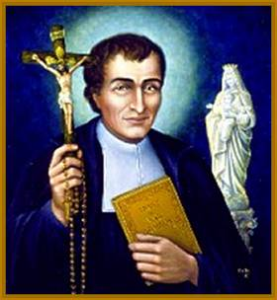
According to Montfort, those who have encountered Mary through true devotion suffer more than anyone else from crosses and suffering,
"because Mary, being the mother of the living, gives to all her children pieces of the Tree of Life which is the cross of Jesus" (SM 22).

Slide 30
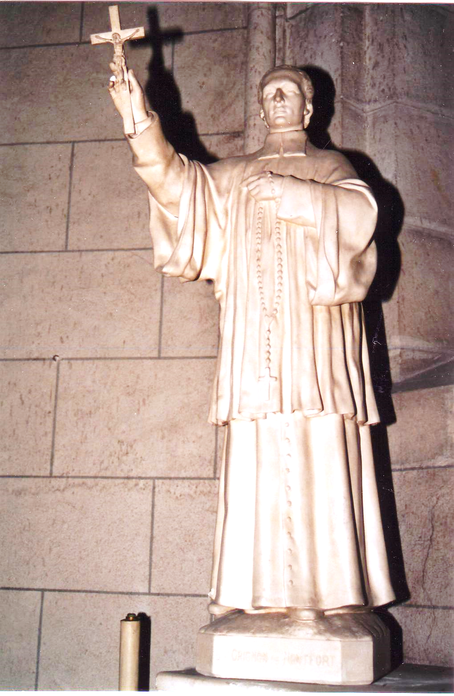
The Cross, the Way of Wisdom
The cross is "less an object of contemplation and an outpouring of sensitivity than a mystery to be unravelled and lived“
It is not enough to proclaim that the Wisdom is the Cross and that the Cross is the Wisdom. One must put oneself in the school of the Master:
"Only Jesus Christ can teach you and make you taste this mystery by his victorious grace" (LAC 26).

Slide 31
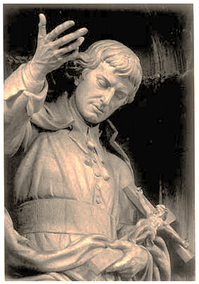
It is therefore necessary to "ask for the Wisdom of the Cross, which is a tasty and experimental science of truth."
It makes the missionary's word fruitful.
"I have never made more conversions than after the bloodiest and most unjust prohibitions" (L. 26).

Slide 32
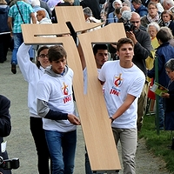
d) The cross, a sign of love.
"I say with certainty, because the best sign that one is loved by God is when one is hated by the world and assaulted by the crosses." (L.13).
Montfort insists on the tact and delicacy of God
in the distribution of crosses
"in proportion to our weakness" (LEW 103).
Each one receives "his cross and not someone else's".

Slide 33
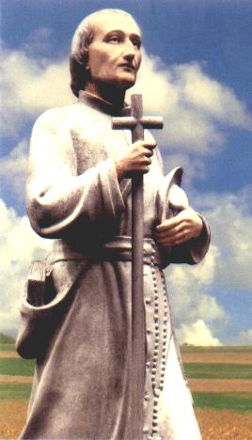
e) The cross, a sign of love
. Progressively, Christ associates the Christian with his own cross in many ways: pain, sickness, spiritual sorrows, ...
Progressively, Christ associates the Christian with his own cross in many ways: pain, sickness, spiritual sorrows, ...

Slide 34
3. In understanding (and Living) Montfort's teachings

Slide 35
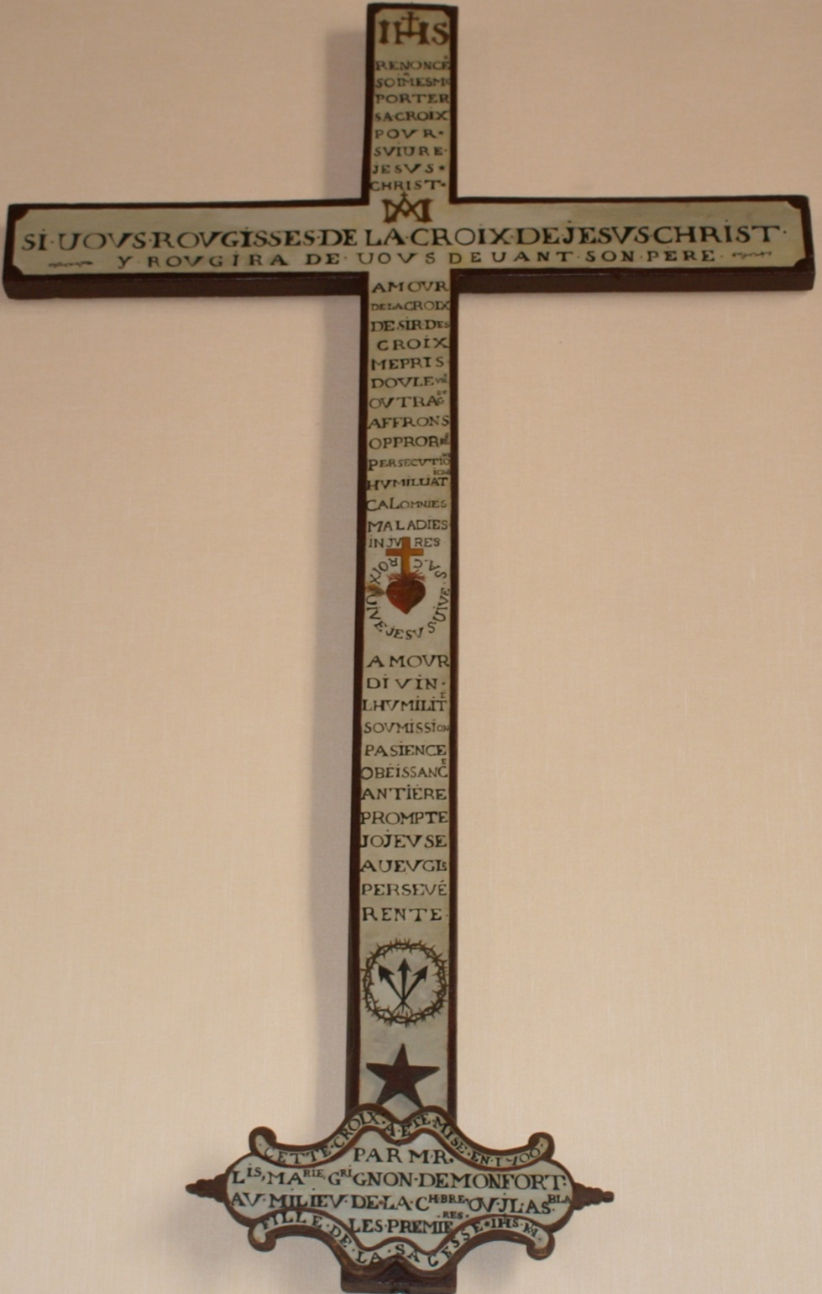
) Christian logic
What feelings encouraged "Montfort the Founder", a few months before his death, when he wished his community of the Daughters of Wisdom "a year full of struggles and victories, of crosses and poverty and contempt" (L.32)?
At first glance, Montfort's behavior and his teaching regarding the cross seem out of the ordinary

Slide 36
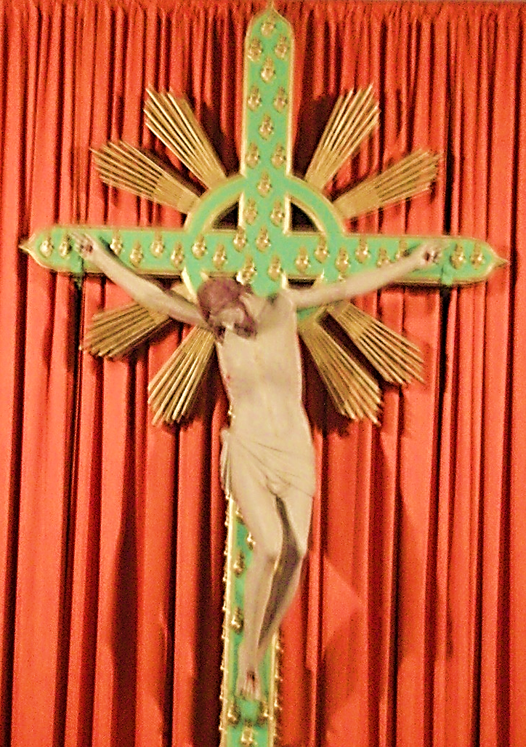
Without denying a certain contempt for human nature, his deepest motivations lie elsewhere.
"God alone", Jesus Christ Wisdom incarnate and crucified, his Gospel, are his only references. Through spiritual intuition and grace, he understood that God himself, in order to save man, chose the path of suffering and Calvary.

Slide 37
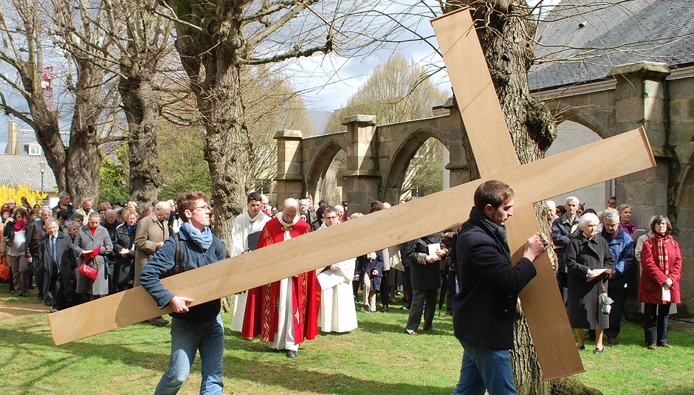
As a baptized person and a missionary, he must borrow the same path. Walking in the footsteps of Jesus Christ requires choosing a way of life that is the opposite of that of the world. The struggle against worldly wisdom generates difficulties that are the source of life and a guarantee of fertility. [...]
Montfort invites all the "friends" of Jesus Christ to understand the need of the cross and to committing themselves to it without compromise.

Slide 38
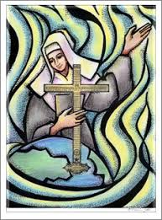
b) Wisdom or Madness?
Certain statements or abbreviated formulas in Montfort's language can give rise to false interpretations of his spiritual doctrine, especially when he speaks of the cross.
Example in LEW chapter XIV: "Wisdom takes her pleasure in it, appreciates it among all that is great and bright in heaven and on earth. (LEW 168).

Slide 39
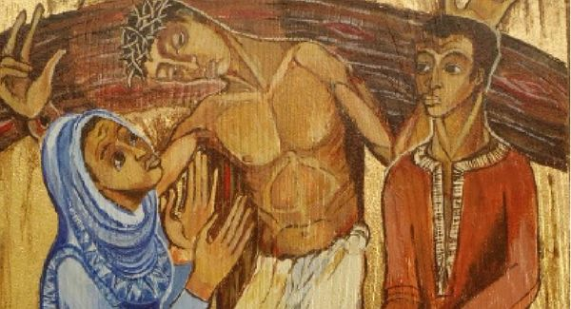
Taking these abrupt expressions as they are, or taking them out of context, would lead to seeing God as a perverse being who delights in human suffering. They are partially illuminated when we see in them the extreme manifestation of God's love and friendship for man.
"There is a bond of friendship so great between Eternal Wisdom and man that it is incomprehensible... ». It was because of "the excess of love she had for him" that she "gave herself up to death to save him" (cf. his reference to Rom. 5:8-9 in LEW 156 "Jesus Christ showed the love he has for us by dying for us, etc.").

Slide 40
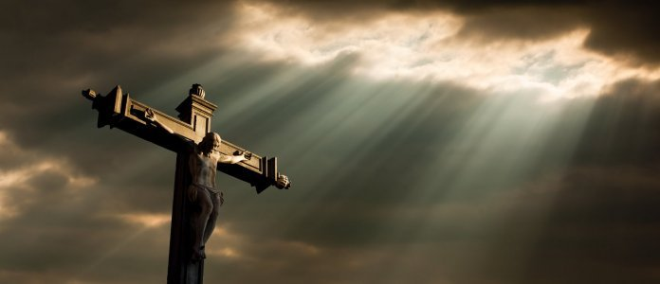
But the mystery of the cross, as of all suffering, does not cease, however. It gets darker and darker when it is God who makes the decision..

Slide 41
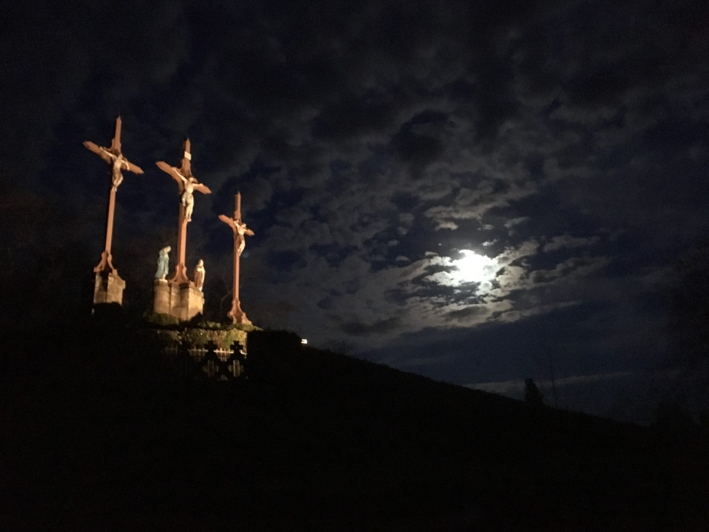
God never wants evil and suffering since he made man to be happy. But, apparently powerless in the face of evil, he wanted to be in solidarity with men in their suffering. This extreme solidarity opens a breach, allowing "hope against hope" (Rom 4:18).

Slide 42
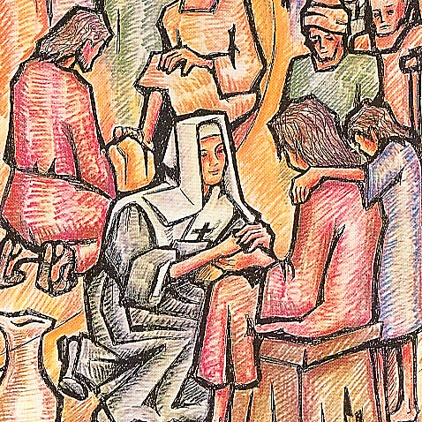
On the cross, God became credible, in his apparent helplessness, becoming man's good Samaritan in his misery, taking on all suffering (Isa 53:4; cf. Isa 53:3.10).
From now on nothing can separate man from the love of God thus manifested in Jesus crucified.

Slide 43
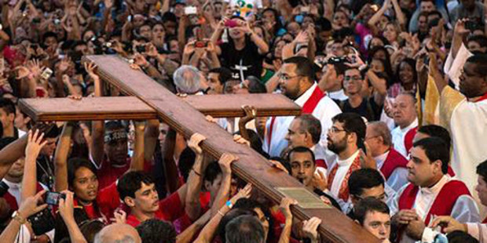
"God did not spare his own Son, but gave him up for us... "(Rm 8, 32-39). [...]
"It is through Christ and in Christ that the enigma of suffering and death which, out of his Gospel, overwhelms us" (Vatican Council II, GS 22).
Jesus Christ proposes his disciples a new way of life, a wisdom according God…

Slide 44
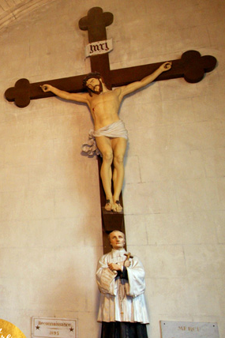
Crazy for Christ
(1 Co 5,10).
Like Francis of Assisi, Ignatius of Loyola, John of the Cross, Teresa of Avila, Teresa of Jesus... like so many others, Montfort's choice is unequivocal.
To suffer and be despised for Christ, to value only the cross, to ask God for it urgently (Cf. LEW 177), to live it day by day.

Slide 45
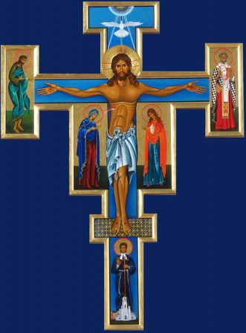
Montfort certainly lived what St. Paul writes to the Galatians:
"I live, but it is no longer I, but Christ who lives in me" (Gal 2:20).
The saints understand the cross. Following God the Man, they welcome the daily cross as their most precious possession. They love it throughout their lives... The cross is the indispensable instrument by which the divine penetrates the human being".

Slide 46
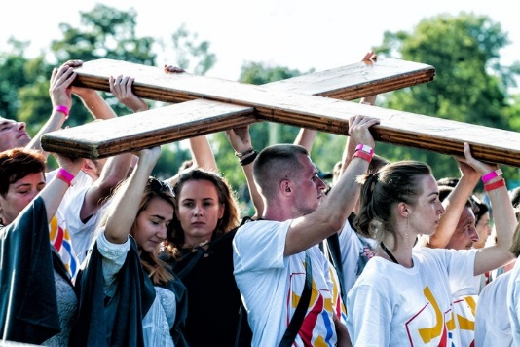
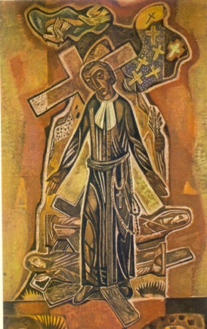
Conclusion
All members of the Church are called to holiness (1 Thessalonians 4:3; cf. Ephesians 1:4), in different forms of life and in different professions.
Under the guidance of the Spirit and in obedience to the Father, all walk in the footsteps of the poor, humble, cross-bearing Christ to deserve to share in his glory (cf. LG 39:41).
The more room Christ crucified has in their hearts and lives, the more his holiness is manifested.

Slide 47
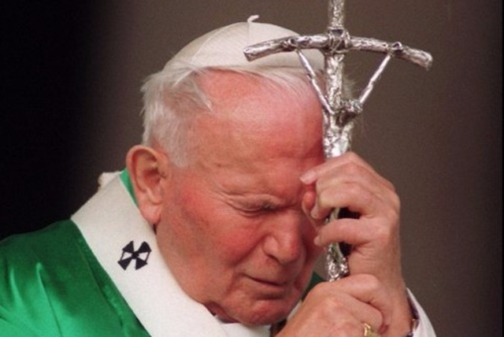
The cross is a very deep mystery down here.
Without much light we do not understand it.
To understand it you need a high spirit,
but you have to listen to it in order to be saved.
Canticle 19 and 102 of Father of Montfort.

