Slide 1
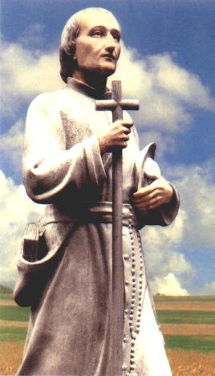
SANT LOUIS MARÍA GRIGNION
OF MONTFORT
APOSTOLIC MISSIONARY
FROM 1700 TO 1716

Slide 2
Saint Louis Mary’s missionaray activities

Slide 3
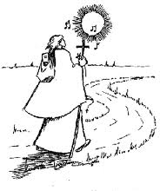
… « I feel a great desire to make love Our Lord and his Blessed Mother, to go, in a poor and simple way, to teach catechism to the poor of the countryside, and to move sinners to devotion to the Blessed Virgin. ». (C.5 of 06.12.1700).

Slide 4
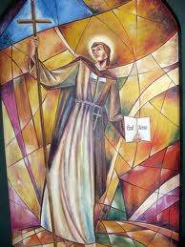
(1706)
He returns from Rome with the title of
« apostolic missionary »

Slide 5
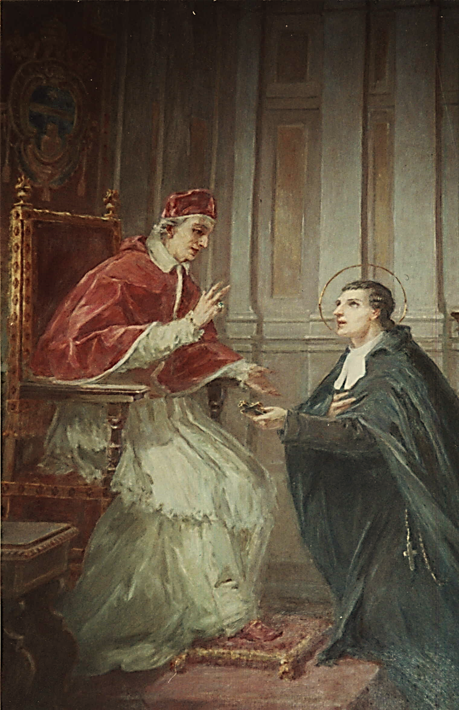
Instructions received from the Pope
Clement XI, in 1706 « To teach Christian doctrine well to the people and to children and to renew everywhere the spirit of Christianity through the renewal of baptismal promises, with perfect submission to the bishops to whose dioceses you are called ». And the Pope added :
« God will hereby bless your work....» (Grandet p. 101).

Slide 6
II-Frutis and roots of his Missionary Activity

Slide 7
2.1- Multiple and long-lasting conversions
Already in 1701, at the age of 28, at Grand-Champ, near Nantes, for ten days (catechism for children twice a day and three sermons), he noticed that « the Good God and the Blessed Virgin gave blessings there » (C. 8 of July 5,1701).
July1702, in Poitiers general hospital «God wanted to use me to make great conversions in the house (the general hospital of Poitiers) and outside.» (C.11, du 04.07.1702).

Slide 8
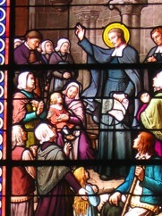
Father Vicent,
a Capuchin, one of Louis Marie’s collaborators in his missions, admired in him his « art of touching hearts and winning souls for Jesus Christ »
(Blain LXIX).

Slide 9
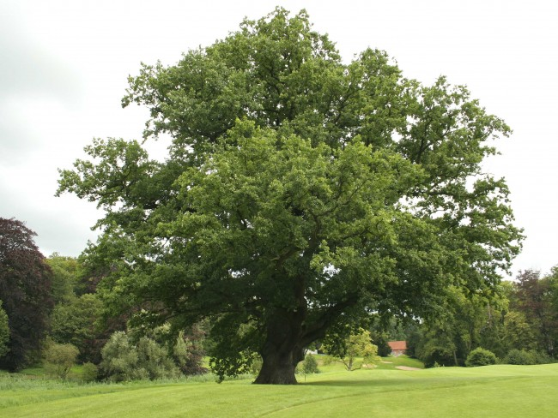
2.2- Deep roots of his action

Slide 10
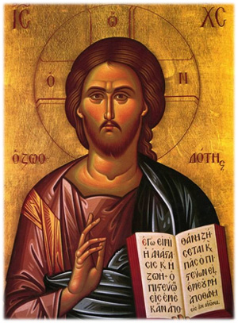
Great desires
Louis-Marie’s whole life was animated and polarized by “great desires” centered on Jesus Christ, Wisdom to be acquired, possessed, made known, loved and served... « Jesus Christ, the Eternal Wisdom, is all you can and must desire.
Desire her, seek her, because she is that unique and precious pearl for whose acquisition you should selle everything you possess. » (LEW, 9).
« The first means to acquire and grow in the knowledge of Wisdom (Which is Jesus Christ) is a burning desire » (LEW, 181-183)

Slide 11
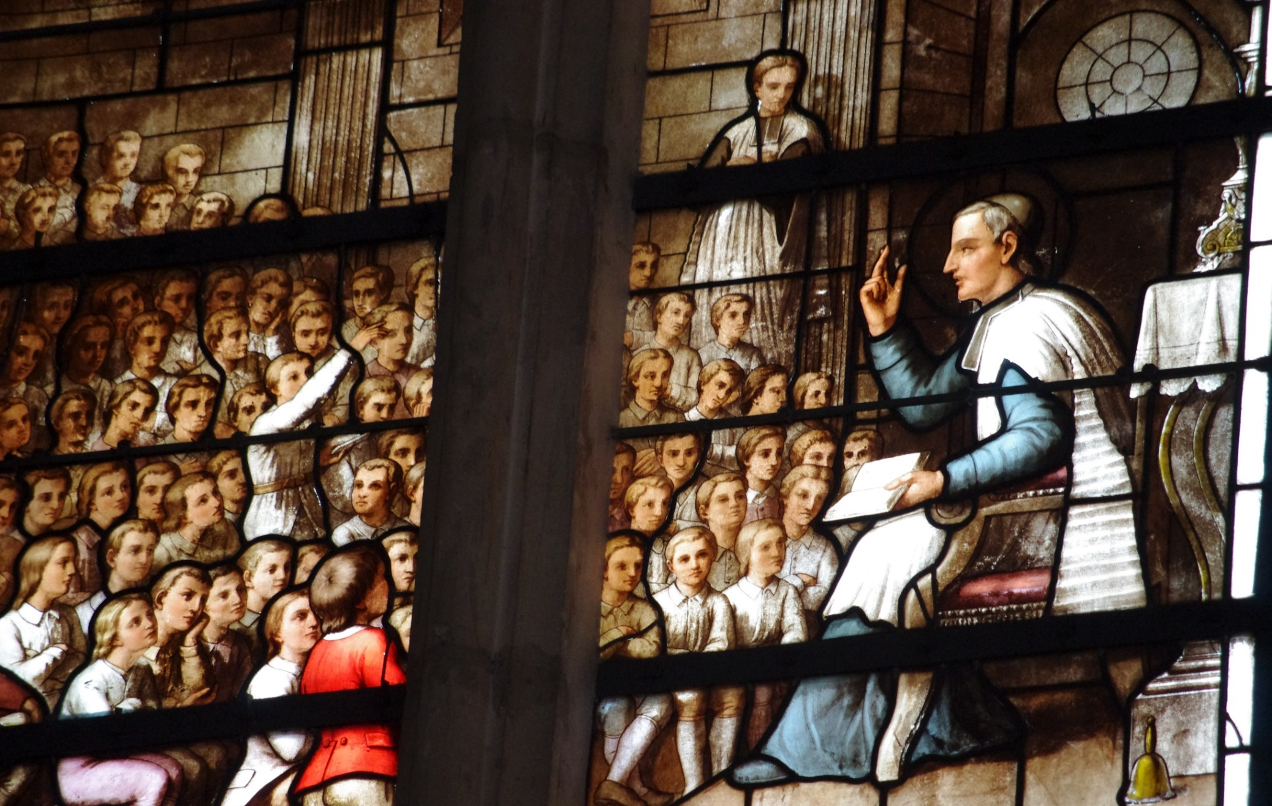
Asking for the grace to enlighten and move hearts

Slide 12
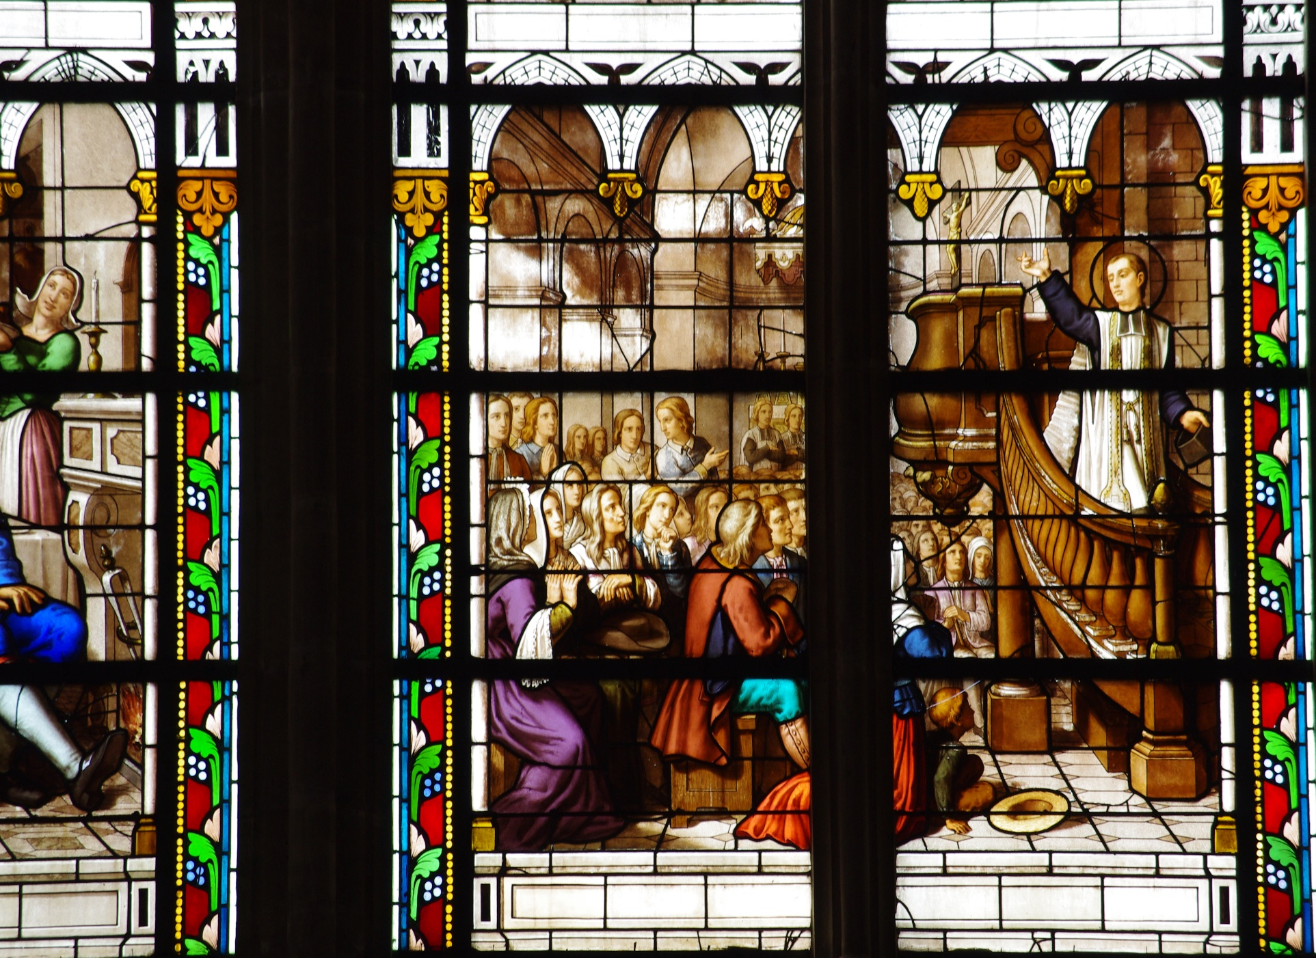
1707 to Mr. Hindré, parish priest of Bréal, who, « amazed by his successes, expressed his surprise: the missionary, in an intimate effusions, answered :
May dear friend, I have been to more tan two thousand places of pilgrimage to ask God for the grace to move hearts and He has granted it to me » (Besnard).

Slide 13
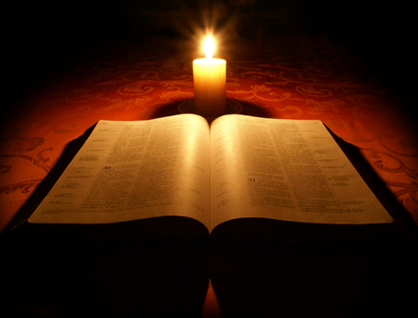
He believed in the efficacy of the word of God :
« The words that divine Wisdom communicates are not common, natural and human words;
They are divine words...
They are strong, moving and penetrating words, […]
They come from the heart of the one who speaks and penetrate to the depths of the heart of the one who listens» (LEW 96).
Let God Speak

Slide 14
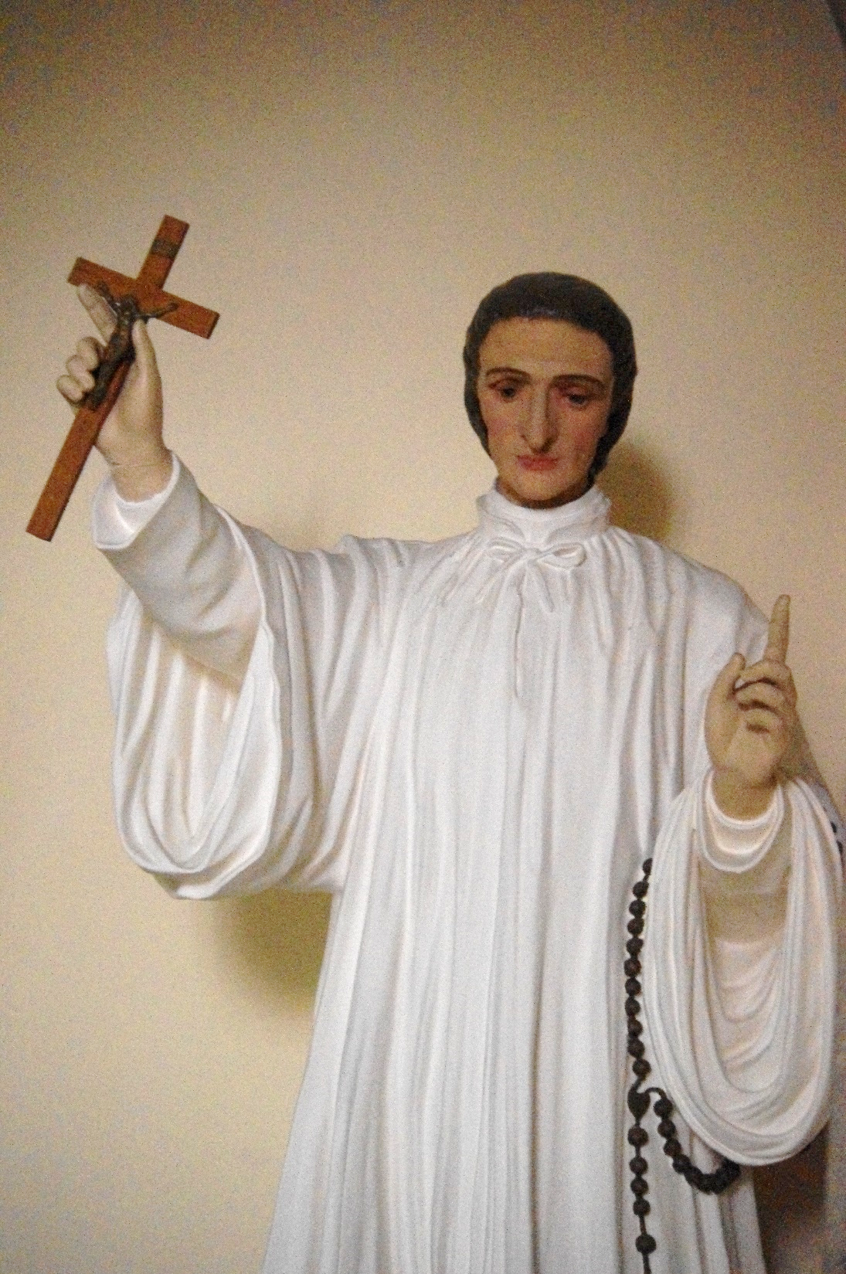
Louis Marie had experienced this way of doing things from the beginning of hispriestly ninistry.He said : « The great God, my Father [...] has given me, since I am here (in Poitiers) lights in the spirit that I did not have, a great facility to express myself and to speak directly without preparation...».

Slide 15
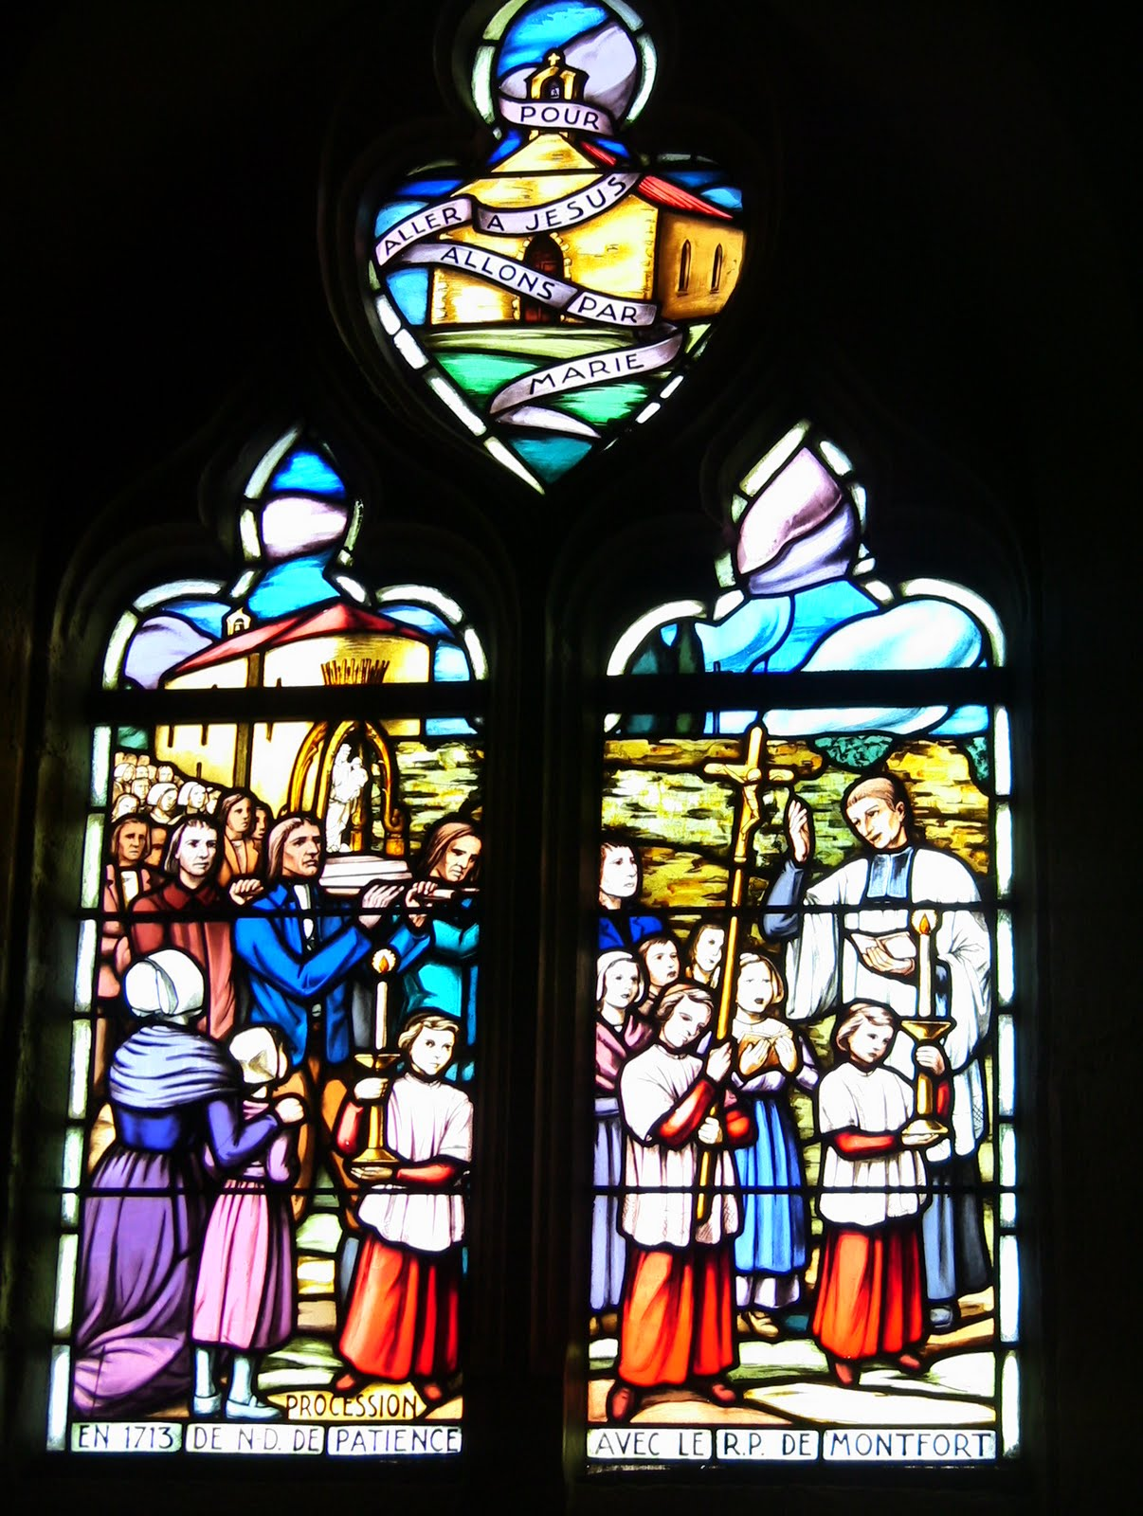
living « to Providence » or « to the apostolic »
Therefore, he rejected any benefit: he asked his missionaries (Rule of 1713) to do
« all their missions in abandonment to Providence, without accepting any support for any future misssion... To be founded on God alone»
(RMCM 50 and 12)

Slide 16
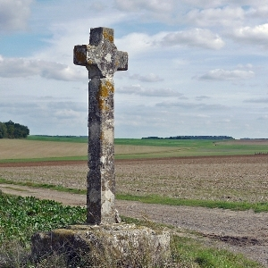
«The Cross is a very profound mystery here below. Without much light we do not know it»
(Ct 19,1)
«As the Incarnate Wisdom had to enter heaven by the way of the Cross, so those who follow her must enter by the same way.» (LEW 180).
The Secret of the Cross
Louis Marie de Montfort gradually penetrated the mystery of the Cross and through a long and hard learning process, experienced the incomparable missionary fruitfulness for the salvation of humanity.

Slide 17
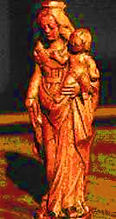
Mary’s Secret
Through Mary
« Jesus Christ came in to the world,
And it is also through her that
he must reign in it » (TD 1).
GOD FATHER, wants to form children through Mary until the consummation of the world, (VD 29),
GOD, SON, wants to form himself and, so to speak, become incarnate every day, through his beloved Mother, in his members(VD31)
GOD, HOLY SPIRIT, wants to form the chosen ones in her and through her»(TD 34)
By intuition and grace, through study and contemplation, (TD 118),
Through spiritual experience and missionary practice
(TD 110, 250),
Luois-Marie gradually discovered Mary’s privileged place in God’s plan of savation.

Slide 18
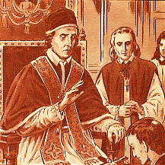
God’s will and communion/obedience to the bishops.
Like Jesus Christ,
His Master,
He learned in suffering to obey and thus he becomes for many the cause of eternal salvation. (cf Heb 5, 8).
«He was convinced that obedience, being the certain mark of God’s will, he should never deviate from it... » (Blain, pp.179-180).

Slide 19
III- Preferential attention to he poor

Slide 20
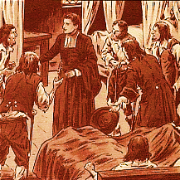
3.1- Louis Marie and the poor of material goods
a) During his studies before 1700
b) In 1701-1703 and 1704-1705 in Poitiers
c) After 1705

Slide 21
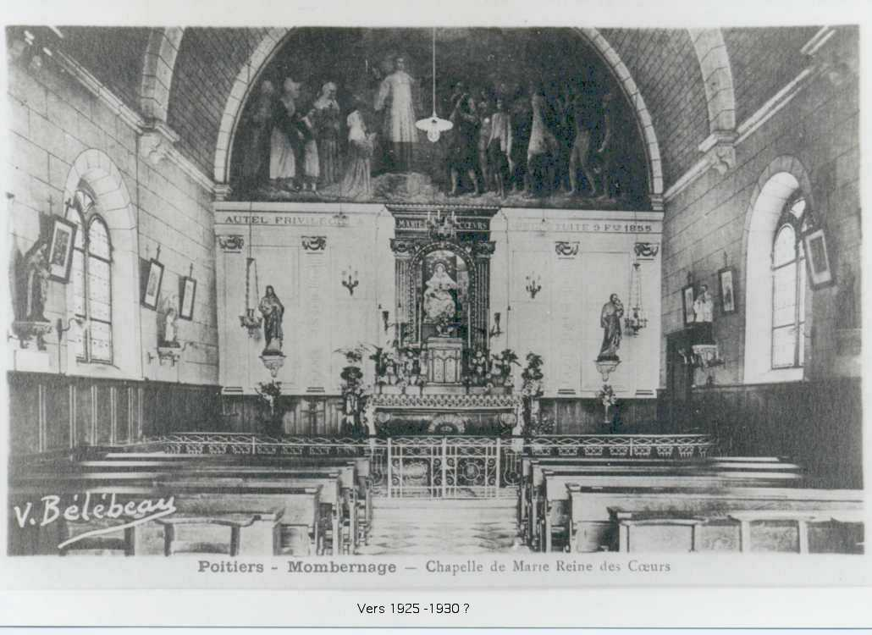
3.2- The poor of spiritual goods
Throughout his life as a missionary, but even more so after1706, « he would show his love for the poor by adhering preferentially, insofar as he could choose, to the religiously less favoured areas: generally the countryside rather than the cities, the underprivileged districts of the cities, the lukewarm region of the diocese of La Rochelle, Aunis» (Fr. Pérouas, idem, p. 163).

Slide 22
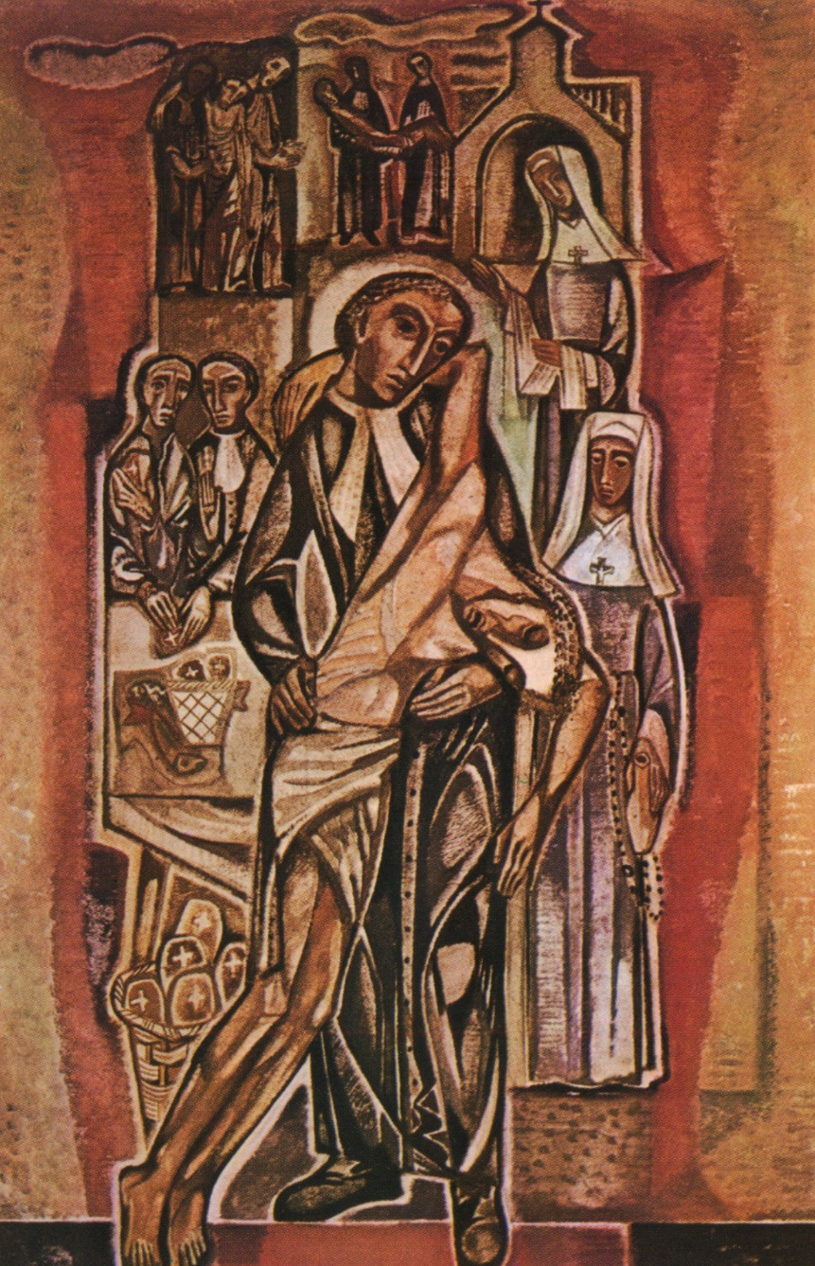
3.3- The poor in the nearest neighbor
3.4- Jesus Christ in the poor
For Father of Montfort, the poor person, whoever he may be, is Jesus Christ. Louis Marie sang this vision of the poor in several of his hymns: the credit of alms, the cries of the poor, the treasures of poverty.

Slide 23
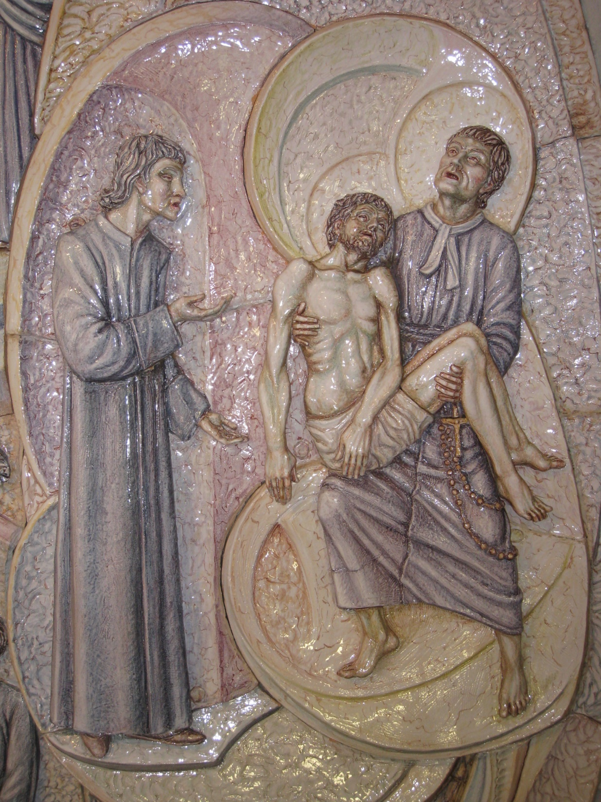
«What is a poor person? It is written that he is the living image, the lieutenant of Jesus Christ, his most precious inheritance. But, better yet, he is Jesus Christ himself. We help or we reject in them this supreme monarch”»
Ct 17,14

Slide 24
In conclusion
Evangelization is an essential aspect of the Church’s mission.
With his personality, his creative pedagogy, his ardent desire to see Christians live more consciously the grace of their baptism, Father of Montfort has worked hard, announcing in word and deed the truths of the Holy Gospel of Jesus Christ.

Slide 25
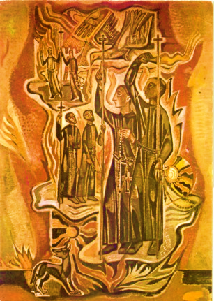
At the end of his life, he made the pilgrimage to Notre-Dame des Ardilliers, following the 33 white penitents, to obtain from God through the intercession of the Blessed Virgin Mary
good missionaries who walk in the footsteps of the Apostles... and
the gift of wisdom to know, taste and practice virtue, and make others taste and practice it......

Slide 26

« It is done, I run through the world, prey to wandering humor to save my poor neighbor.»
(C. 22,1)

